Slide 1

Presentation Title
Presenter Name

Slide 2
Rubric
Activity | Tasks
Preparation | Confirm current IP address.
IPv4 Address Assignment | Change the IP address

Slide 3
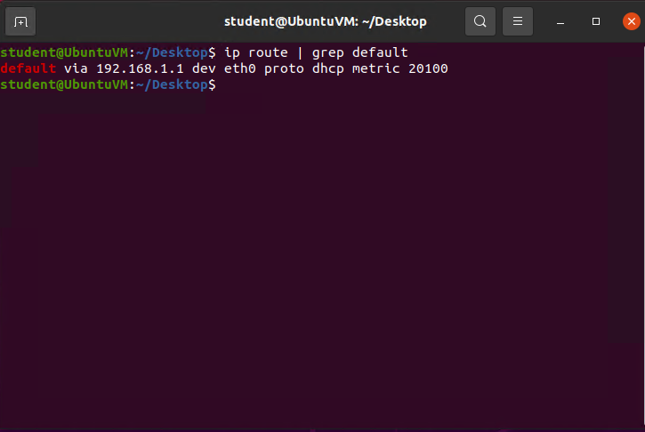
Preparation
In this screenshot, I am confirming the current IP address.

Slide 4
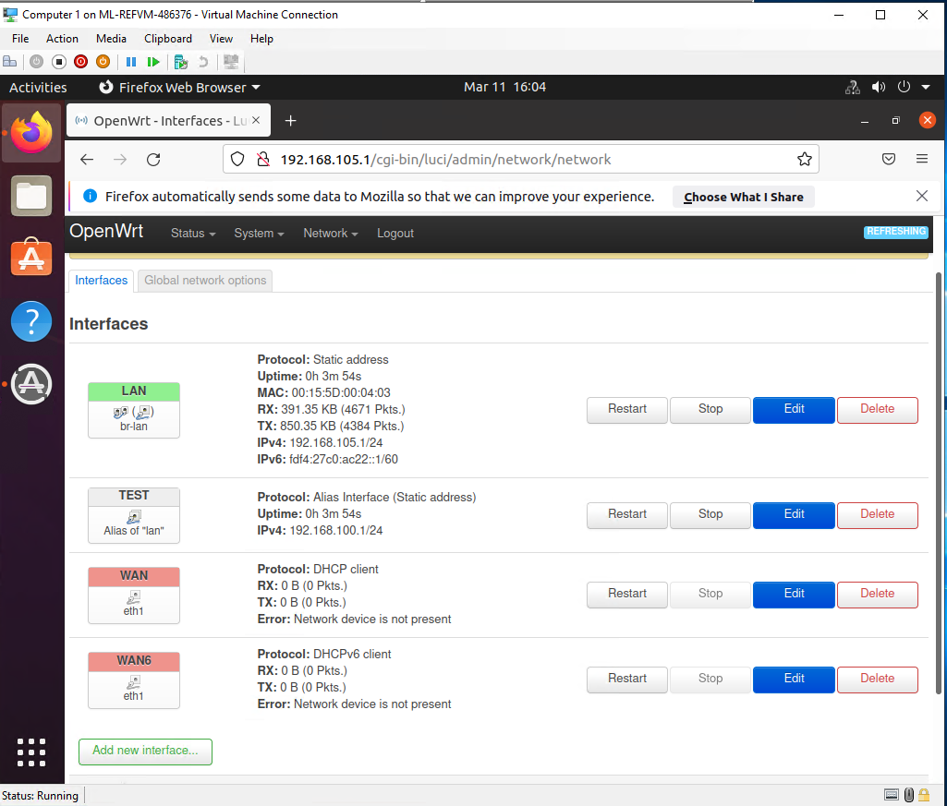
Ipv4 Address Assignment
This is the interfaces page that shows the new ipv4 address on the LAN interface.

Slide 5
Rubric
Activity | Tasks
Dynamic IP Address Assignment | I am changing the computer’s IP on the virtual machine to match.
Connectivity Test | After changing the IPs, I am testing connectivity to the SOHO router.

Slide 6
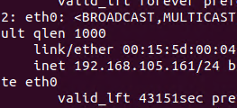
Dynamic IP address assignment
This screenshot is of the IPv4 address of the Computer 1 VM.

Slide 7

Dynamic IP address assignment
This screenshot is of the IPv4 address of Computer 2 VM.

Slide 8
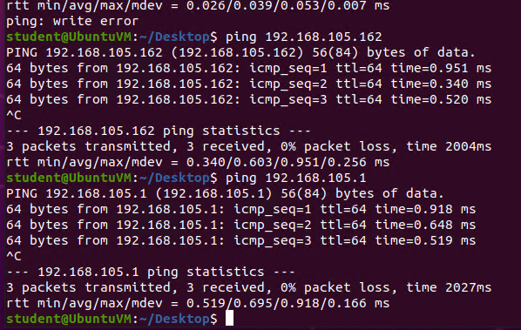
Connectivity Test
This screenshot shows the connectivity tests between the Computer 1 VM and the other two devices (i.e., the SOHO Router VM and Computer 2 VM).

Slide 9
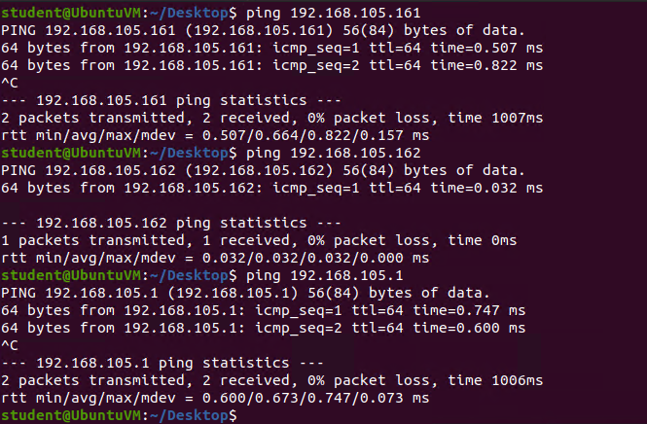
Connectivity Test
This screenshot shows connectivity tests between the Computer 2 VM and the other two devices (i.e., the SOHO Router VM and Computer 1 VM).

Slide 10
Rubric
Activity | Tasks
IP Subnetting | Subnetting table
Loopback Interfaces | I create two loopback interfaces.
Connectivity Tests | I check the connectivity between the loops and the computer.

Slide 11
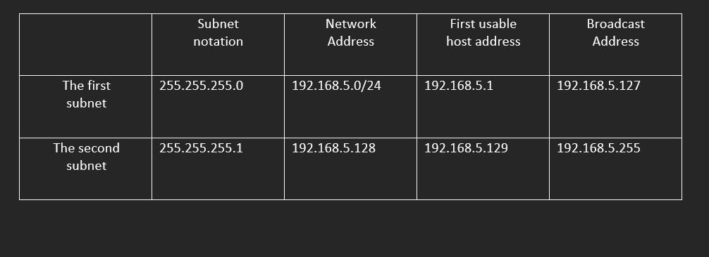
Subnetting Table
This table includes two /25 subnets, listing the subnet notation, network address, first usable host address, last usable host address, and broadcast address of each subnet.

Slide 12
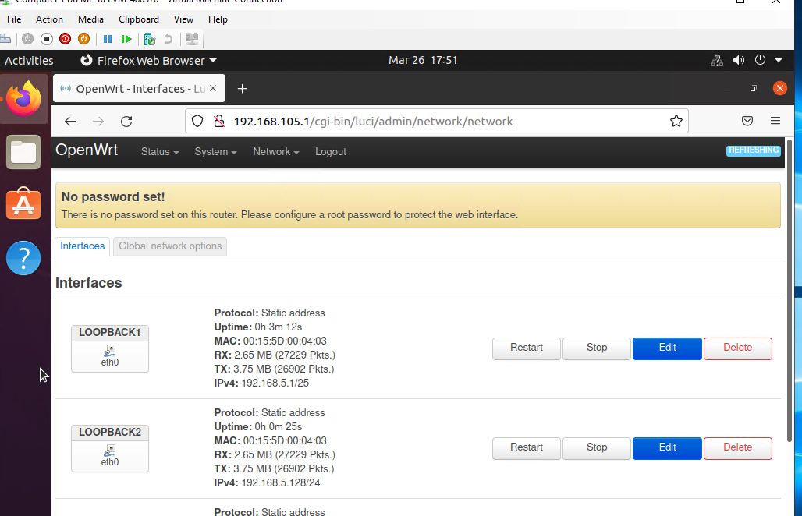
Loopback Interfaces
This screenshot shows both Loopback1 and Loopback2 interfaces and their correct IPv4 addresses.

Slide 13
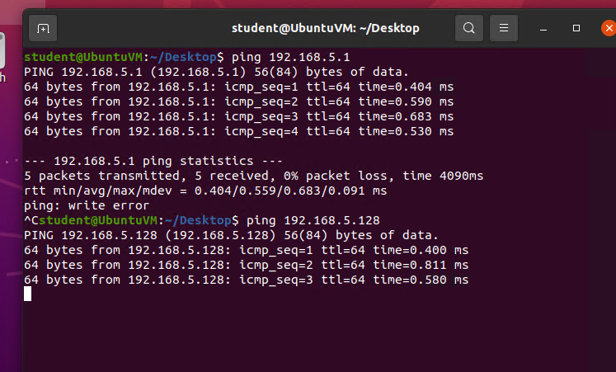
Connectivity Tests
This screenshot shows two successful ping tests from the Computer 1 VM to the Loopback 1 and Loopback 2 interfaces.

Slide 14
Rubric
Activity | Tasks
Microsoft Visio Network Diagram | Relationship diagram of the computers and the SOHO router

Slide 15
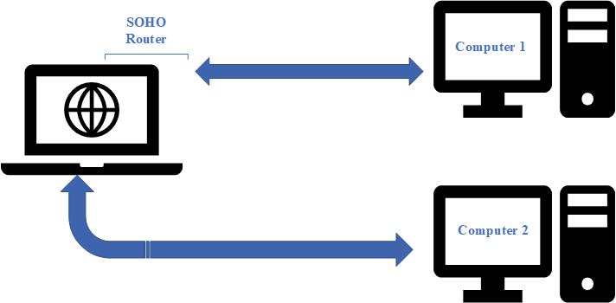
Microsoft Visio Network Diagram
This diagram illustrates the interconnection of the Computer 1 VM, the Computer 2 VM, and the SOHO Router VM.

Slide 16
Rubric
Activity | Tasks
SOHO Wireless Network Security | Six commonly asked questions about SOHO security

Slide 17
SOHO Wireless Network Security
1. What are the factory default username and password of a TP-Link router? Why is it important to change the default username and password of a SOHO router?
Answer: The password is: admin The username is: admin
If you don’t change the defaults, anyone can access it with easily accessible information.
2. To protect a SOHO wireless network with a small number of devices, which address management method provides more control, configuring the device IP addresses manually (static IP) or using a DHCP server (dynamic IP)? Why?
Answer: Static IP, as it is hardcoded, can be direct and has points to access your network remotely.
3. What does MAC filtering do? If needed, when would you use deny filtering rules and when would you use allow filtering rules? What happens to devices that want to connect, if the “Allow the stations specified by any enabled entries in the list to access” function is enabled but there are no entries in the list?
Answer: Allows you to control wireless stations accessing the IP, depending on the MAC addresses.

Slide 18
SOHO wireless network security
1. What wireless security settings are displayed on the Wireless Security page? Which one is recommended by the vendor? Why?
Answer: WPA2-PSK AES. Enterprise authentication and TKIP encryption are not supported.
2. Among the configurations you explored in this module, which one is a true security function? Why?
Answer:
MAC filtering because it can block access and is not always static.
3. What would you do to protect your wireless network at home? Why?
Answer:
I would use a Static IP, a set of firewalls, and depending on what I’m accessing, a VPN: because it is the best for a small network and has more security than probably necessary for my home network.

Slide 19
Conclusion
In this project, I learned how computers comprehend, display, and use IP addresses. I learned about the layers of the OSI, what operates on each layer and how the computer handles the data.

