Slide 1

Python algorithm exploration
In this presentation I explore and track various forms of algorithms in python.
I create, use and track efficiency of different methods of accomplishing my goals.

Slide 2

Goals
Activity | Requirement(s)
Develop Code to Test Algorithm’s Real-World Speed | TimeProcess.py Code
Develop Code to Use Objects with the ArrayList | Client.py Code
Develop Code to Test Algorithm Speed | ArrayListActualSpeed.py code
Screenshot to Demonstrate Working Application | Screenshot of running application showing your name and the current date
Excel Table Showing Relevant Speeds | Table showing amount of time for each process

Slide 3
TimeProcess.py
Python Code
TimeProcess.py Python code.
Includes the following processes:
Test the following process speed:
  Display “Hello Everyone” one thousand times
Seconds run 1000 times: 0.066822
Code:#Name: Zachariah Swanson
#Date: 1/14/2023
import time # use time library to time the code executions
# get current time before the process
start_time = time.time()
# run the process
for i in range(1000):
print( "Hello Everyone!" )
# get current time after the process
end_time = time.time()
# subtract start time from end time to get time used by process
total_time = end_time - start_time
# Show the result. Note: .6f means “show six decimal places”
print("\nSeconds run 1000 times: {:.6f}".format(total_time))

Slide 4
Client.py
Python Code
Code:# Name Zachariah Swanson
# Date 1/14/2023
class Client:
def __init__(self, client_id=0, first_name="Unknown", last_name="Unknown", phone="Unknown", email="Unknown"):
self.__client_id = client_id
self.__first_name = first_name
self.__last_name = last_name
self.__phone = phone
self.__email = email
#classes comparing objests must implement __eq__ and __lt__ methods
#__lt__ means "less than" and it must return a bollean
#__eq__ means "equals" and it must return a bollean
def __lt__(self, other):
return self.__client_id < other.__client_id
def __eq__(self, other):
return self.__client_id == other.__client_id
#__str__() method is automaticly called when you print the object
def __str__(self):
return str(self.__client_id) + ", " + self.__last_name + ", " + self.__first_name
# getters and setters
def get_client_id(self):
return self.__client_id
def set_client_id(self, client_id):
self.__client_id = client_id
def get_first_name(self):
return self.__client_id
def set_first_name(self, first_name):
self.__first_name = first_name
def get_last_name(self):
return self.__last_name
def set_last_name(self, last_name):
self.__last_name = last_name
def get_phone(self):
return self.phone
def set_phone(self, phone):
self.__phone = phone
def get_email(self):
return self.email
def set_email(self, email):
self.__email = email
Paste your Client.py Python code in the box on the right side.
Include the following attributes and behaviors:
Attributes
  __client_id
  __first_name
  __last_name
  __phone
  __email
Behaviors
  __eq__
  __str__
Getters and Setters

Slide 5
ArrayListActualSpeed.py
Python Code
Code#Name: Zacharaiah Swanson
#Date: 1/14/2023
from ArrayList import ArrayList
from Client import Client
from Quicksort import Quicksort
from datetime import date
import time
import random
import sys
#display name and date then output
print("Name:", "Zachariah Swanson")
print("Date:", date.today())
print()
# create list
clients = []
input_file_name = "ClientData.csv"
with open(input_file_name) as infile:
for line in infile:
# split the line based on commas
s = line.split(',')
client_id = int( s[0] ) #convert to int
f_name = s[1]
l_name = s[2]
phone = s[3]
email = s[4]
#create a client object using data
clt = Client(client_id, f_name, l_name, phone, email)
#add client object to list
clients.append(clt)
#sort the clients list
Quicksort.sort(clients)
#how many clients do we have
num_records = len(clients)
my_array_list = ArrayList()
# Senario 1: Printer,call, or service queues
Section_Title = "Printer queue or Call queue"
print(Section_Title)
print("-" * len(Section_Title))
#How long does this take?
start_time = time.time()
for i in range(num_records):
my_array_list.append(clients[i])
end_time = time.time()
total_time = end_time - start_time
print("Secounds to add records: {:.6f}".format(total_time))
#how long does it take to remove records from the front of the arraylist?
start_time = time.time()
for i in range(num_records):
my_array_list.remove_at(0)
end_time = time.time()
total_time = end_time - start_time
print("Secounds to remove records: {:.6f}".format(total_time))
#Scenario 2: Customer Service Center
answer = input("Continue (y/n)? ")
if answer.lower() != "y":
sys.exit() #end application
section_title = "Senerio: Customer Service Center"
print(section_title)
print("-" * len(section_title))
#add clients to the ArrayList
for i in range(num_records):
my_array_list.append(clients[i])
# how long does it take to randomly display 1000 records?
start_time = time.time()
for i in range(1000):
smallest_id = 100001
largest_id = smallest_id + num_records
random_num = random.randint(smallest_id, largest_id)
# print(my_array_list.search(Client(random_num))) print(my_array_list.search_sorted(Client(random_num)))
end_time = time .time()
total_time = end_time - start_time
print("Secounds to display random records: {:.6f}".format(total_time))
#Senario 3: Call center
answer = input("Continue (y/n)? ")
if answer.lower() != "y":
sys.exit() #end application
section_title = "Senerio: Call Center"
print(section_title)
print("-" * len(section_title))
# how long does it take to add records, randomly display records, and remove 1000 randomly?
start_time = time.time()
#add records
current_id = 100001 + num_records + 1
for i in range(1000):
my_array_list.append(Client(current_id))
current_id += 1
#display random records
for i in range(1000):
smallest_id = 100001
largest_id = smallest_id + num_records
random_num = random.randint(smallest_id, largest_id)
print(my_array_list.search(Client(random_num)))
for i in range(1000):
smallest_id = 100001
largest_id = smallest_id + num_records
random_num = random.randint(smallest_id, largest_id) print(my_array_list.search(Client(random_num)))
end_time = time .time()
total_time = end_time - start_time
print("Secounds to add, diplay, and remove records: {:.6f}".format(total_time)):
Includes the following processes:
Read records into application
Test the following process speeds:
  Add records to beginning of data structure
  Add records to end of data structure
  Add records to middle of data structure
  Retrieve records from beginning of data structure
  Retrieve records from end of data structure
  Retrieve records from middle of data structure

Slide 6
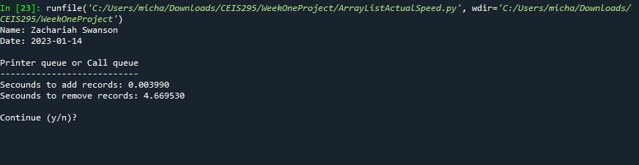
Screenshot of
Running Code
This is a screenshot oh the code presented in the previous slide.

Slide 7
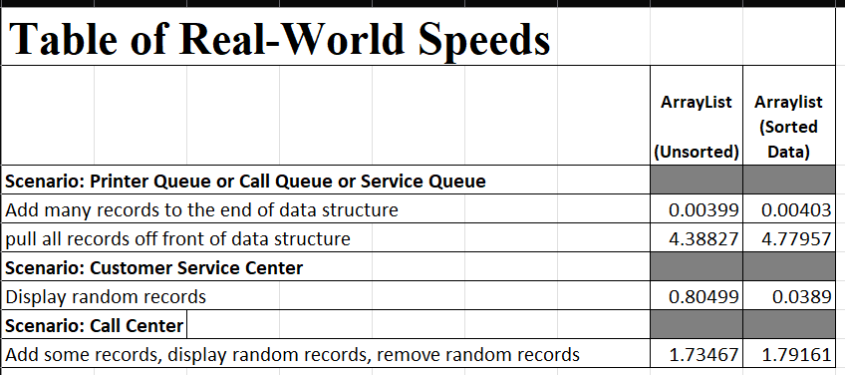
Table of Speeds
A table showing the time that it takes for the following scenarios:
Printer Queue or Call Queue or Service Queue
  Add many records to end of data structure
  Pull all records off front of data structure
Customer Service Center
  Display random records
Call Center
  Add some records
  Display random records
  Remove some records

Slide 8
Goals
Activity | Requirement(s)
Develop Code to Test Algorithm Speed | LinkedListActualSpeed.py Code
Screenshot to Demonstrate Working Application | Screenshot of running application showing your name and the current date
Excel Table Showing Relevant Speeds | Table Showing Speeds

Slide 9
LinkedListActualSpeed.py
Python Code
Code:#Name: Zacharaiah Swanson
#Date: 1/15/2023
from LinkedList import LinkedList
from Client import Client
from datetime import date
import time
import random
import sys
#display name and date then output
print("Name:", "Zachariah Swanson")
print("Date:", date.today())
print()
# create list
clients = []
# read the records from the ClientData.csv file
input_file_name = "ClientData.csv"
with open(input_file_name) as infile:
for line in infile:
# split the line based on commas
s = line.split(',')
client_id = int( s[0] ) #convert to int
f_name = s[1]
l_name = s[2]
phone = s[3]
email = s[4]
#create a client object using data
clt = Client(client_id, f_name, l_name, phone, email)
#add client object to list
clients.append(clt)
#how many clients do we have
num_records = len(clients)
my_linked_list = LinkedList()
#Scenario 1: Printer or Call Queue
section_title = "Senerio 1: Printer or Call Queue"
print(section_title)
print("-" * len(section_title))
start_time = time.time()
for i in range(num_records):
my_linked_list.add_last(clients[i])
end_time = time.time()
total_time = end_time - start_time
print("Secounds to add records: {:.6f}".format(total_time))
#how long does it take to remove records from the front of the Linkedlist?
start_time = time.time()
for i in range(num_records):
my_linked_list.remove_first()
end_time = time.time()
total_time = end_time - start_time
print("Secounds to remove records: {:.6f}".format(total_time))
answer = input("Continue (y/n)? ")
if answer.lower() != "y":
sys.exit() #end application
#Scenario 2: Customer Service Center
section_title = "Senerio 2: Customer Service Center"
print(section_title)
print("-" * len(section_title))
#add clients to the LinkedList
for i in range(num_records):
my_linked_list.add_last(clients[i])
# how long does it take to randomly display 1000 records?
start_time = time.time()
for i in range(1000):
smallest_id = 100001
largest_id = smallest_id + num_records
random_num = random.randint(smallest_id, largest_id)
# print(my_array_list.search(Client(random_num))) print(my_linked_list.search(Client(random_num)))
end_time = time .time()
total_time = end_time - start_time
print("Secounds to display random records: {:.6f}".format(total_time))
#Senario 3: Call center
answer = input("Continue (y/n)? ")
if answer.lower() != "y":
sys.exit() #end application
section_title = "Senerio 3: Call Center"
print(section_title)
print("-" * len(section_title))
# how long does it take to add records, randomly display records, and remove 1000 randomly?
start_time = time.time(
#add records
current_id = 100001 + num_records + 1
for i in range(1000):
my_linked_list.add_last(Client(current_id))
current_id += 1
#display random records
for i in range(1000):
smallest_id = 100001
largest_id = smallest_id + num_records
random_num = random.randint(smallest_id, largest_id) print(my_linked_list.search(Client(random_num)))
#remove ransom records
for i in range(1000):
smallest_id = 100001
largest_id = smallest_id + num_records
random_num = random.randint(smallest_id, largest_id)
print(my_linked_list.search(Client(random_num)))
end_time = time .time()
total_time = end_time - start_time
print("Secounds to add, diplay, and remove records: {:.6f}".format(total_time))
Includes the following processes:
Read records into application
Test the following process speeds:
  Add records to beginning of data structure
  Add records to end of data structure
  Add records to middle of data structure
  Retrieve records from beginning of data structure
  Retrieve records from end of data structure
  Retrieve records from middle of data structure

Slide 10
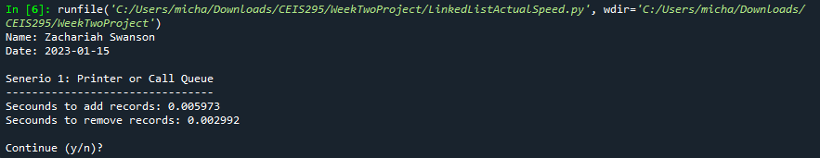
Screenshot of
Running Code
This is a screenshot of the code displayed in the previous slide.

Slide 11
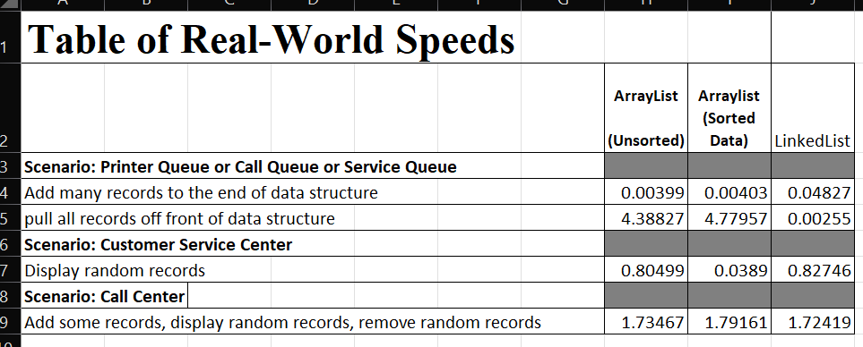
Table of Speeds
Update the table from last week that shows the times for the ArrayList. Add a new column and show the times for the LinkedList for comparison.
Printer Queue or Call Queue or Service Queue
  Add many records to end of data structure
  Pull all records off front of data structure
Customer Service Center
  Display random records
Call Center
  Add some records
  Display random records
  Remove some records

Slide 12
Goals
Activity | Requirement(s)
Develop Code to Use Objects with the ACD | Call.py Code
Develop Code to Simulate ACD | AutomaticCallDistributor.py code
Screenshot to Demonstrate Working Application | Screenshot of running application showing your name and the current date

Slide 13
Call.py
Python Code
Code
:#Name: Zachariah Swanson
#Date: 01/20/2023
from time import strftime #used for datetime
class Call:
def __init__(self, client_id=0, client_name="Unknown",client_phone="Unknown"):
self.client_id = client_id
self.client_name = client_name
self.clent_phone = client_phone
self.call_date = strftime("%m/%d/%Y")
self.call_date = strftime("%H:%M")
#__str__ method is called when you print the object
def __str__(self):
return str(self.client_id) + ", " + self.client_name + ", " + \
"\n\tPhone: " + self.client_phone + \
"\tDate/Time" + self.call_date + " @ " + self.call_date
Includes the following attributes and behaviors:
Attributes
  call_id
  customer_name
  customer_phone
  call_date
  call_time
Behaviors
  __str__

Slide 14
AutomaticCallDistributor.py
Python Code
Code:#Name: Zachariah Swanson
#Date: 01/20/2023
from Queue import Queue
from Call_Class import Call
from datetime import date
import time # use to puase simulation
import random #Generate random num
#dispaly Name and dat
print("Name:","Zachariah Swanson")
print("Date:", date.today(),"\n")
#create list
calls = []
#read call record into list
input_file_name = "ClientData.csv"
with open(input_file_name) as infile:
for line in infile:
#split line based off commas
s = line.split(',')
client_id = int( s[0] )
client_name = s[1]
client_phone = s[2]
# create call object based of line
a_call = Call(client_id, client_name, client_phone)
# add the call object to list
calls.append(a_call)
# Queue for calls
calls_waiting = Queue()
call_number = 0
#how long is the simmulation
secounds = int( input("How many secounds do you want to simulate? ") )
#run simulation for given number
for i in range(secounds):
print("-" * 40)
time.sleep(2) #puase for given number of secounds
random_event = random.randint(1, 3)
#do event based of random number
if random_event == 1:
print("Call received. Caller added to queue.")
calls_waiting.enqueue( calls[call_number] )
print("\TNumber of calls waiting in queue:", calls_waiting.get_length())
elif random_event == 2:
print("Call sent to representative for service.")
if calls_waiting.get_length() > 0:
print("Caller information")
print(calls_waiting.dequeue())
else:
print("The call waiting queue is emty.")
print("\tNumber of calls waiting in queue:", calls_waiting.get_length())
else:
print("Nothing happend during this secound in time ")
print("\tNumber of calls waiting in queue:", calls_waiting.get_length())
print("\nThe 'Automatic Call Distributor' simulation has completed")
Paste your Python code. Include the following processes:
Simulation of ADT
  Ask user how many times to repeat
  On each loop:
    Randomly generate a number from 1 to 3
    If 1, add call to queue
    If 2, remove call from queue
    If 3, do nothing

Slide 15
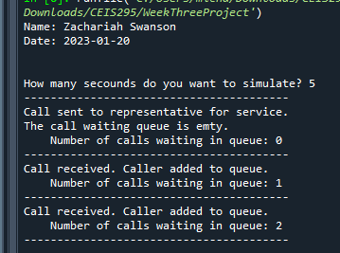
Screenshot of
Running Code
This is a screenshot of the previous slides code.

Slide 16
Goals
Activity | Requirement(s)
Develop Code to Use Objects with the Sort Routines | Client.py Code
Develop Code to Test the Sort Algorithm Speeds | SortingActualSpeed.py code
Screenshot to Demonstrate Working Application | Screenshot of running application showing your name and the current date
Excel Table Showing Relevant Speeds | Table showing amount of time for each sort routine

Slide 17
Client.py
Python Code
Code:
#Name Zachariah Swanson
# Date 1/26/2023
class Client:
def __init__(self, client_id=0, first_name="Unknown", last_name="Unknown", phone="Unknown", email="Unknown"):
self.__client_id = client_id
self.__first_name = first_name
self.__last_name = last_name
self.__phone = phone
self.__email = email
#classes comparing objests must implement __eq__ and __lt__ methods
#__lt__ means "less than" and it must return a bollean
#__eq__ means "equals" and it must return a bollean
def __lt__(self, other):
this_full_name = self.__last_name + " " + self.__first_name
other_full_name = other.__last_name+ " " + other.__first_name
return this_full_name < other_full_name
def __le__(self, other):
this_full_name = self.__last_name + " " + self.__first_name
other_full_name = other.__last_name+ " " + other.__first_name
return this_full_name <= other_full_name
def __eq__(self, other):
return self.__client_id == other.__client_id
#__str__() method is automaticly called when you print the object
def __str__(self):
return self.__last_name + ", " + self.__first_name
Paste your Client.py Python code in the box on the right side.
Include the following attributes and behaviors:
Attributes
  __client_id
  __first_name
  __last_name
  __phone
  __email
Behaviors
  __lt__
  __le__
  __eq__
  __str__
Getters and Setters

Slide 18
SortingActualSpeed.py
Python Code
Code:#Name: Zacharaiah Swanson
#Date: 1/26/2023
from MergeSort import MergeSort
from Client import Client
from datetime import date
import time
#display name and date then output
print("Name:", "Zachariah Swanson")
print("Date:", date.today())
print()
#input_file_name = 'ClientData100.csv'
#input_file_name = 'ClientData1000.csv'
#input_file_name = 'ClientData10000.csv'
input_file_name = 'ClientData100000.csv'
# create list
clients = []
# read the records from the ClientData.csv file
with open(input_file_name) as infile:
for line in infile:
# split the line based on commas
s = line.split(',')
client_id = int( s[0] ) #convert to int
f_name = s[1]
l_name = s[2]
phone = s[3]
email = s[4]
#create a client object using data
clt = Client(client_id, f_name, l_name, phone, email)
#add client object to list
clients.append(clt)
#how many clients do we have
num_records = len(clients)
#Scenario: Sorting data
section_title = "Senerio: Sorting" + str(num_records) + " Records"
print(section_title)
print("-" * len(section_title))
#how long does it take to sort records?
start_time = time.time()
#call static method
MergeSort.sort(clients)
end_time = time.time()
total_time = end_time - start_time
print("Secounds to sort {0} records: {1:.6f}".format(num_records, total_time))
Paste your Python code. Include the following processes:
Read records into application
Test the following sorting algorithm speeds:
  Bubble Sort
  Selection Sort
  Insertion Sort
  Shell Sort
  Quicksort
  Merge Sort

Slide 19
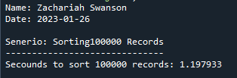
Screenshot of
Running Code
This is a screenshot of the previous slides code.

Slide 20
Goals
Activity | Requirement(s)
Develop Code to Use Objects with the Sort Routines | Client.py Code
Develop Code to Test the Searching Algorithm Speeds | SearchingActualSpeed.py code
Screenshot to Demonstrate Working Application | Screenshot of running application showing your name and the current date
Excel Table Showing Relevant Speeds | Table showing amount of time for each search routine

Slide 21
Client.py
Python Code
Code:# Name Zachariah Swanson
# Date 2/4/2023
class Client:
def __init__(self, client_id=0, first_name="Unknown", last_name="Unknown", phone="Unknown", email="Unknown"):
self.__client_id = client_id
self.__first_name = first_name
self.__last_name = last_name
self.__phone = phone
self.__email = email
#classes comparing objests must implement __eq__ and __lt__ methods
#__lt__ means "less than" and it must return a bollean
#__eq__ means "equals" and it must return a bollean
def __lt__(self, other):
return self.__client_id < other.__client_id
def __le__(self, other):
return self.__client_id <= other.__client_id
def __eq__(self, other):
return self.__client_id == other.__client_id
#__str__() method is automaticly called when you print the object
def __str__(self):
return str(self.__client_id) + "," + self.__last_name + ", " + self.__first_name
# getters and setters
def get_client_id(self):
return self.__client_id
def set_client_id(self, client_id):
self.__client_id = client_id
def get_first_name(self):
return self.__client_id
def set_first_name(self, first_name):
self.__first_name = first_name
def get_last_name(self):
return self.__last_name
def set_last_name(self, last_name):
self.__last_name = last_name
def get_phone(self):
return self.phone
def set_phone(self, phone):
self.__phone = phone
def get_email(self):
return self.email
def set_email(self, email):
self.__email = email
Paste your Client.py Python code in the box on the right side.
Include the following attributes and behaviors:
Attributes
  __client_id
  __first_name
  __last_name
  __phone
  __email
Behaviors
  __lt__
  __eq__
  __str__
Getters and Setters

Slide 22
SearchingActualSpeed.py
Python Code
Code:#Name: Zacharaiah Swanson
#Date: 2/4/2023
from LinearSearch import LinearSearch
from BinarySearch import BinarySearch
from Quicksort import Quicksort
from Client import Client
from datetime import date
import random #used to generate random numbers
import time
import sys #Exit early
#display name and date then output
print("Name:", "Zachariah Swanson")
print("Date:", date.today())
print()
#input_file_name = 'ClientData100.csv'
#input_file_name = 'ClientData1000.csv'
#input_file_name = 'ClientData10000.csv'
input_file_name = 'ClientData100000.csv'
# create list
clients = []
# read the records from the ClientData.csv file
with open(input_file_name) as infile:
for line in infile:
# split the line based on commas
s = line.split(',')
client_id = int( s[0] ) #convert to int
f_name = s[1]
l_name = s[2]
phone = s[3]
email = s[4]
#create a client object using data
clt = Client(client_id, f_name, l_name, phone, email)
#add client object to list
clients.append(clt)
#how many clients do we have
num_records = len(clients)
#Scenario: Search for 100 records
section_title = "Senerio: Searchig Through" + str(num_records) + " Records"
print(section_title)
print("-" * len(section_title))
# Must sort the data to do binary search.
Quicksort.sort(clients)
#start and end record numbers
start_record = 100001
end_record = start_record + num_records
#how long does it take to sort records?
start_time = time.time()
#How long does it take to do a linear search?
for i in range(1000):
client_id = random.randint(start_record, end_record)
clt = Client(client_id)
result = BinarySearch.search(clients, clt)
if result is None:
print(clt, "was not found.")
else:
print(result)
end_time = time.time()
total_time = end_time - start_time
print("Secounds to linear search for 1000 random records: {:.6f}".format(total_time))
Paste your Python code. Include the following processes:
Read records into application
Test the following searching algorithm speeds:
  Linear Search
  Binary Search
Test these two algorithms against different size datasets
  100 records
  1,000 records
  10,000 records
  100,000 records

Slide 23
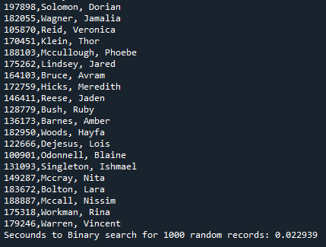
Screenshot of
Running Code
This is a screenshot of the previous slides code.

Slide 24
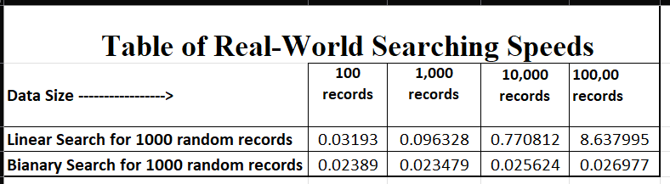
Table of Searching Speeds
A table showing the time that it takes for the following searching algorithms using different data sizes:
Linear Search
Binary Search

Slide 25
Goals
Activity | Requirement(s) | Points
Develop Code to Test Algorithm Speed | BinarySearchTreeActualSpeed.py Code | 20
Screenshot to Demonstrate Working Application | Screenshot of running application showing your name and the current date | 20
Excel Table Showing Relevant Speeds | Table Showing Speeds | 10

Slide 26
BinarySearchTreeActualSpeed.py
Python Code
Code:#Name: Zacharaiah Swanson
#Date: 2/12/2023
from BinarySearchTree import BinarySearchTree
from Client import Client
from datetime import date
import time
import random
import sys
#display name and date then output
print("Name:", "Zachariah Swanson")
print("Date:", date.today())
print()
# create list
clients = []
# read the records from the ClientData.csv file
input_file_name = "ClientData.csv"
with open(input_file_name) as infile:
for line in infile:
# split the line based on commas
s = line.split(',')
client_id = int( s[0] ) #convert to int
f_name = s[1]
l_name = s[2]
phone = s[3]
email = s[4]
#create a client object using data
clt = Client(client_id, f_name, l_name, phone, email)
#add client object to list
clients.append(clt)
#how many clients do we have
num_records = len(clients)
# reate the Binary Search Tree
my_bst = BinarySearchTree()
#Scenario 1: Printer or Call Queue
section_title = "Senerio 1: Printer or Call Queue"
print(section_title)
print("-" * len(section_title))
start_time = time.time()
for i in range(num_records):
my_bst.insert(clients[i])
end_time = time.time()
total_time = end_time - start_time
print("Secounds to add records: {:.6f}".format(total_time))
#how long does it take to remove the smallest records of the Tree?
start_time = time.time()
for i in range(num_records):
my_bst.remove_minimum()
end_time = time.time()
total_time = end_time - start_time
print("Secounds to remove records: {:.6f}".format(total_time))
#Scenario 2: Customer Service Center
answer = input("Continue (y/n)? ")
if answer.lower() != "y":
sys.exit() #end application
section_title = "Senerio 2: Customer Service Center"
print(section_title)
print("-" * len(section_title))
#add clients to the LinkedList
for i in range(num_records):
my_bst.insert(clients[i])
# how long does it take to randomly display 1000 records?
start_time = time.time()
for i in range(1000):
smallest_id = 100001
largest_id = smallest_id + num_records
random_num = random.randint(smallest_id, largest_id)
print(my_bst.search(Client(random_num)))
end_time = time.time()
total_time = end_time - start_time
print("Secounds to display 1000 random records: {:.6f}".format(total_time))
#Senario 3: Call center
answer = input("Continue (y/n)? ")
if answer.lower() != "y":
sys.exit() #end application
section_title = "Senerio 3: Call Center"
print(section_title)
print("-" * len(section_title))
start_time = time.time()
#add records
current_id = 100001 + num_records + 1
for i in range(1000):
my_bst.insert(Client(current_id))
current_id += 1
# how long does it take to add more records to the BST?
current_id = 100001 + num_records + 1
for i in range(1000):
my_bst.insert(Client(current_id))
current_id += 1
# Display records
for i in range(1000):
smallest_id = 100001
largest_id = smallest_id + num_records
random_num = random.randint(smallest_id, largest_id)
print(my_bst.search(Client(random_num)))
#Remove 1000 random records
for i in range(1000):
smallest_id = 100001
largest_id = smallest_id + num_records
random_num = random.randint(smallest_id, largest_id)
print(my_bst.remove(Client(random_num)))
end_time = time .time()
total_time = end_time - start_time
print("Secounds to add records,")
print("display 1000 records, ")
print("and remove 1000 remove records: {:.6f}".format(total_time))
Paste your Python code. Include the following processes:
Read records into application
Test the following process speeds:
  Add records to beginning of data structure
  Add records to end of data structure
  Add records to middle of data structure
  Retrieve records from beginning of data structure
  Retrieve records from end of data structure
  Retrieve records from middle of data structure

Slide 27
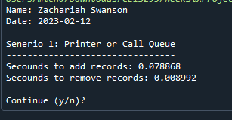
Screenshot of
Running Code
This is a screenshot of the previous slides code

Slide 28
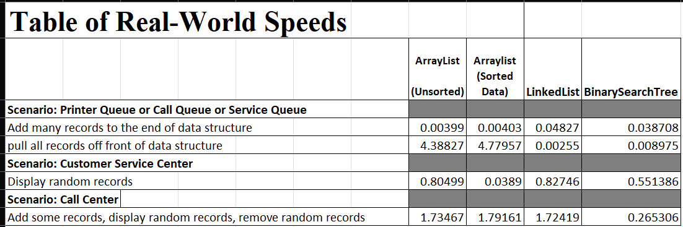
Table of Speeds
Update the table from last week that shows the times for the ArrayList and LinkedList. Add a new column and show the times for the BinarySearchTree for comparison.
Printer Queue or Call Queue or Service Queue
  Add many records to end of data structure
  Pull all records off front of data structure
Customer Service Center
  Display random records
Call Center
  Add some records
  Display random records
  Remove some records

