Slide 1

Security+
Zachariah Swanson

Slide 2
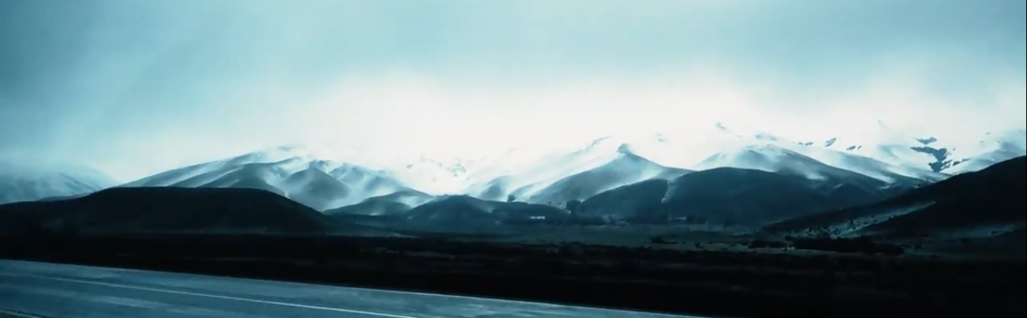
Security+
This presentation is the progress of my learning how to better secure my computer, files, and network.

Slide 3
Activity | Task
File Encryption | A screenshot showing the file after encryption.
File Decryption | A screenshot showing the file after decryption.
In the following slides, I will be creating a file, encrypting it, attempting to access it then decrypting it.

Slide 4
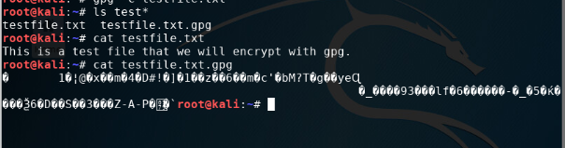
This is an example of file encryption; it includes:
Content of the plaintext file stating “This is a text file that we will encrypt with gpg. ”
Content of the encrypted file no longer shows legible text.

Slide 5
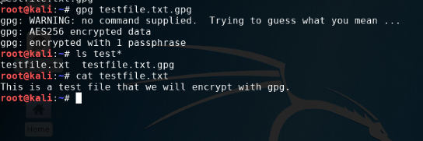
File Decryption
This screenshot shows me decrypting the file using the passphrase and shutting it off for access.
The encrypted file is listed by its name only.
The decrypting process inputting the ‘gpg testfiile.text.gpg’ command, then supplying a passcode to confirm authorization.
Both the encrypted file and the original plaintext file are listed.

Slide 6
Activity | Requirement(s) | Points
Question | Answer | 30
Nmap Scan | Screenshot | 30
In the following slide, I show the result of a nmap after executing the command ‘ sudo iptables --policy Input drop ’ and setting rules for incoming and outgoing IP addresses.
What effect does the sudo iptables --policy input drop command have on the access to computing resources?
This command tells the computer to drop all incoming packets that do not match the set rules.

Slide 7
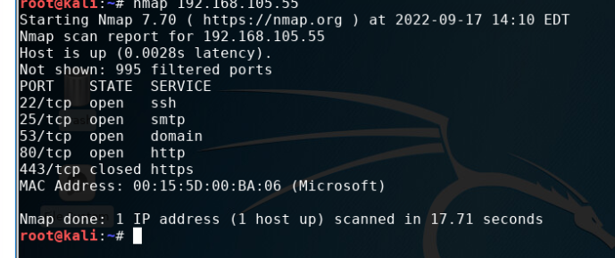
Nmap Scan
This screenshot should show the Nmap scan result of the Linux Server VM.
While there are two VM’s with unique IP addresses, the Nmap only returns one.

Slide 8

In the following slides, I will present a proposed security policy for a fictional organization.

Slide 16
Revision History
Date of change | Responsible | Summary of change
September 2022 | SANS policy team | Personal devices policy

Slide 17
Activity | Requirement(s) | Points
Common-auth Configuration File | Screenshot | 30
MFA Logon Screen | Screenshot | 30
In the following slide, I implement a two-step authentication requirement in the login.

Slide 18
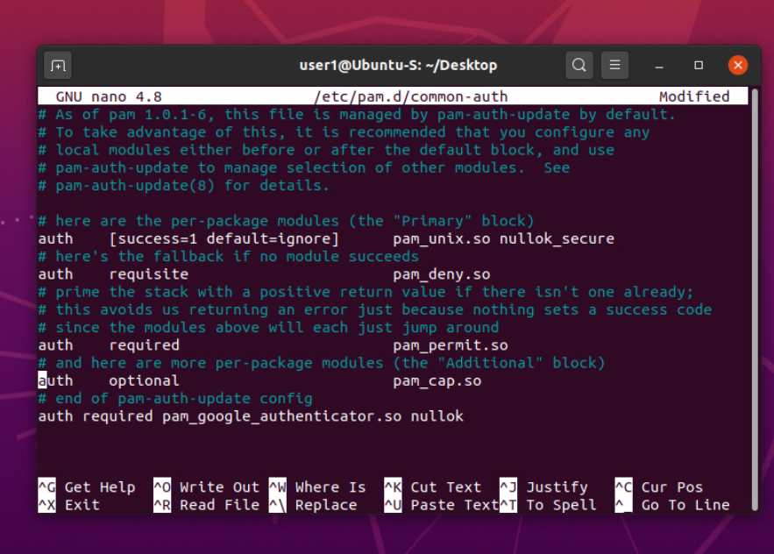
Common-auth Configuration File
This screenshot shows the entry that adds the Google Authenticator module upon login.

Slide 19
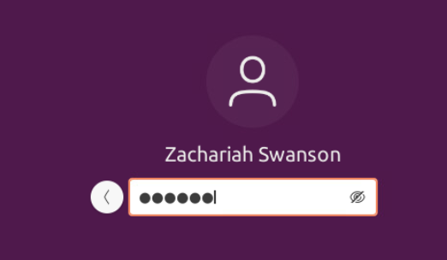
MFA Logon Screen
This screenshot shows the login screen where a verification code is required.

Slide 22


Thank You
Zachariah Swanson
https://michaelswanzach.wixsite.com/my-site

