Slide 1

SEC290
THIS project is about exploring firewalls and establishing protection from attacks on the system

Slide 2
Rubric
Activity | Tasks
Basic attack analysis | Answer 5 questions
References | At least two references are included

Slide 3
Basic attack analysis
In this session I open two Virtual machines one of which has an an ongoing signal. In the other I use wireshark to capture the signal before and after blocking the signal.
Comparing captures no. 20 and 22. Both packets are ICMP traffic but there are subtle differences between them. The time-to-live and data field sizes in the two packets. What differences do you see?
Number 20 has a length of 84.
Do a little Internet research to discover which operating systems use the specific values in their ping commands. What operating system generated the echo request in capture 20? A Linux or Unix based of the previous information.
Review packet no. 37 and beyond, what do you think is taking place here?
IP Flooding
Look at capture 22846. What is suspicious about the flag settings in this packet?
Reserved bit: Not set, Don’t fragment: not set, More fragment: not set, Fragment offset: 0.
What is the IP address of the host being targeted? 192.168.25.1

Slide 4
References
Baran, G. (2023, July 21). Operating systems can be detected using Ping Command. GBHackers. https://gbhackers.com/operating-systems-can-be-detected-using-ping-command/
Bhargava, A. (2022, May 4). What is an IP flood. What is an IP Flood. https://www.tutorialspoint.com/what-is-an-ip-flood#:~:text=requests%20per%20second.-,IP%20Flooding%20is%20a%20sort%20of%20DoS%20attack%20in%20which,preventing%20other%20devices%20from%20connecting.

Slide 5
Rubric
Tasks | Insert
Creating and Testing an SSL/TLS file | Screenshot of SSL transfer.
Creating and Testing an SSL/TLS file cont’d | Screenshot of TLS file.
In this session I create SSL and TLS file ten test them. These pathways allow websites through a firewall created.

Slide 6
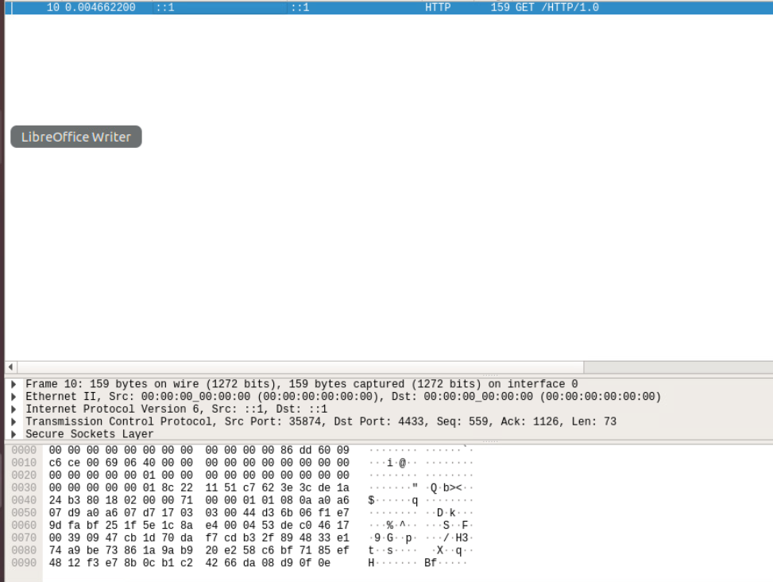
Creating and testing an SSL file
Show the GET request in the Info column of Wireshark. Including flags.

Slide 7
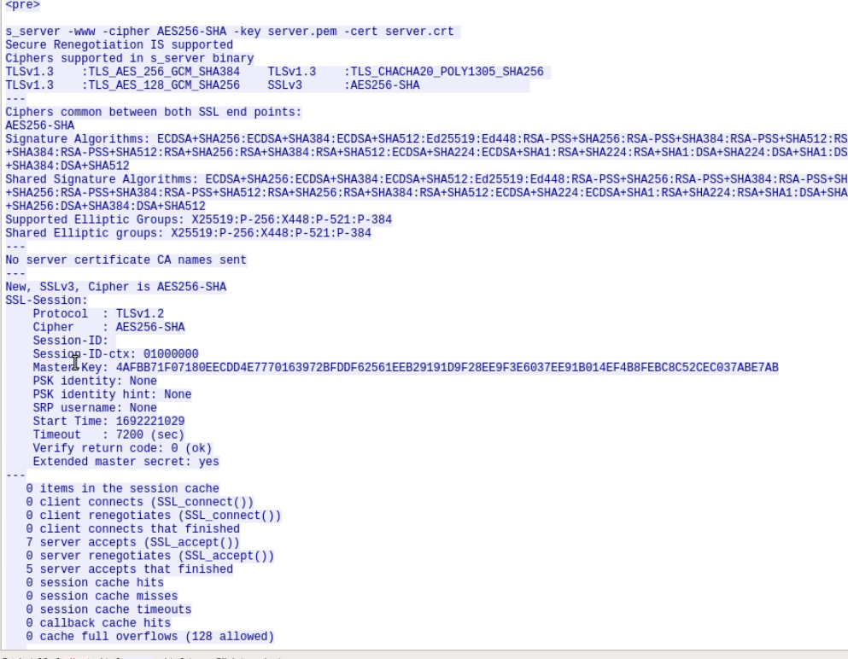
Creating and testing a TLS file cont’d
Showing the decrypted SSL stream. From the TLS file.

Slide 8
Rubric
Tasks | Inserts
Testing Snort rules | Two screenshots
Creating Snort rules | Two screenshots
In this week I use Snort to create a file containing rules and track its usage is Wireshark.

Slide 9
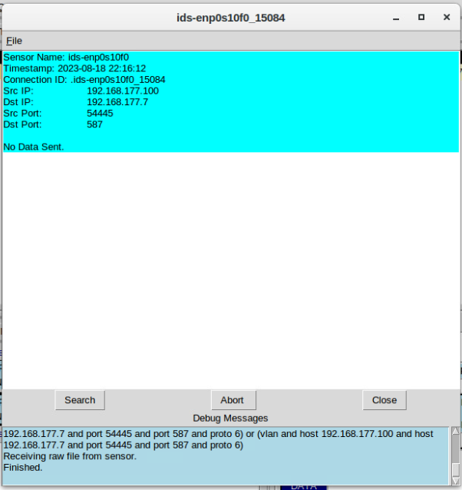
Testing Snort rules
Showing the transcript of the XMAS scan alert.

Slide 10
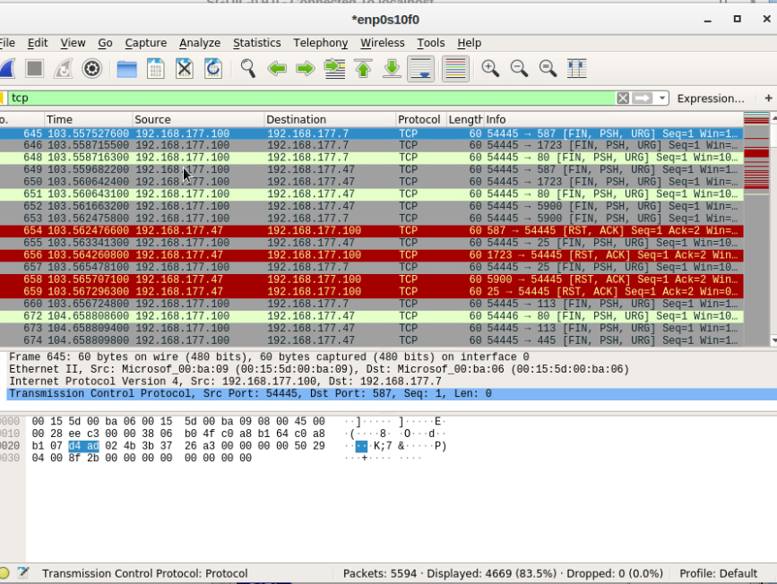
Testing Snort rules cont’d
Show the TCP packets generated by the XMAS scan.

Slide 11
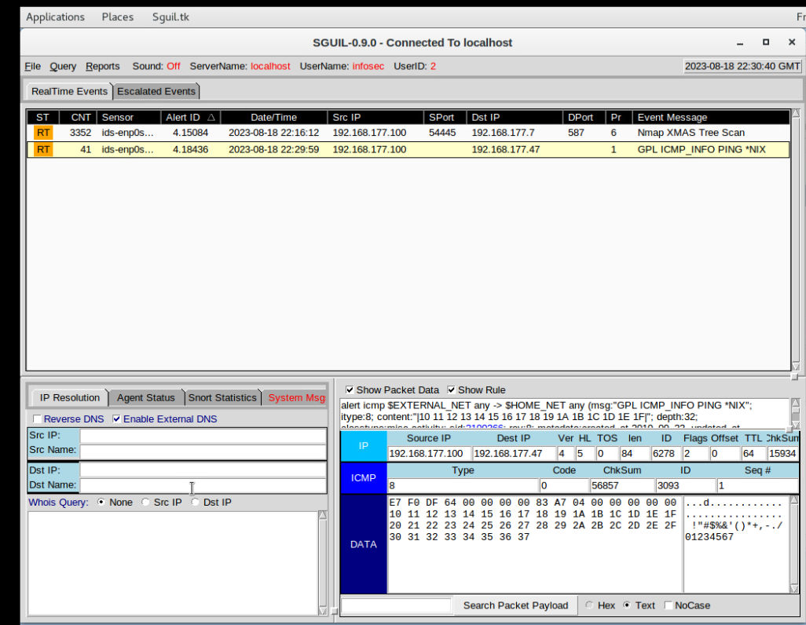
Creating Snort rules
Shows the ping activity alert.

Slide 12
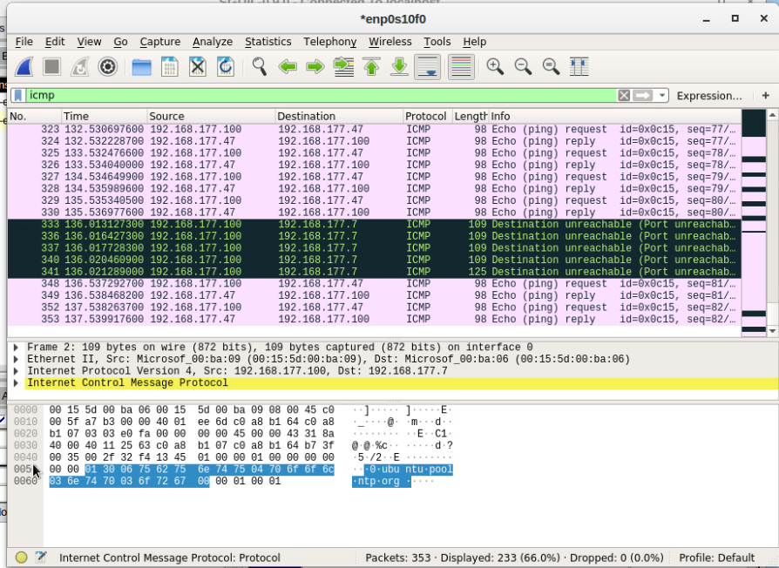
Creating Snort rules cont’d
Showing the ICMP packets generated by the ping activity.

Slide 13
Rubric
Tasks | Inserts
Linux Processes | Screenshot
Process Hacker | Screenshot
Process Monitor | Screenshot
In this week's session I track a file in a process monitor.

Slide 14
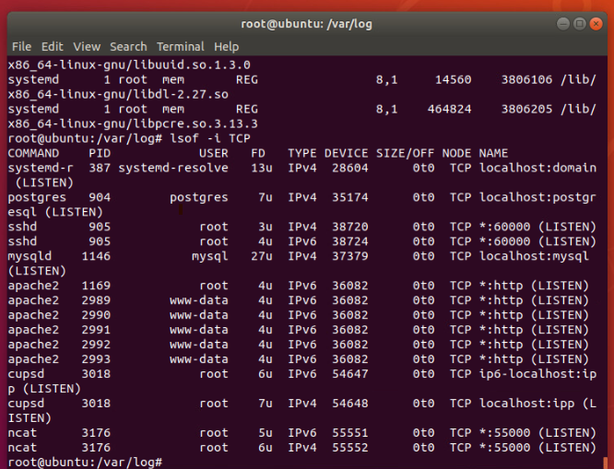
Linux Processes
Showing port 55000 open for both ipv4 and ipv6.

Slide 15
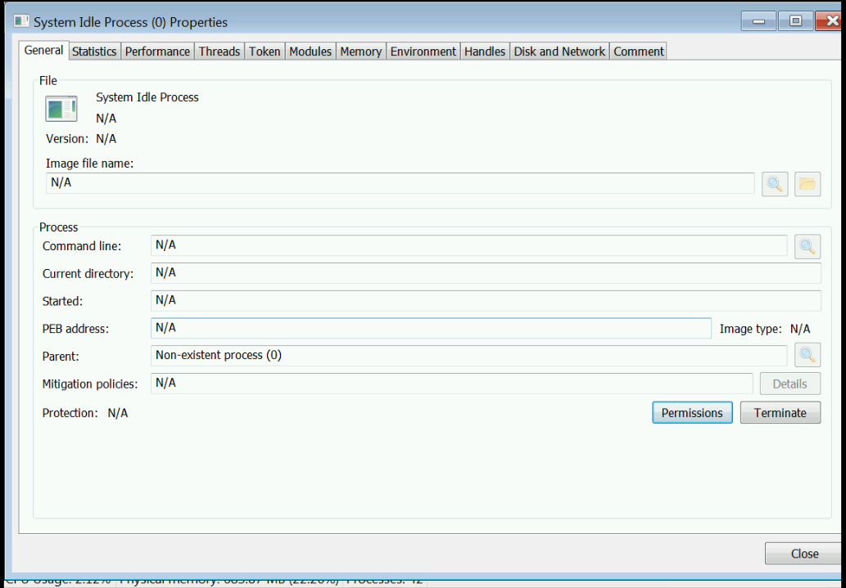
Process Hacker
Showing properties of a chosen process.

Slide 16
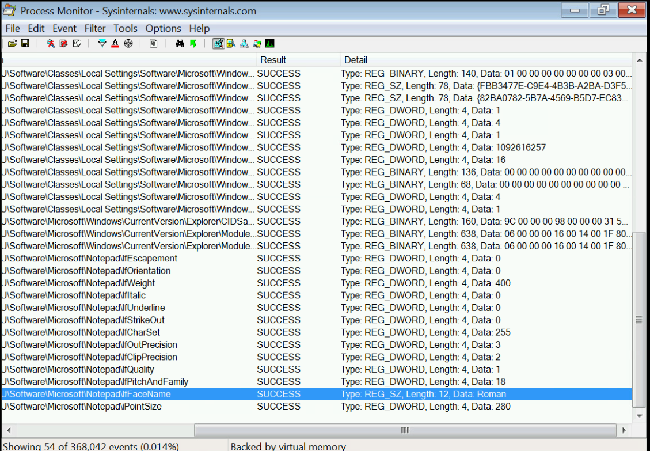
Process Monitor
Showing ifFaceName in the Path column and Data: Roman in the Detail column.

Slide 17
Rubric
Activity | Requirement(s)
Time-based access - 1 | Screenshot
Time-based access - 2 | Screenshot
Time-based access - 3 | Screenshot
In this weeks session I open the pathway between two virtual machines by using a third VM as a router.

Slide 18
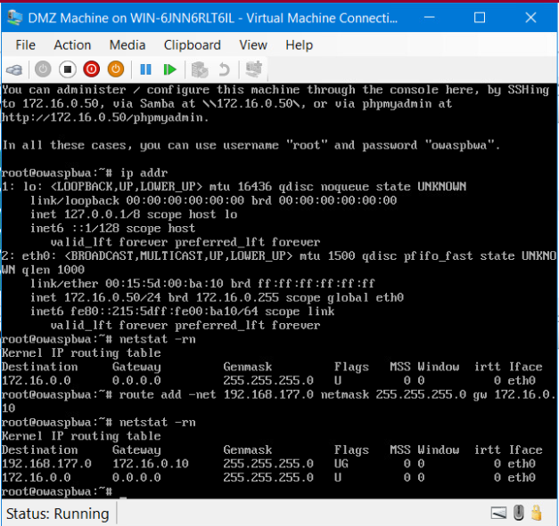
Time-based Access
It should show the output of the DMZ route table.

Slide 19
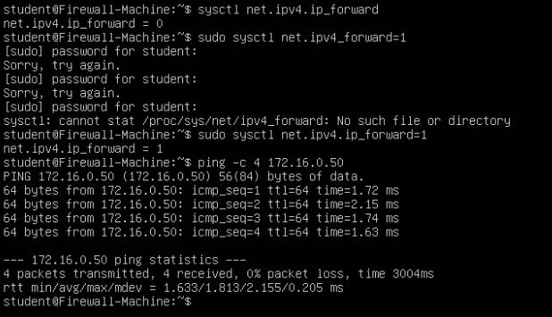
Time-based Access
Shows a successful ping from the Ubuntu Web VM and the DMZ VM.

Slide 20
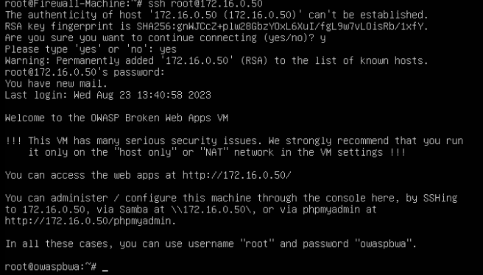
Time-based Access
Showing two time-based access rules in the FORWARD chain

