Slide 1
CEIS 110 class project
Project presented by Zachariah Swanson

Slide 2
In this project I will cover the following points
Installing a package.
Intergrading and using the package.
Calling out previous projects to preform new tasks.
Extracting and graphing data from a project into a deliverable form.
Using data from a program to mathematically predict plausible outcomes.

Slide 3
In the following slides I will be showing the installation of a package. This package calls data from news about weather.

Slide 4
Rubric
Activity | Requirement(s)
Develop Flowchart | Flowchart
Software Library Installation | Screenshot of software library installed

Slide 5
Flowchart
Start
Install python
module
Download weather data to database
Cleanse weather data
Include the following processes:
Install python
Download weather data to a database.
Extract weather data from database into a comma separated file with python
Cleanse weather data
Use Excel to manipulate data
Use python data analytics modules to develop graphical models
Use Excel to manipulate data
Use python data analytics models to develop graphical models
Stop

Slide 6
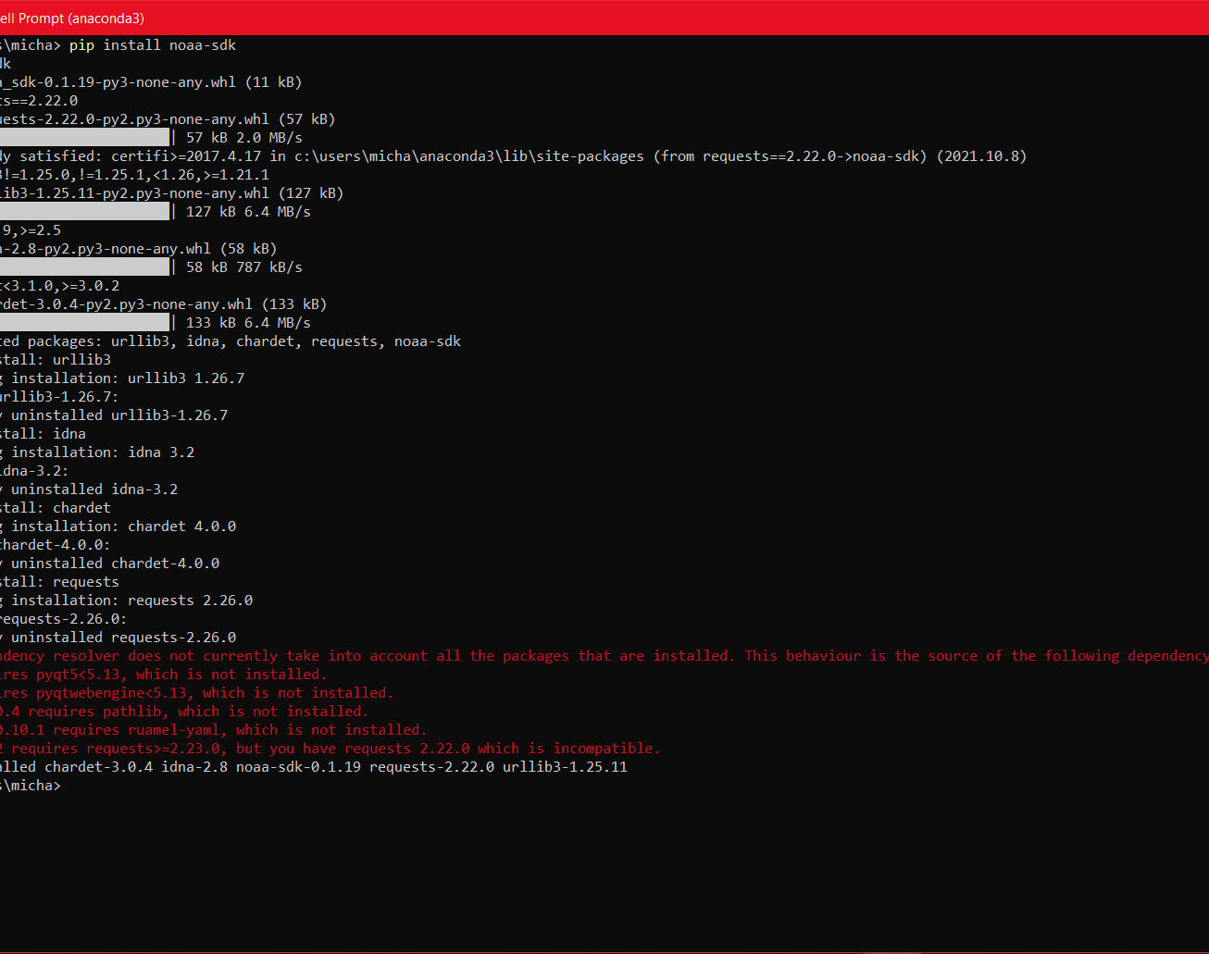
Software Inventory
Include screenshot of NOAA-SDK library installed
Ensure result "Successfully installed noaa-sdk" of pip install command is visible in your screenshot.

Slide 7
In the following slides, I build a program from the package to ensure all the files are stored for further development and have a clear file path. This program's design activates a refined set of data to be called.

Slide 8
Rubric
Activity | Requirement(s)
Code | Screenshot of code in Spyder with your name, date, and zip code
Execution | Screenshot of Python console showing program ran successfully
Database file | Screenshot from Windows Explorer showing database file was created

Slide 9
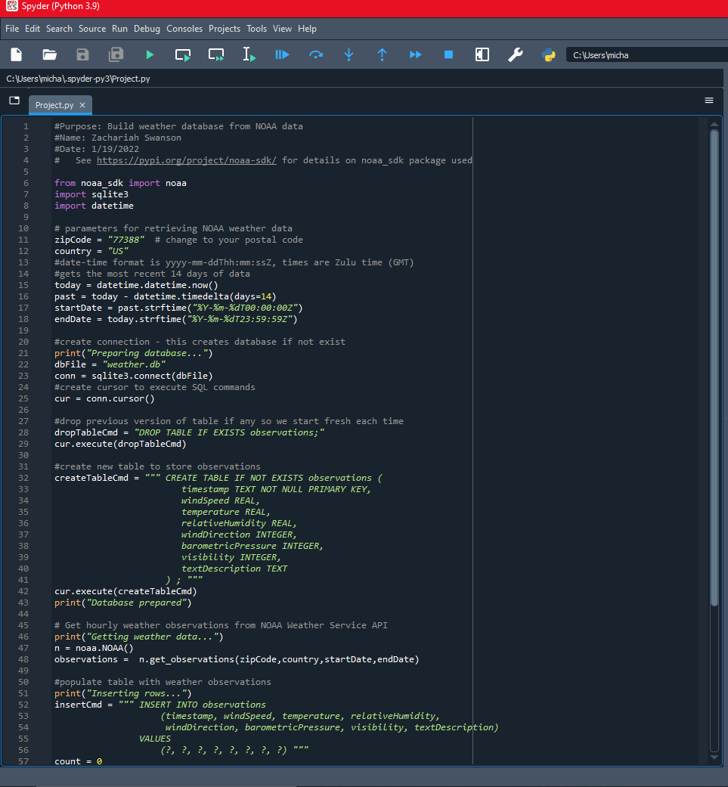
BuildWeatherDb.py Code
Screenshot of code in Spyder
Must have your name and date in comments
Must have your zip code

Slide 10
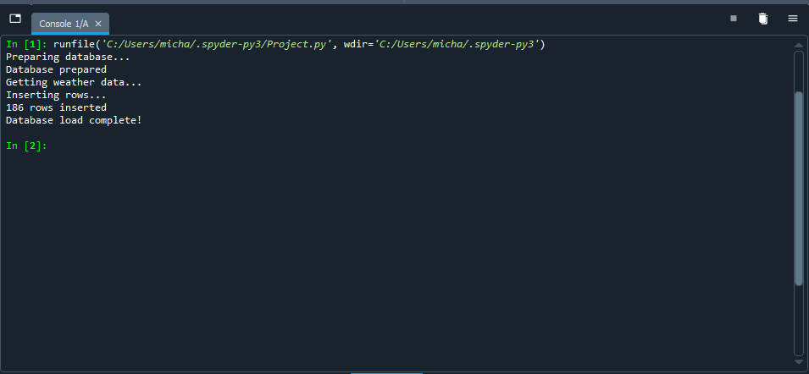
Python Console
Screenshot of program output in Python console showing program executed successfully

Slide 11
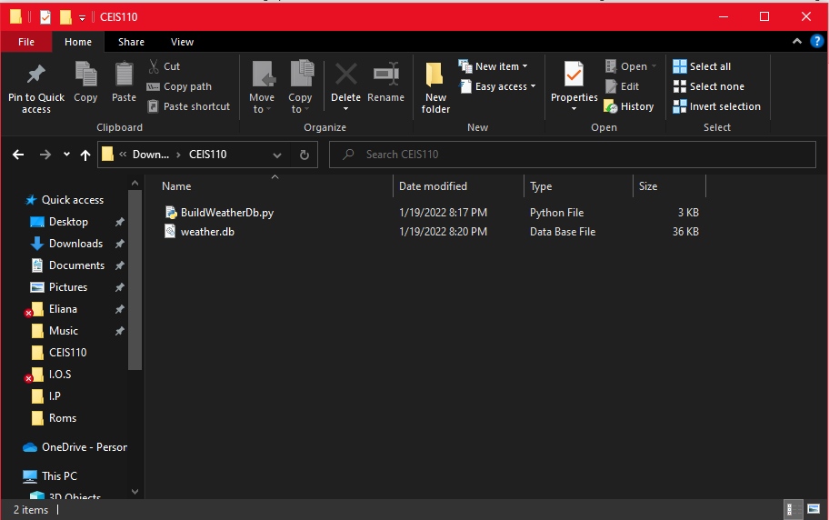
Weather.db File
Screenshot of Windows File Explorer showing database file Weather.db was created

Slide 12
In the following slides I show the gathering of data. I use the program to call temperature and set it so I can all humidity, time, and wind pressure.

Slide 13
Rubric
Activity | Requirement(s) | Points
Query to retrieve all columns and rows | Screenshot of query and results | 20
Query to retrieve lowest and highest temperature | Screenshot of query and results | 20
Query to find all Clear days | Screenshot of query and results | 20

Slide 14
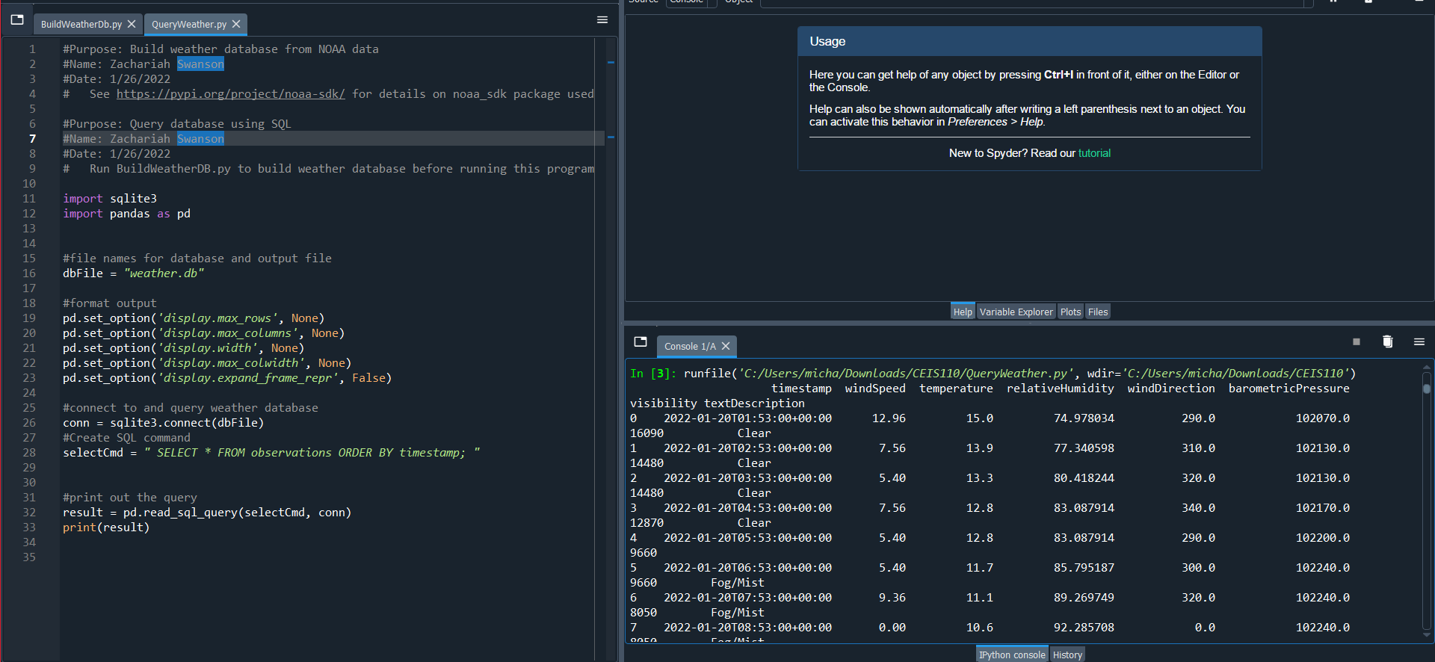
Query to retrieve all columns and all rows
Screenshot of SQL query command and results

Slide 15
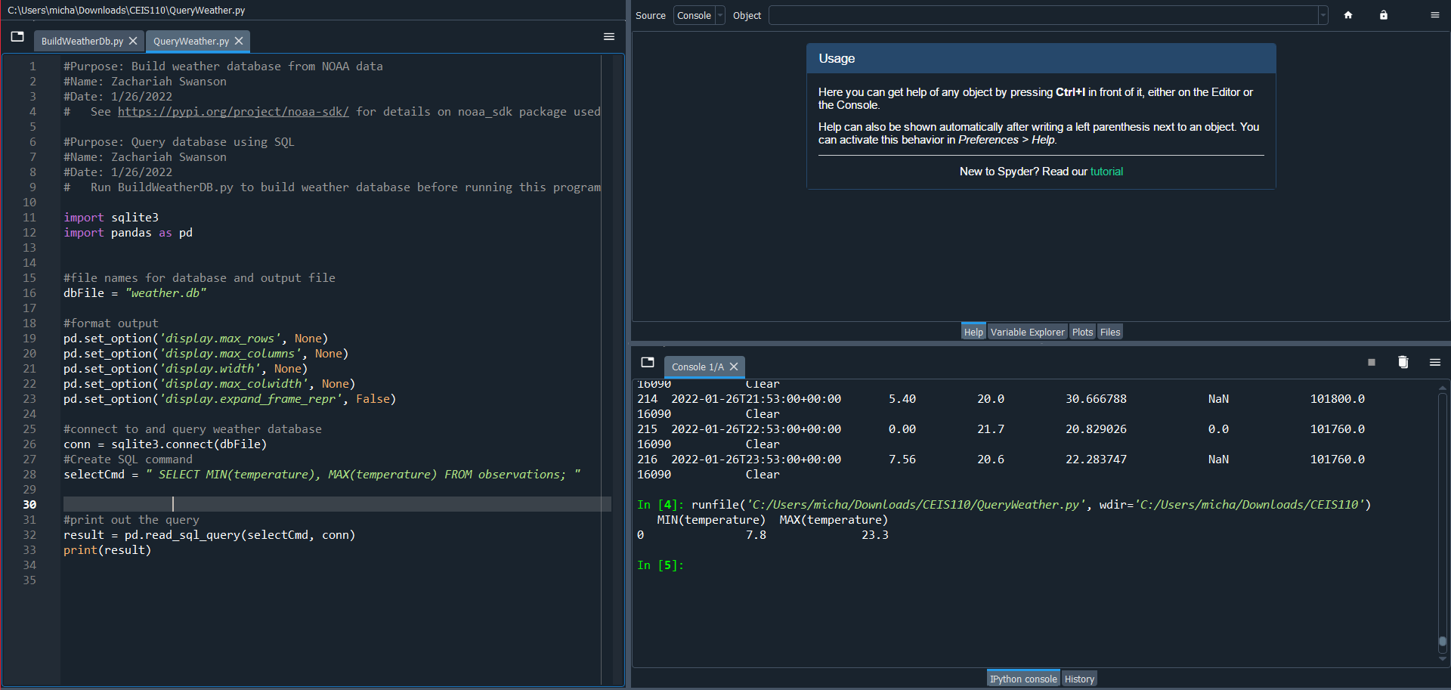
Query to retrieve lowest and highest temperatures
Screenshot of SQL query command and results

Slide 16
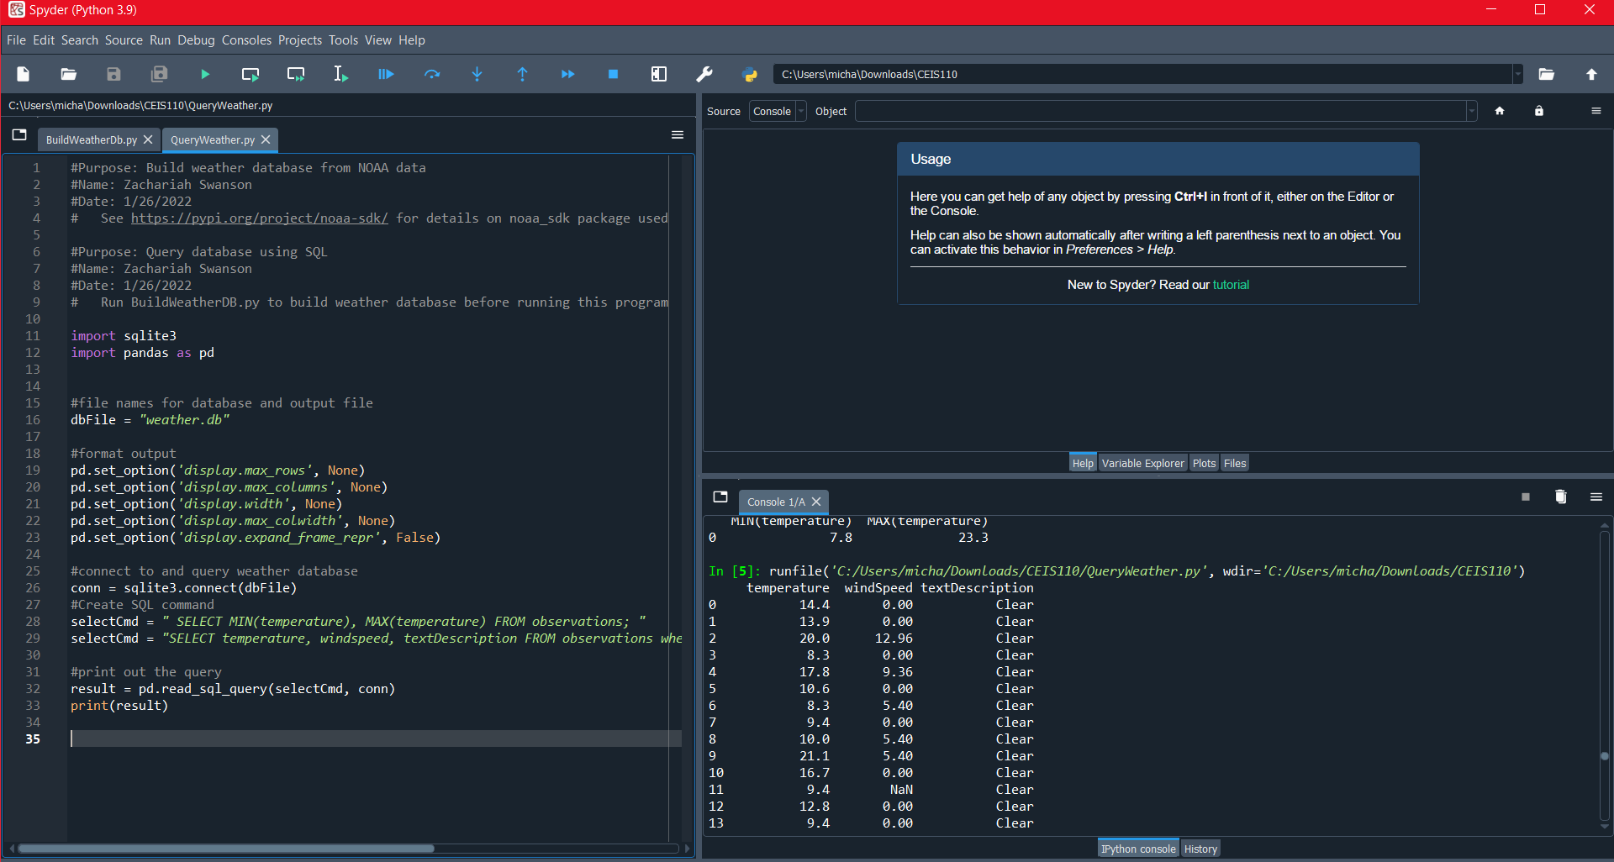
Query to retrieve all clear days
Screenshot of SQL query command and results

Slide 17
In the following slides I show the gathering and graphing of data for use.
I use the data from the previous program to show data for a period of time.

Slide 18
Rubric
Activity | Requirement(s) | Points
Python code | Screenshot of code | 20
Retrieve and convert data into CSV format | Screenshot of data in Excel file | 20
Temperature and Humidity chart | Chart of data from database | 20

Slide 19
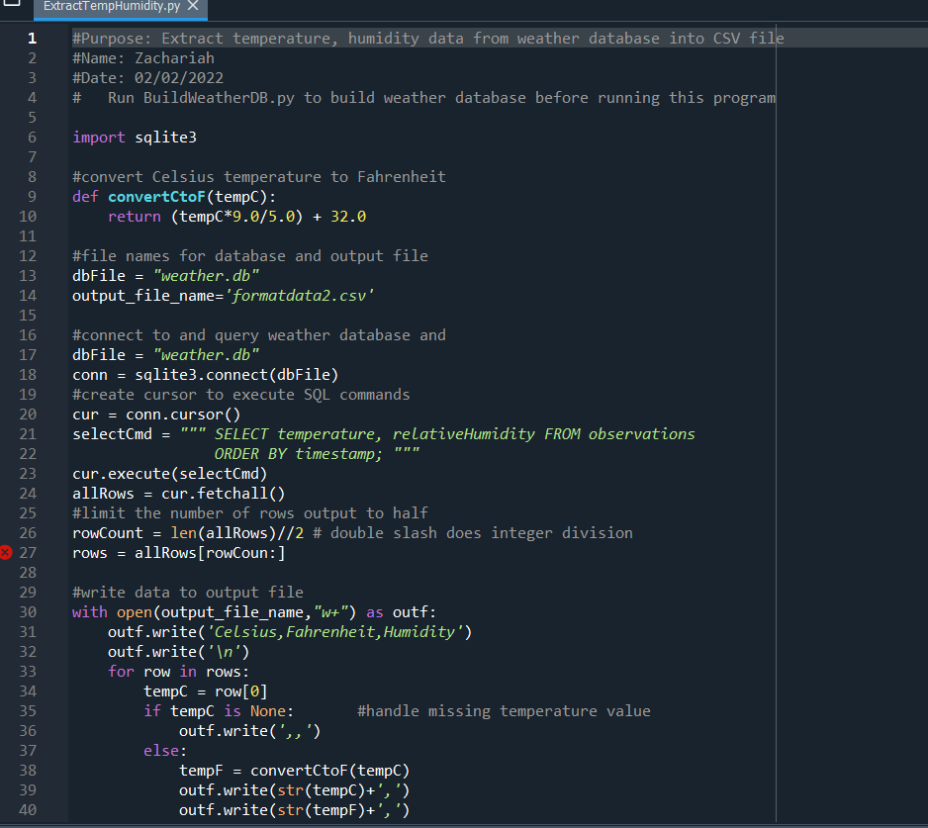
Python code
ExtractTempHumidity.py Python code with your name and date in comments

Slide 20
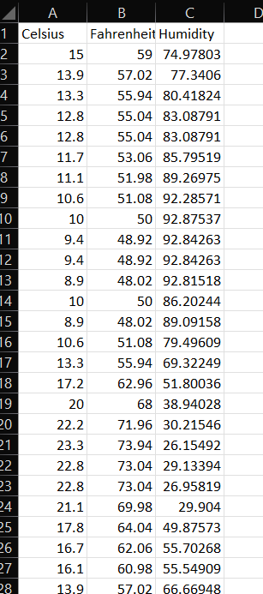
Retrieve and convert data to CSV format
Formatdata file open in Excel showing 3 columns of data

Slide 21
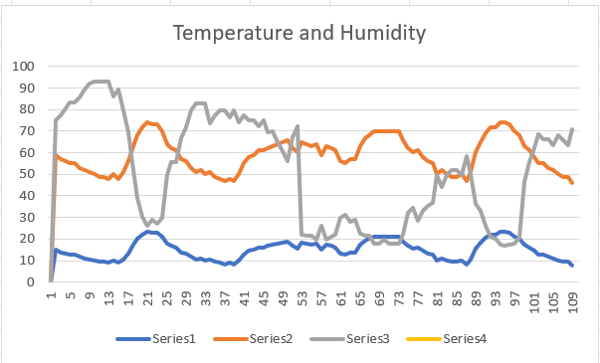
Temperature and humidity chart
Excel chart based on temperature and humidity data from database

Slide 22
In the following slides I’m using data and graphs to predict figures based of previous data.

Slide 23
Rubric
Activity | Requirement(s)
Plot #1 | Picture/screenshot of plot from data with code
Plot #2 | Picture/screenshot of plot from data with code
Analysis | Question, plot, and answer
Prediction | Prediction based on data

Slide 24
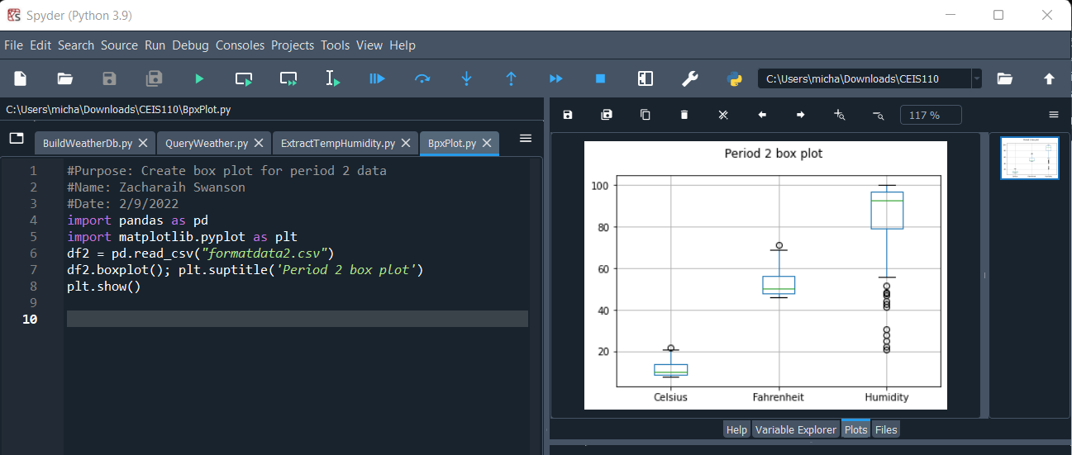
Plot #1
Plot and code used to generate it
Box
Line
Histogram
Scatter

Slide 25
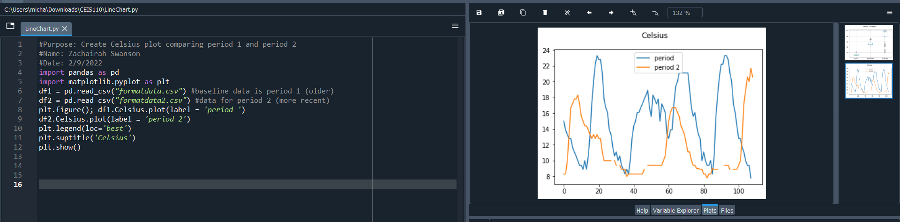
Plot #2
Plot and code used to generate it
Box
Line
Histogram
Scatter

Slide 26
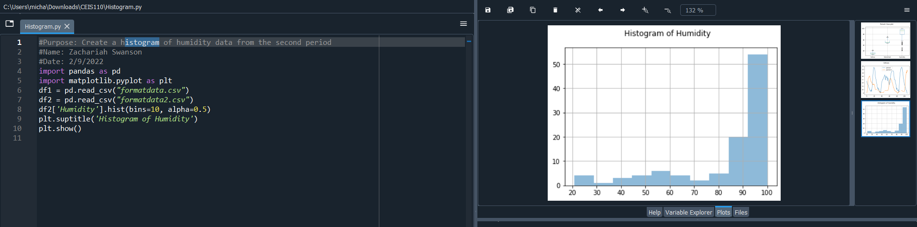
Analysis
Think of your own question and create a chart/graph to answer it
Question:
What is the highest humidity in your area in the last month?
Answer supported by Chart:
58

Slide 27
Prediction
Develop a prediction based on the data. What variations in temperature and humidity do you expect over the next few hours or days? How would humidity change if temperature goes up or down?
In the next few days, I expect the temperature to and the humidity to rise. If the temperature would increase the humidity should increase, and if it would fall, I would expect it to decrease.

Slide 28
Difficulties for this project.
For me the most difficult part of this project was predicting outcomes. I could follow the code but telling the outcome of a code I didn’t write.

Slide 29
Closing
This project was to prove my ability to learn about code, what data is useful and relevant to a situation, and to use data so that it is easy to process. In this project I used weather data to form graphs, predictions, tables and additional programs.

