Slide 1

Linux + CompTIA
This is an example of operating systems.
Navigating Linux file tree, managing servers, and accessing information.

Slide 2

Navigating the Linux filesystem tree
In the following three slides I will be creating two directory's each with their own subdirectory and activating them by creating files within the directory.

Slide 3
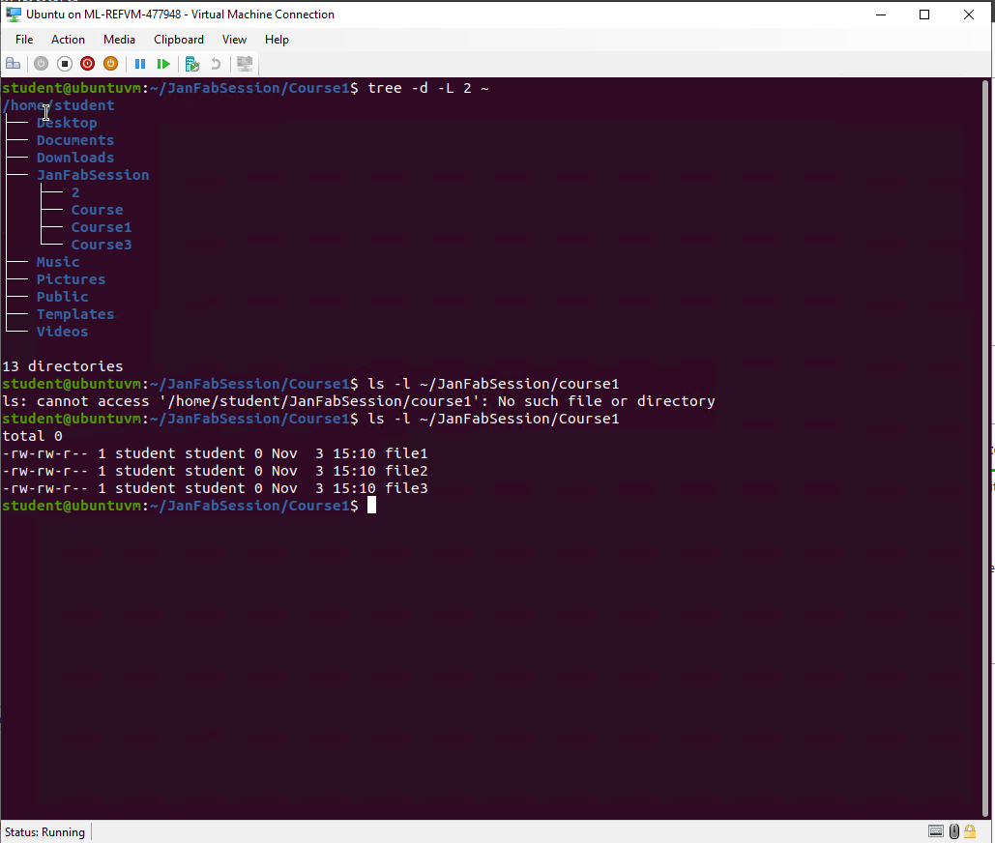
Create directories and files
In the following screenshot I’ve created a directory called JanFebSession. In that directory I have three files.

Slide 4
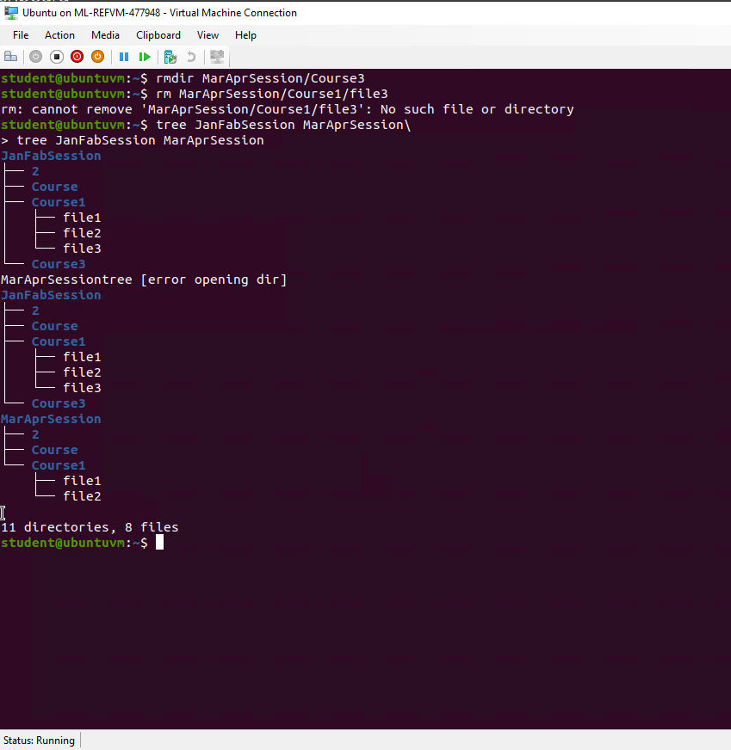
Copy and remove directories and files.
In this screenshot I’m showing the tree before and after deleting the third file.

Slide 5
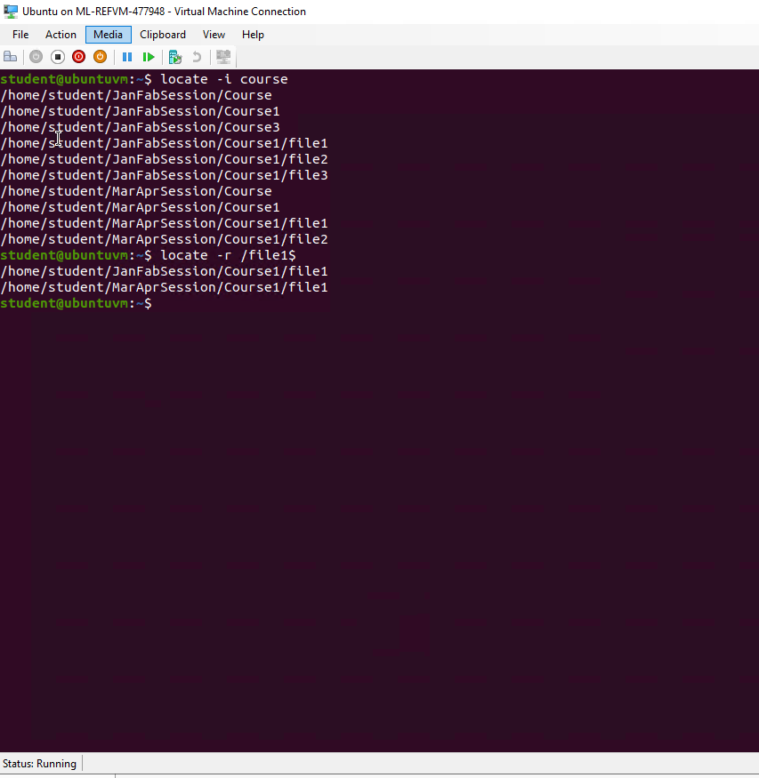
Locate directories and files
I created a sub directory within JanFebSession called Course. Then created another directory called MarAprSession and a course sub directory with 2 files of its own.
Then I located files named file1 showing that both sub directories have a file1.

Slide 6
Create a shell script
In the following three slides I’m showing an example of a shell script.

Slide 7
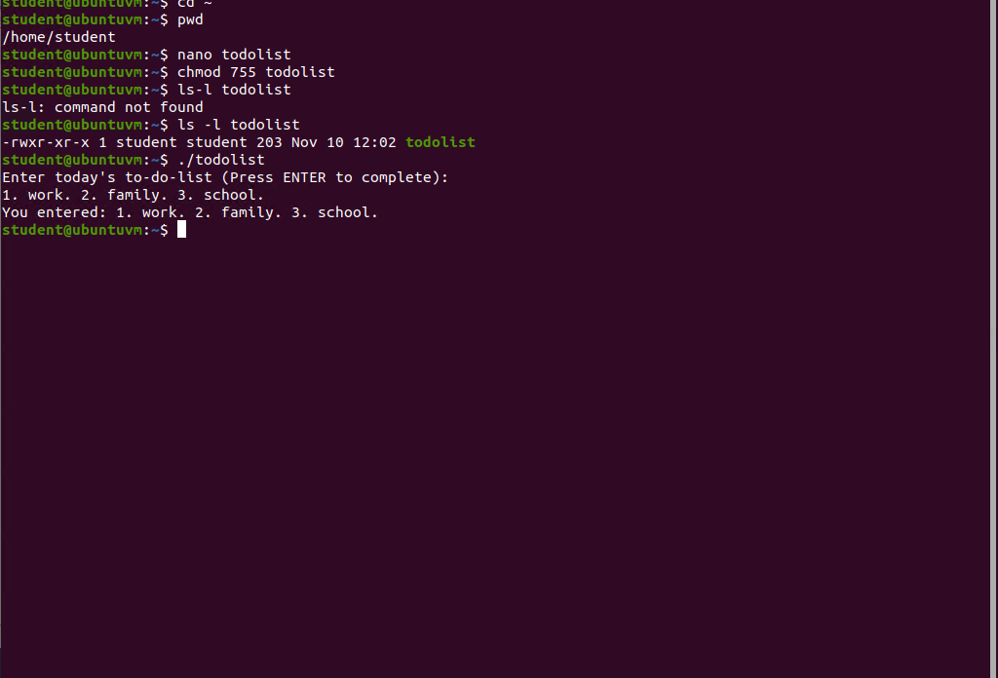
Change script file permissions
In this slide I have created a shell script called todolist. I set the permissions of the shell list so that the user has full permissions while group and other have read and execute. I then provide a string to my shell script which will return the string and log it.

Slide 8
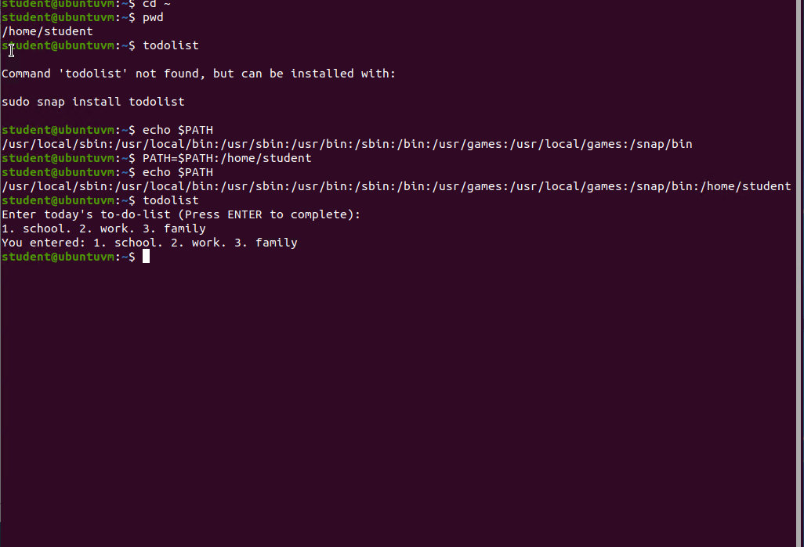
Set the PATH variable
In this slide I echo $PATH to see how the shell script has been set into my system. I provide the shell script with a second string.

Slide 9
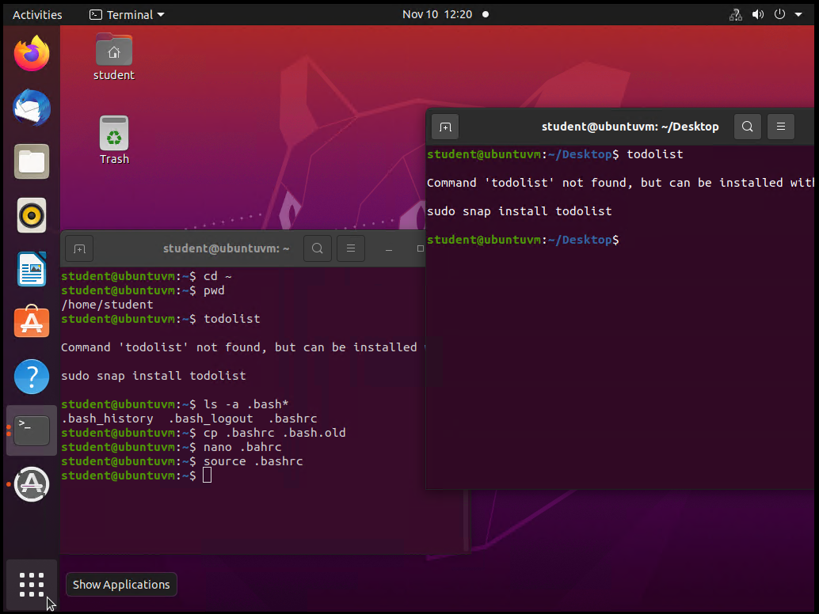
Make the PATH variable permanent
I make the PATH variable permanent, then run todolist in order to ensure it takes place.

Slide 10
Add users and groups in CLI
In the following three slides I create and activate two additional users.

Slide 11
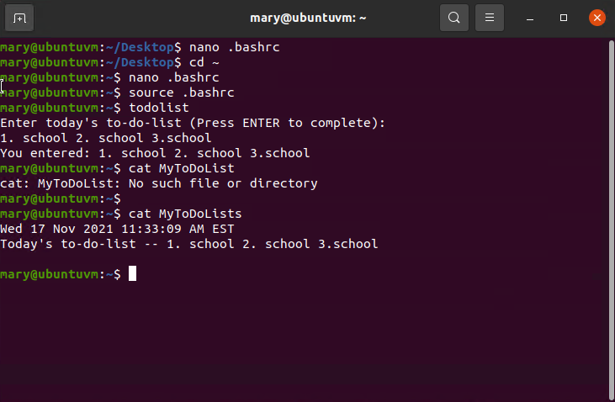
Test user and group settings
In this slide I’ve created and logged into another user. I then tried to access the todolist and show I could only read and execute the shell script.

Slide 12
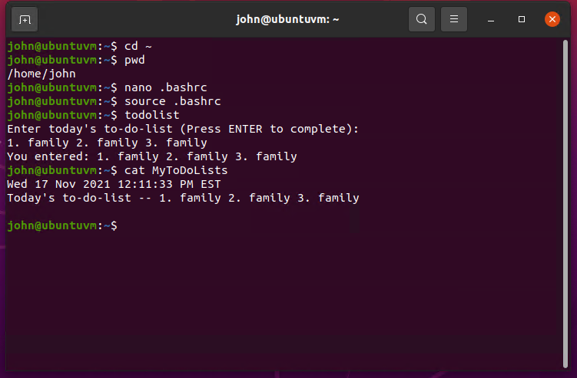
Add users in GUI
In this slide I’ve created a third user and accessed todolist from their account.

Slide 13
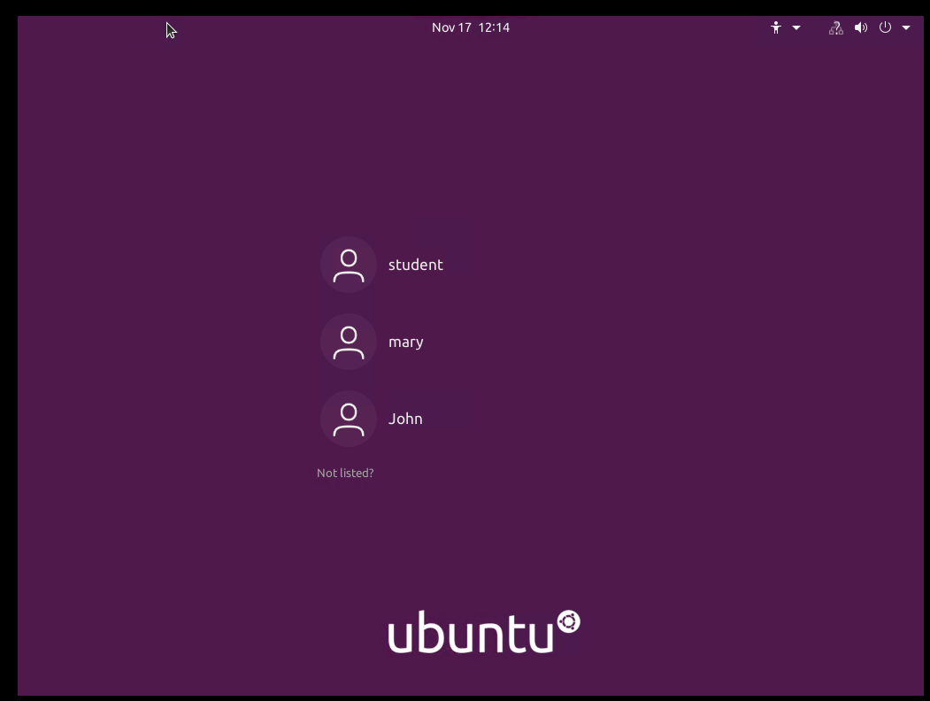
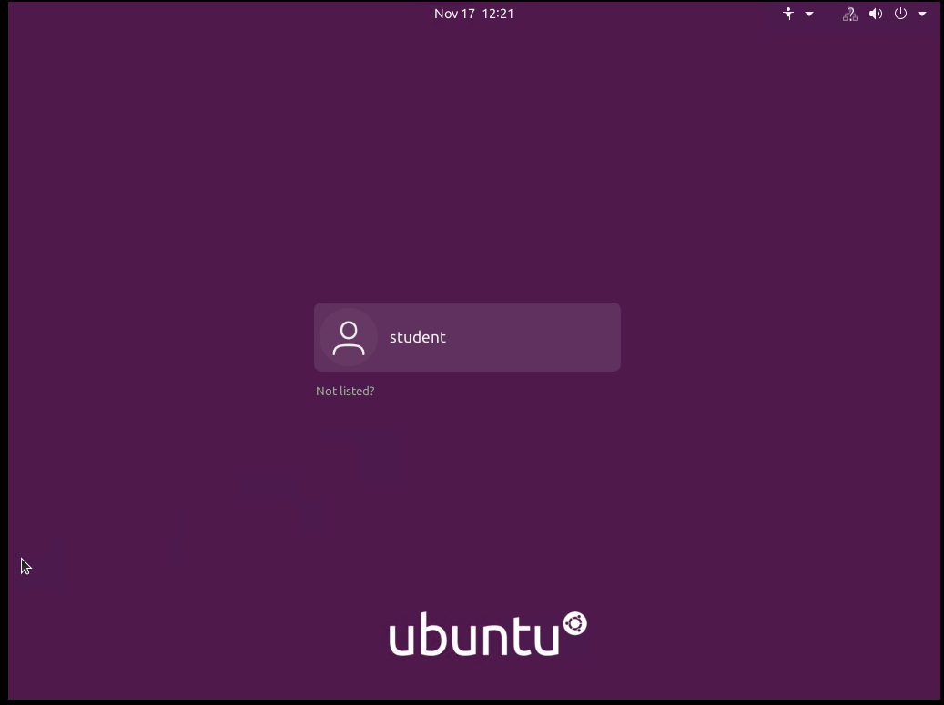
Remove users and groups
In the top screenshot I’m showing the GUI for logging in with ubunto.
In the bottom screenshot I deleted the unneeded users and shown the results after logging out.

Slide 14
Manage network interfaces
In the next three slides I am accessing and providing network info.

Slide 15
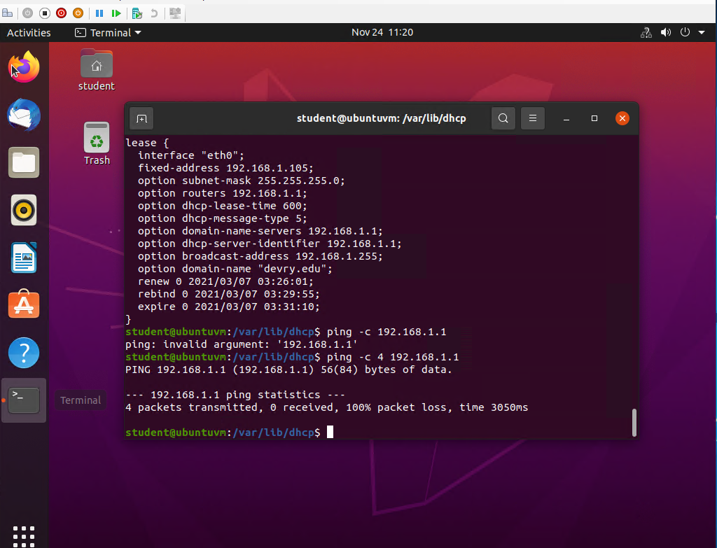
Discover host IP configurations
In this slide I am locating the host IP, and pinging it.

Slide 16
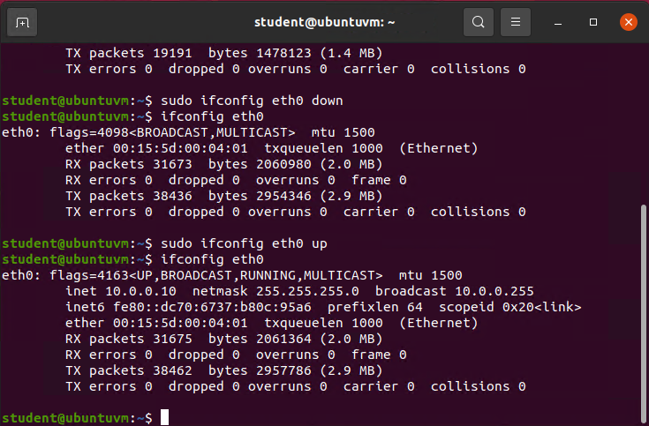
Use network utilities
In this slide I am turning the network on and off showing the network each time to see the difference.

Slide 17
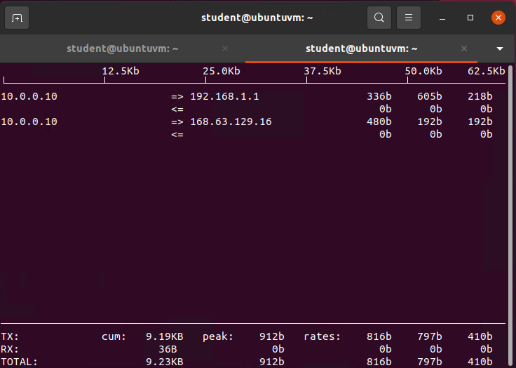
Monitor network bandwidth usage
In this slide I’m showing the IP address bandwidth download and upload speeds.

Slide 18
In the first set slides I was navigating and creating file systems. In Linux directory's need files or they can’t be called on.
In the second set slides I created a shell script also called an executable file. Executable files are used to keep our system and process running.
In the third set of slides, I created and used new users. I added security like passwords and expiration dates for those passwords. I showed how the permissions on a system are important and need attention.
In the last set of slides, I am navigating the systems network, and providing the IP address. I showed how to shut down or revive the network. Although I did not do it within my presentation it is possible to set up several networks at the same time or access one at a time.

