Slide 1

Traffic light using esp32
Presenter Zachariah Swanson

Slide 2



Agenda
Topic one: Preparing the project.
Topic two: Installing and testing the first light
Topic three: Installing and testing second light
Topic four: Installing and testing crosswalks.
Topic five: Wiring LCD and active buzzer for emergency signal. Downloading the Appropriate library and testing the LCD.
Topic six: Installing emergency signal light, and motion sensor for less active street and testing.

Slide 3

Scenario
I was tasked with designing and developing a two-way traffic light controller with a pedestrian crossing and an emergency signal.
The pedestrian crossing will have an LCD message on whether the pedestrian can or cannot cross the street. When they can travel, the LCD will count down from ten (10) to zero (0), indicating the amount of time they have to cross.
The emergency signal will force red lights to turn on in all directions, and the blue light will flash. The final step is to use a motion sensor to allow traffic to flow continuously on significant streets and only switches to slow traffic streets when motion is detected.

Slide 4
Rubric of week 2
Activity | Requirement(s)
Inventory of parts | Picture of required inventory of components
ESP32 mounted and powered ON | Picture
Installation of Arduino IDE | Screenshot of COM port selected
WiFi Scan | Screenshot of Serial Monitor

Slide 5
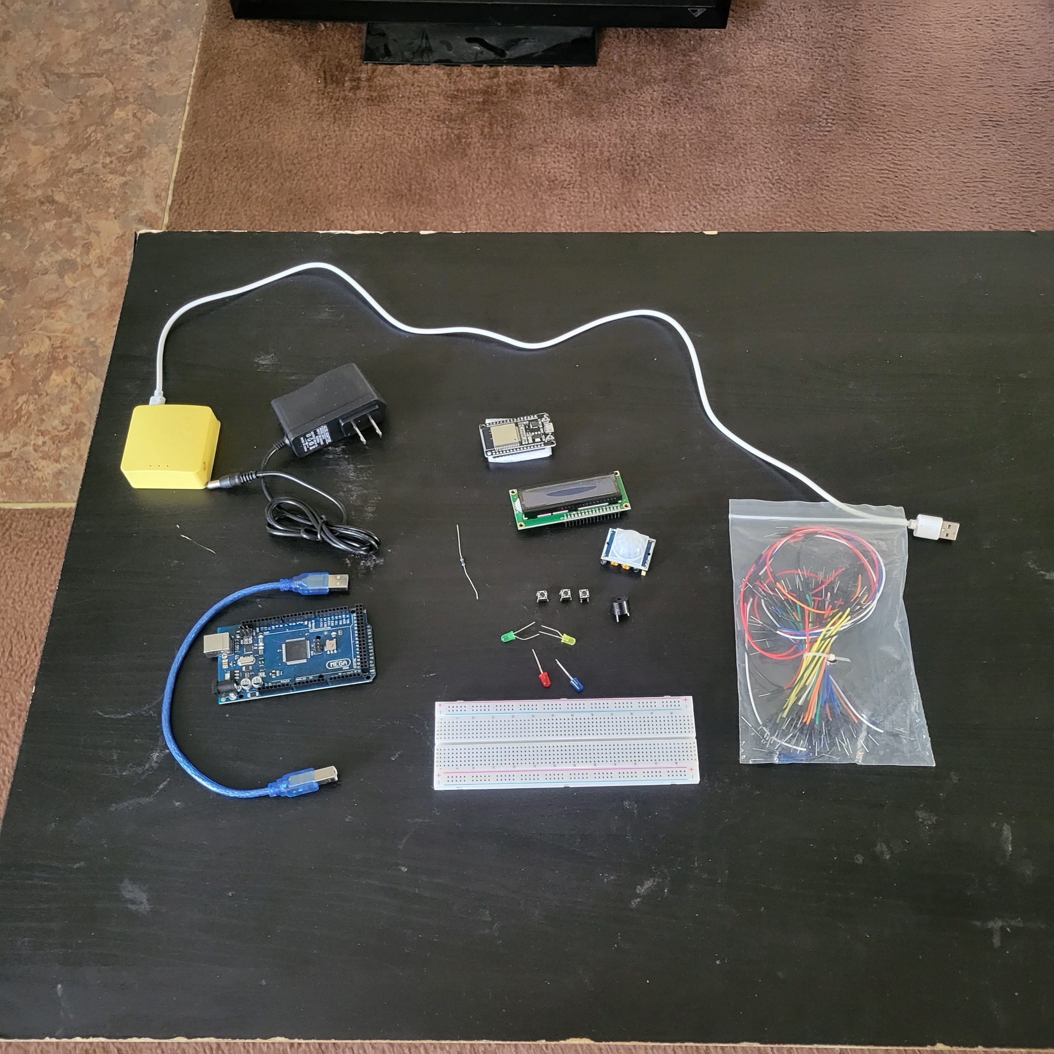
Inventory
ESP 32 Board
Colored LEDs: Red, Yellow, Green, and Blue
220 Ohm Resistors (optional)
Wires
Breadboard(s)
LCD Unit with I2C Adapter
Active Buzzer
Mini Router
Push Button(s)
PIR Motion Sensor

Slide 6
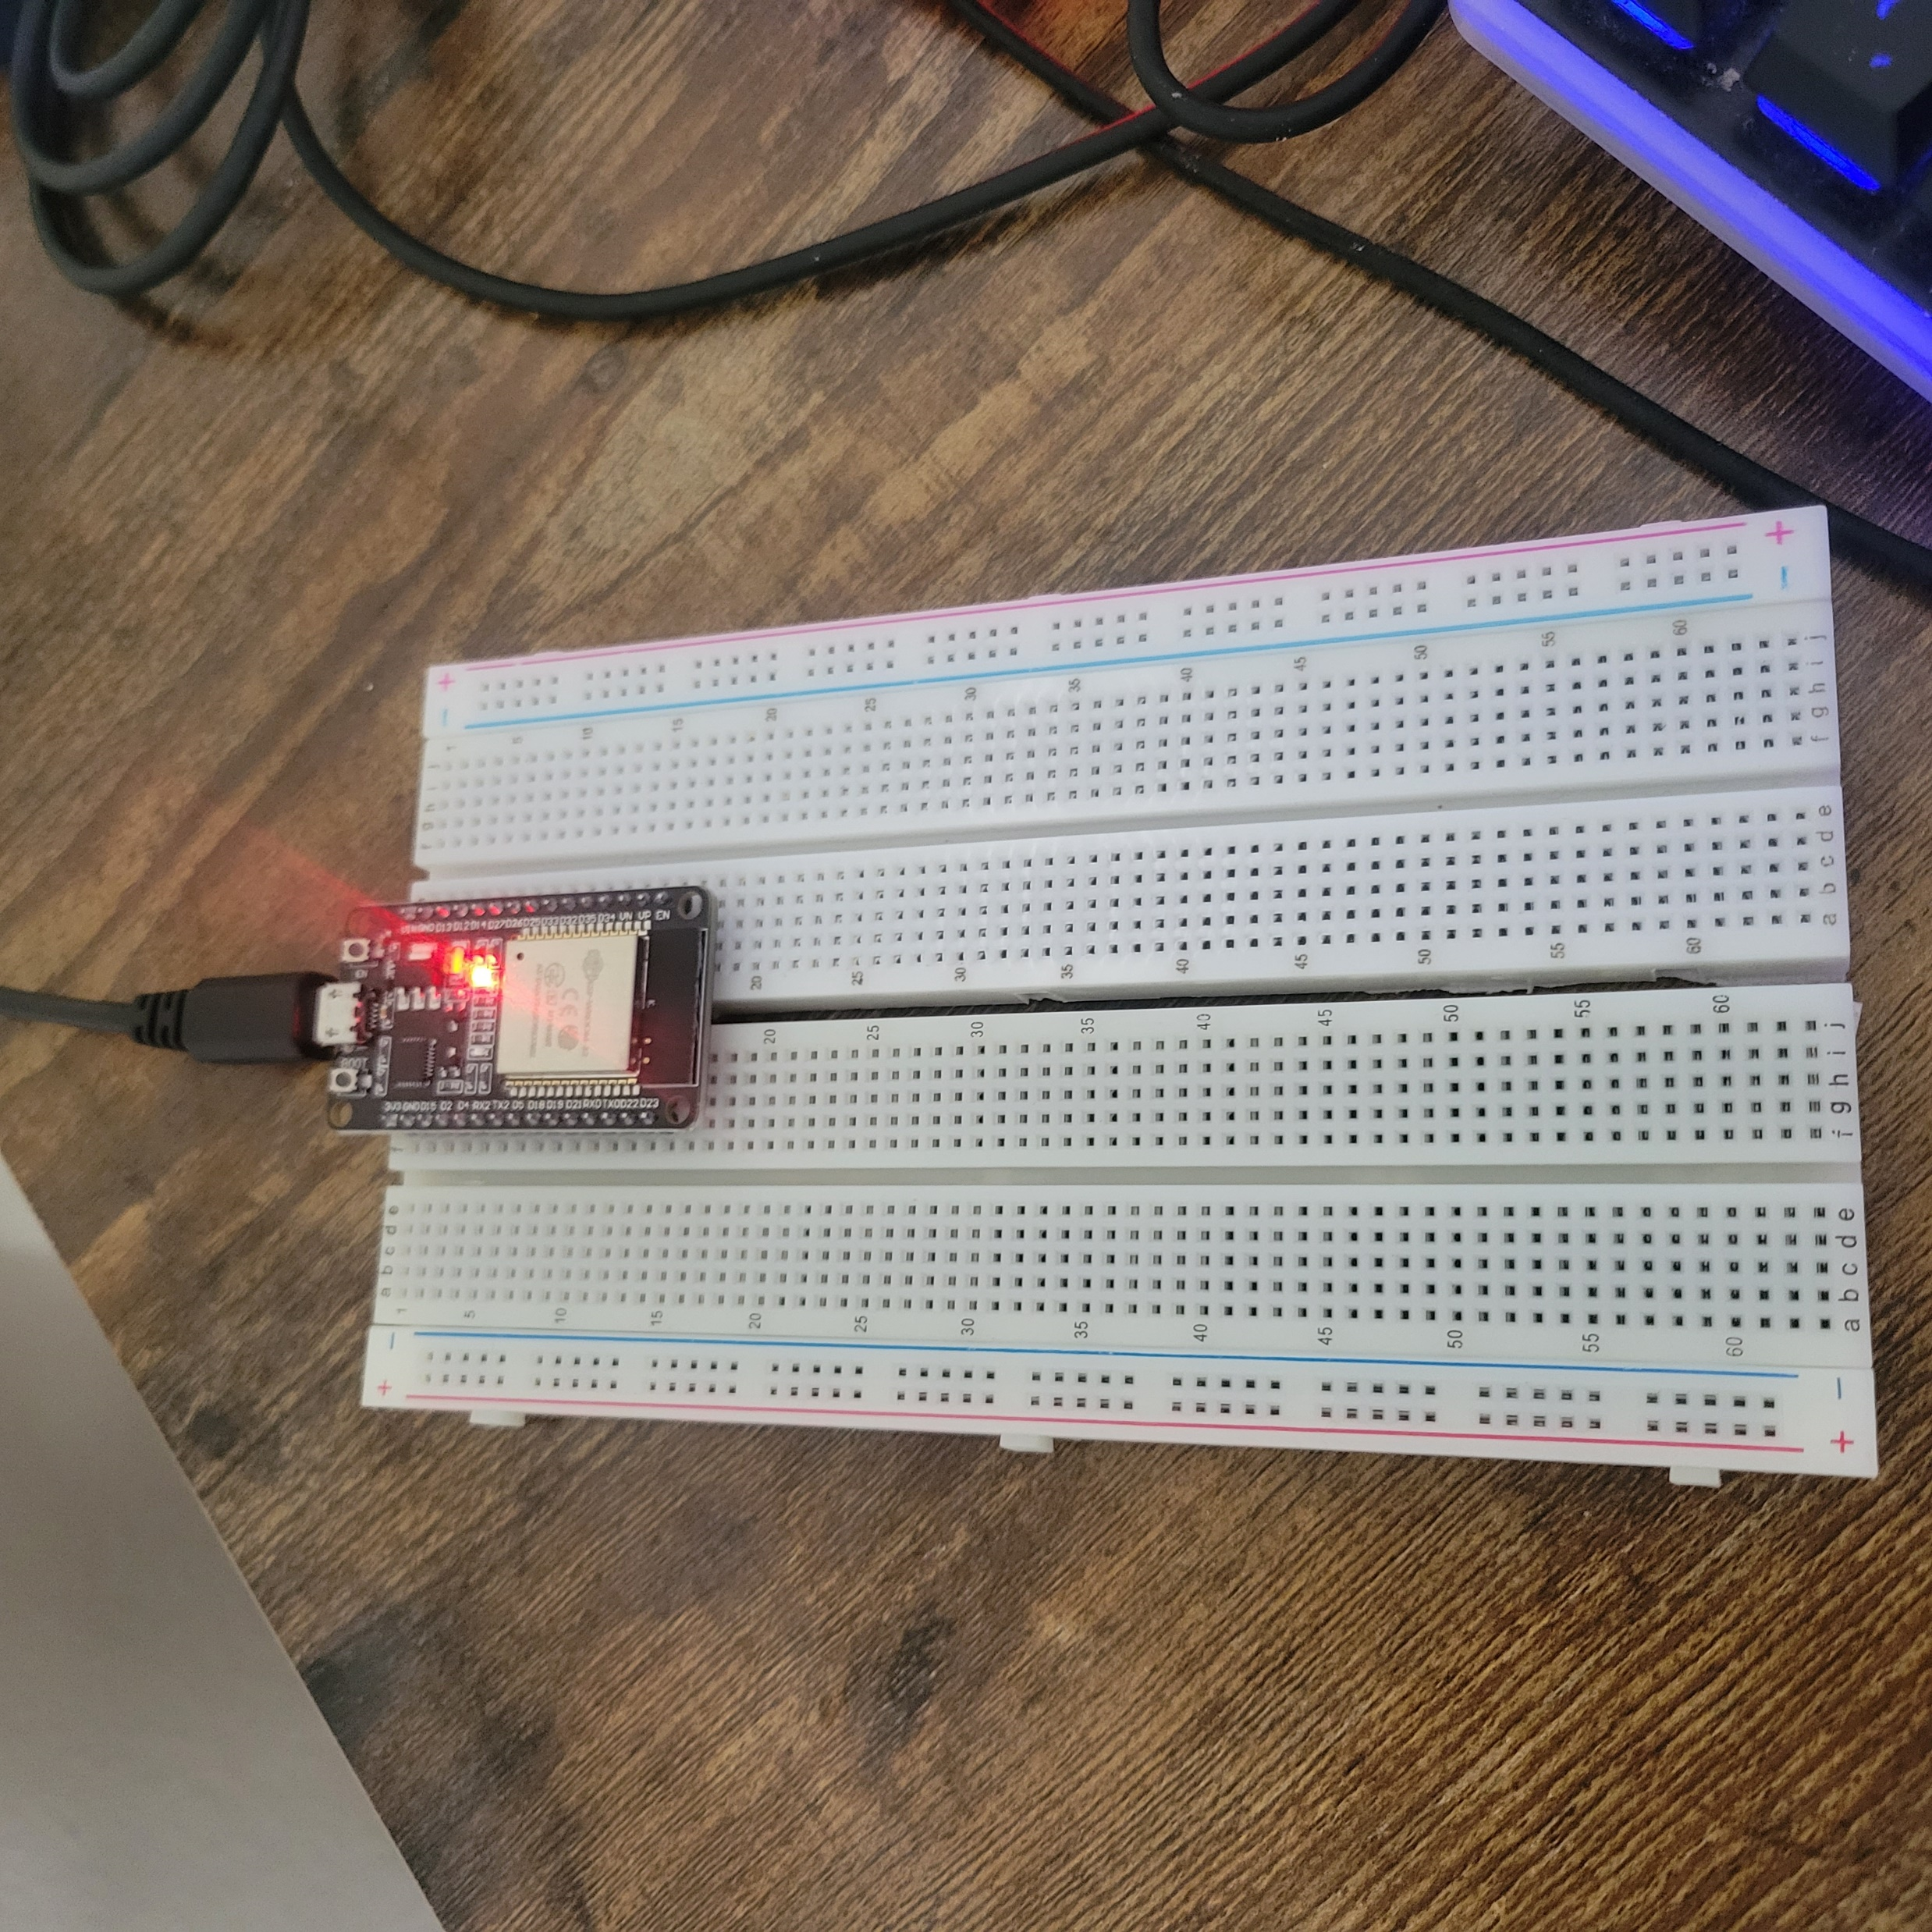
ESP32
Microcontroller mounted and powered on.
This mainly ensures that the esp32 receives power while I install drivers and test the signal.

Slide 7
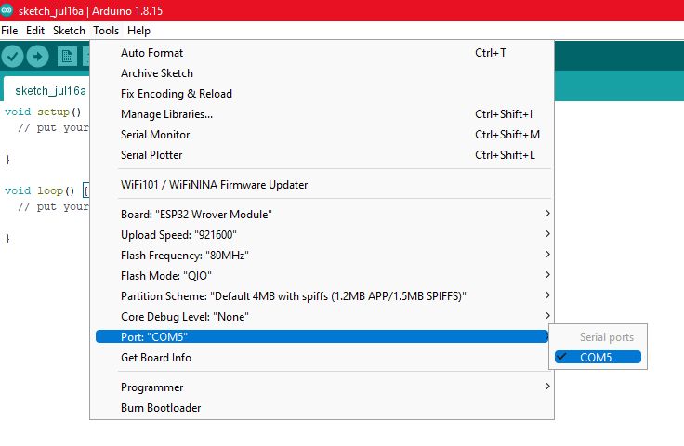
Installation of Arduino IDE
Screenshot of Arduino IDE with Port selected from Tools menu.

Slide 8
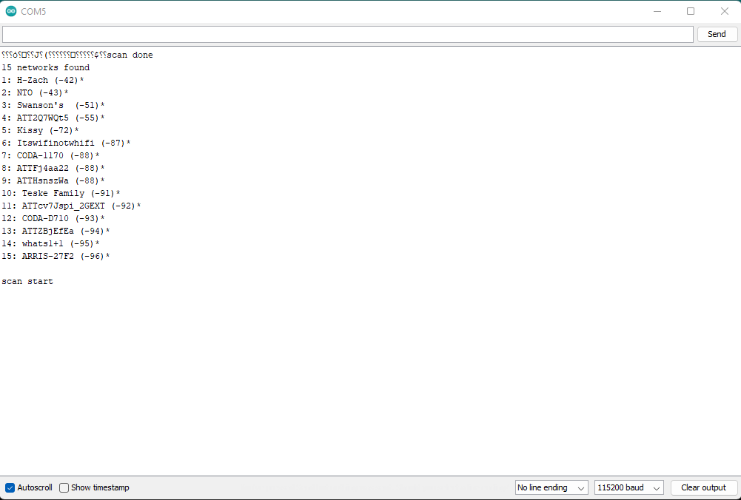
ESP32 WiFi Scan
This screenshot of the Serial Monitor in Arduino IDE shows the available networks. I need to ensure that the esp32 is connected to the same network as me.

Slide 9
Rubric –Week 3
Activity | Requirement(s)
Include a picture of your circuit | Picture of the breadboard with LEDs ON
Screenshot of code showing your name in comment | Screenshot of code in Arduino IDE showing your name in one of the comments

Slide 10
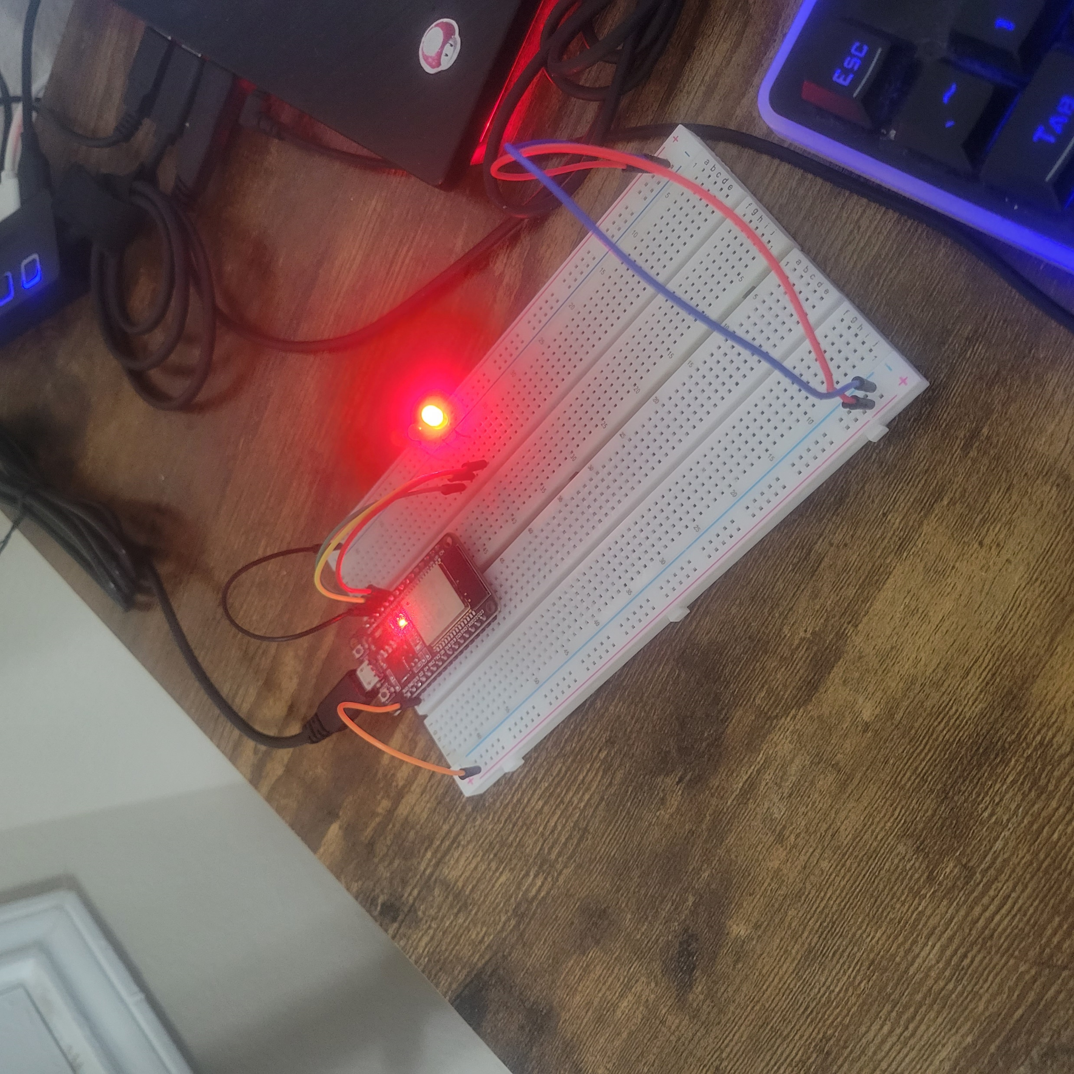
Picture of circuit with working LEDs
ESP 32 Board
Colored LEDs: Red, Yellow, and Green
220 Ohm Resistors (optional)
Wires
Breadboard

Slide 11
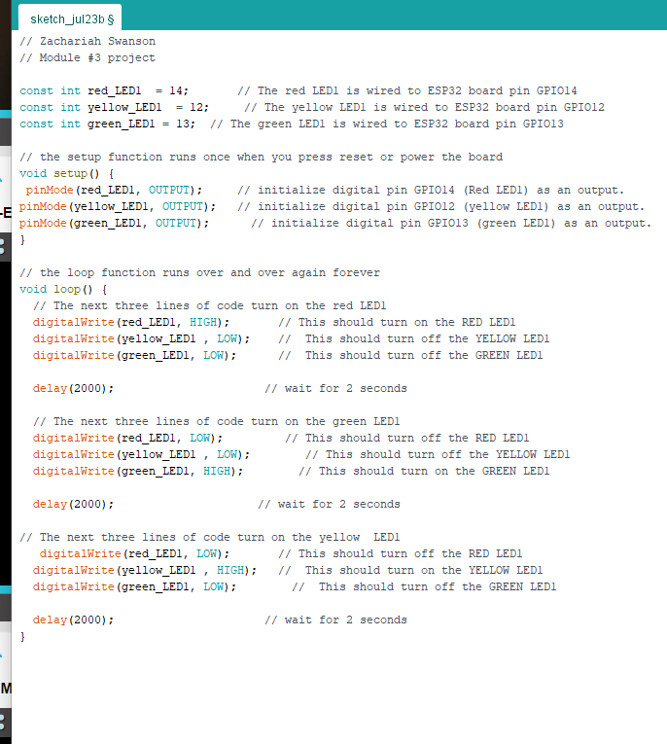
Screenshot of code in Arduino IDE
Screenshot of code in Arduino IDE. This is the base of the code for the remaining project; as it develops, it will be more challenging to fit in a screenshot.

Slide 12
Rubric –Week 4
Activity | Requirement(s)
Include a picture of your circuit | Picture of the breadboard with LEDs ON
Screenshot of code showing your name in comment | Screenshot of code in Arduino IDE showing your name in one of the comments

Slide 13
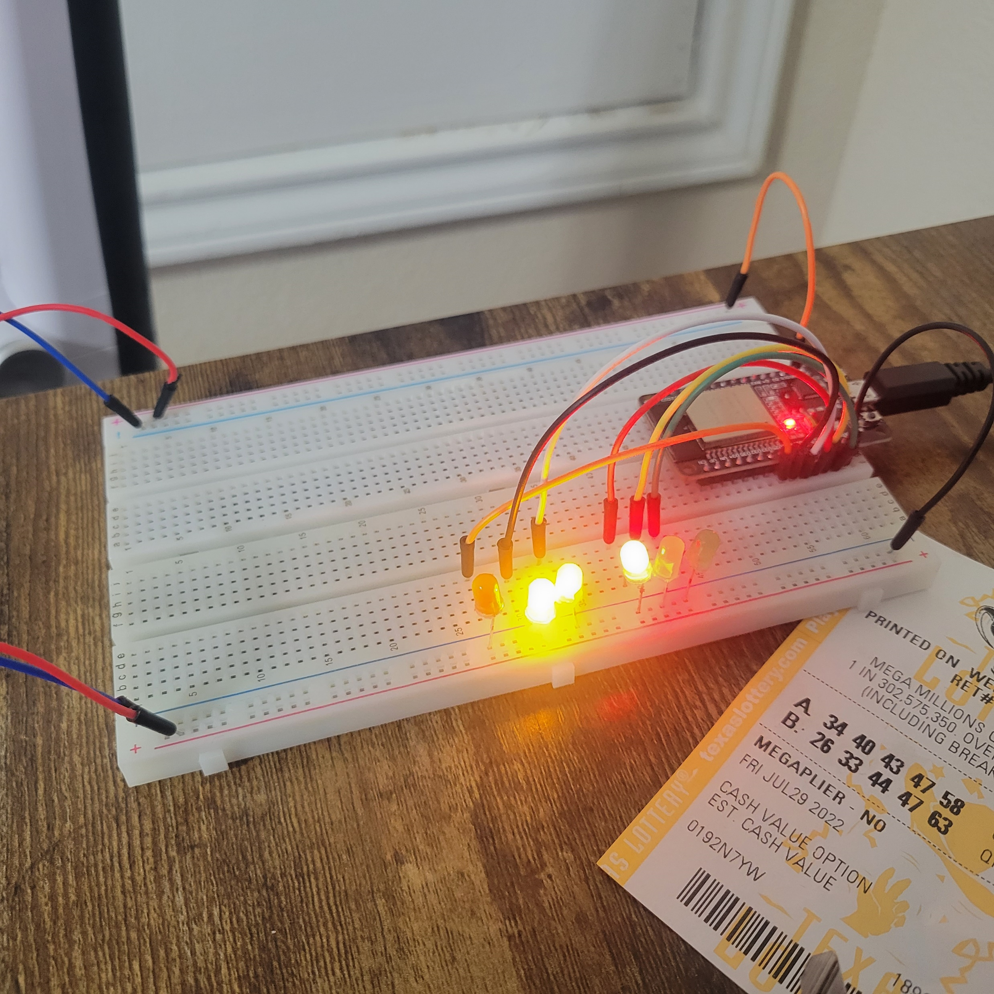
Picture of circuit with working LEDs
ESP 32 Board
Colored LEDs: Red, Yellow, and Green (two sets)
220 Ohm Resistors (optional)
Wires
Breadboard

Slide 14
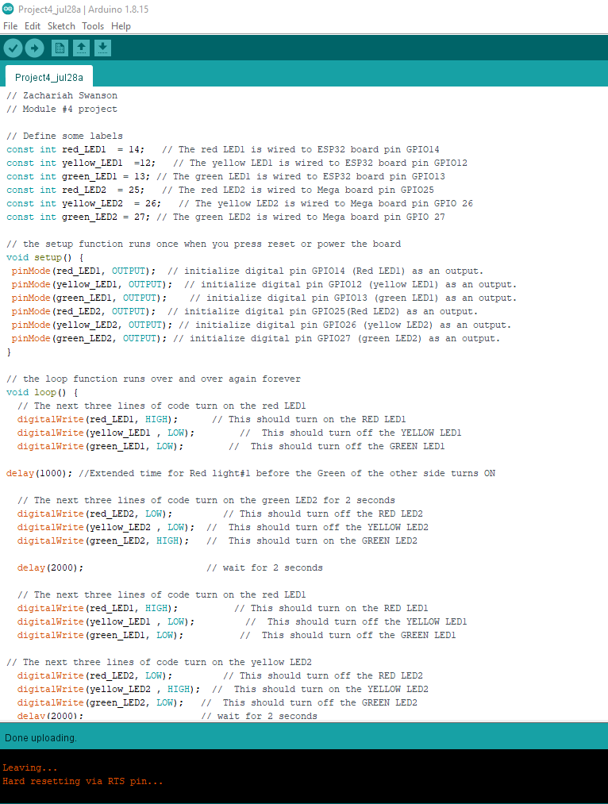
Screenshot of code in Arduino IDE
Screenshot of code in Arduino IDE. This week’s code mirrors last week’s; however, I define another set of lights and a timing system for both sets this week.

Slide 15
Rubric –week 5
Activity | Requirement(s)
Include a picture of your circuit | Picture of the breadboard with LEDs ON
Screenshot of code showing your name in comment | Screenshot of code in Arduino IDE showing your name in one of the comments
Screenshot of output in Serial Monitor | Screenshot of Serial Monitor from Arduino IDE

Slide 16
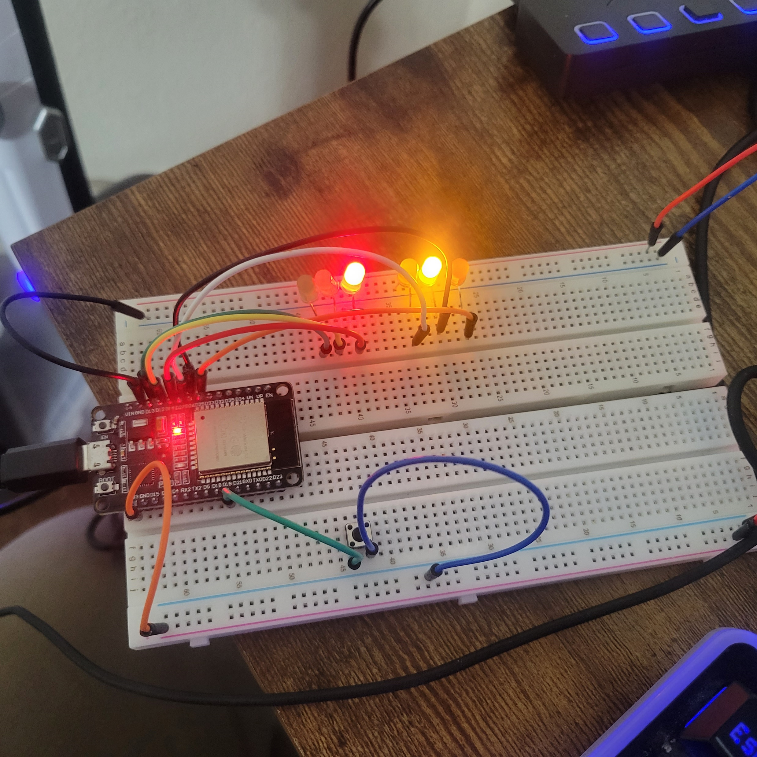
Picture of circuit with working LEDs
ESP 32 Board
Colored LEDs: Red, Yellow and Green (two sets)
220 Ohm Resistors (optional)
Push Button
Wires
Breadboard

Slide 17
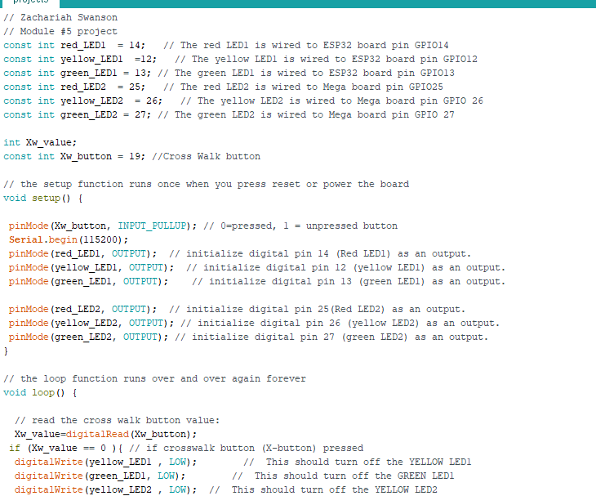
Screenshot of code in Arduino IDE
Screenshot of code in Arduino IDE. This week's code defines a button and sets up a count down from ten for the crosswalk.

Slide 18
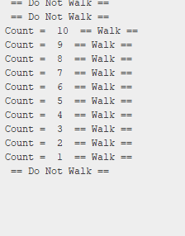
Screenshot of Serial Monitor in Arduino IDE
Screenshot of output in Serial Monitor.
This is a test of the button later to be displayed on the LCD

Slide 19
Rubric –Week 6
Activity | Requirement(s)
Include a picture of your circuit | Picture of the breadboard with LEDs ON and LCD displaying message
Screenshot of code showing your name in comment | Screenshot of code in Arduino IDE showing your name in one of the comments
Screenshot of output in Serial Monitor | Screenshot of Serial Monitor from Arduino IDE

Slide 20
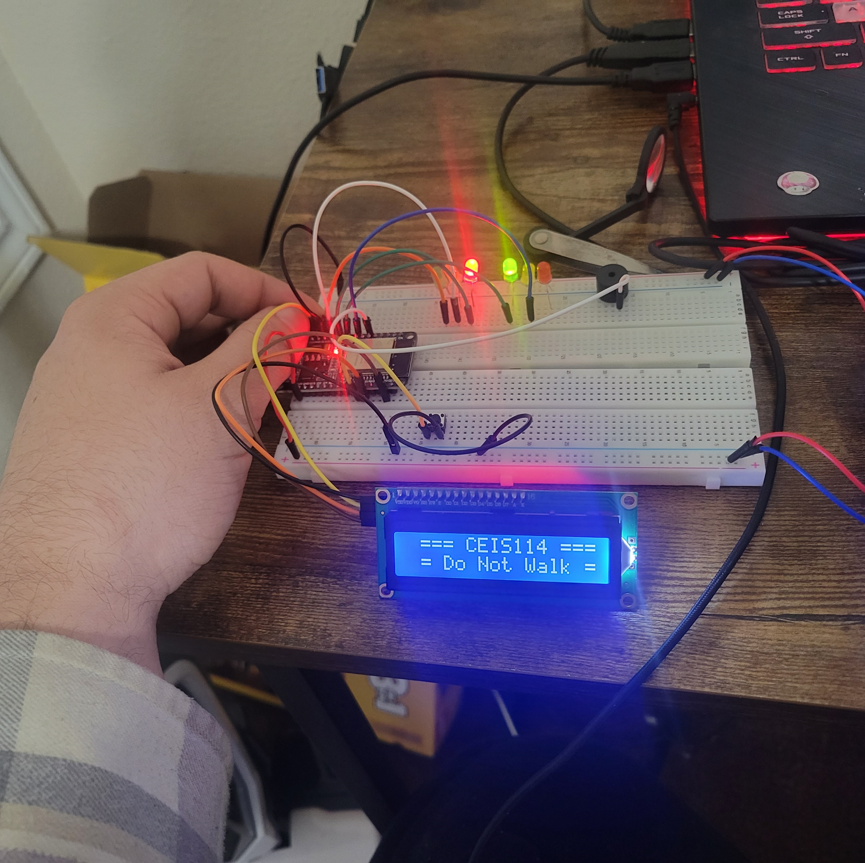
Picture of circuit with working LEDs and LCD display
ESP 32 Board
Colored LEDs: Red, Yellow and Green (two sets)
220 Ohm Resistors (optional)
Push Button
LCD Unit with Message Display
Wires
Breadboard

Slide 21
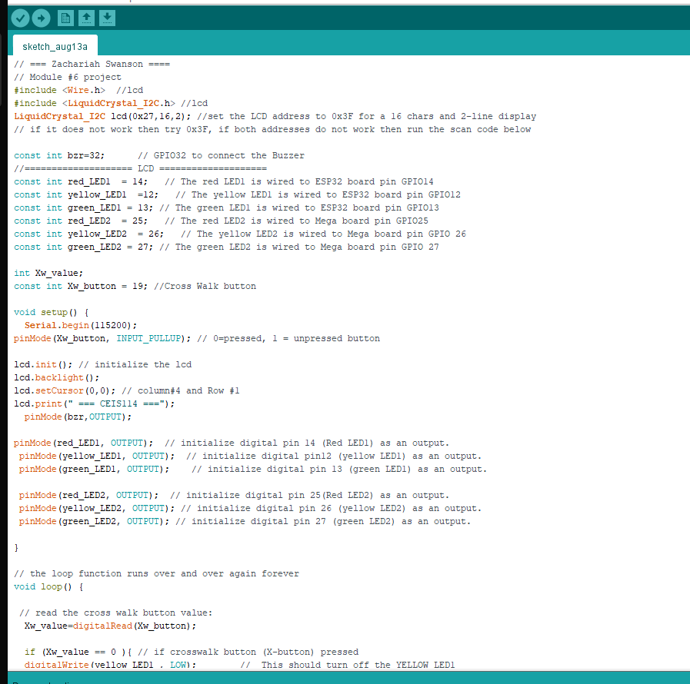
Screenshot of code in Arduino IDE
Screenshot of code in Arduino IDE.
This week I define the LCD and test that it displays a passive message.

Slide 22
Screenshot of Serial Monitor in Arduino IDE
Screenshot of output in Serial Monitor.
Once the button is pressed, the LCD will display the countdown.

Slide 23
Rubric – Week 7
Activity | Requirement(s)
Include a picture of your circuit | Picture of the breadboard with LEDs ON, LCD displaying message and motion sensor in place.
Screenshot of code showing your name in comment | Screenshot of code in Arduino IDE showing your name in one of the comments
Screenshot of output in Serial Monitor | Screenshot of Serial Monitor from Arduino IDE

Slide 24
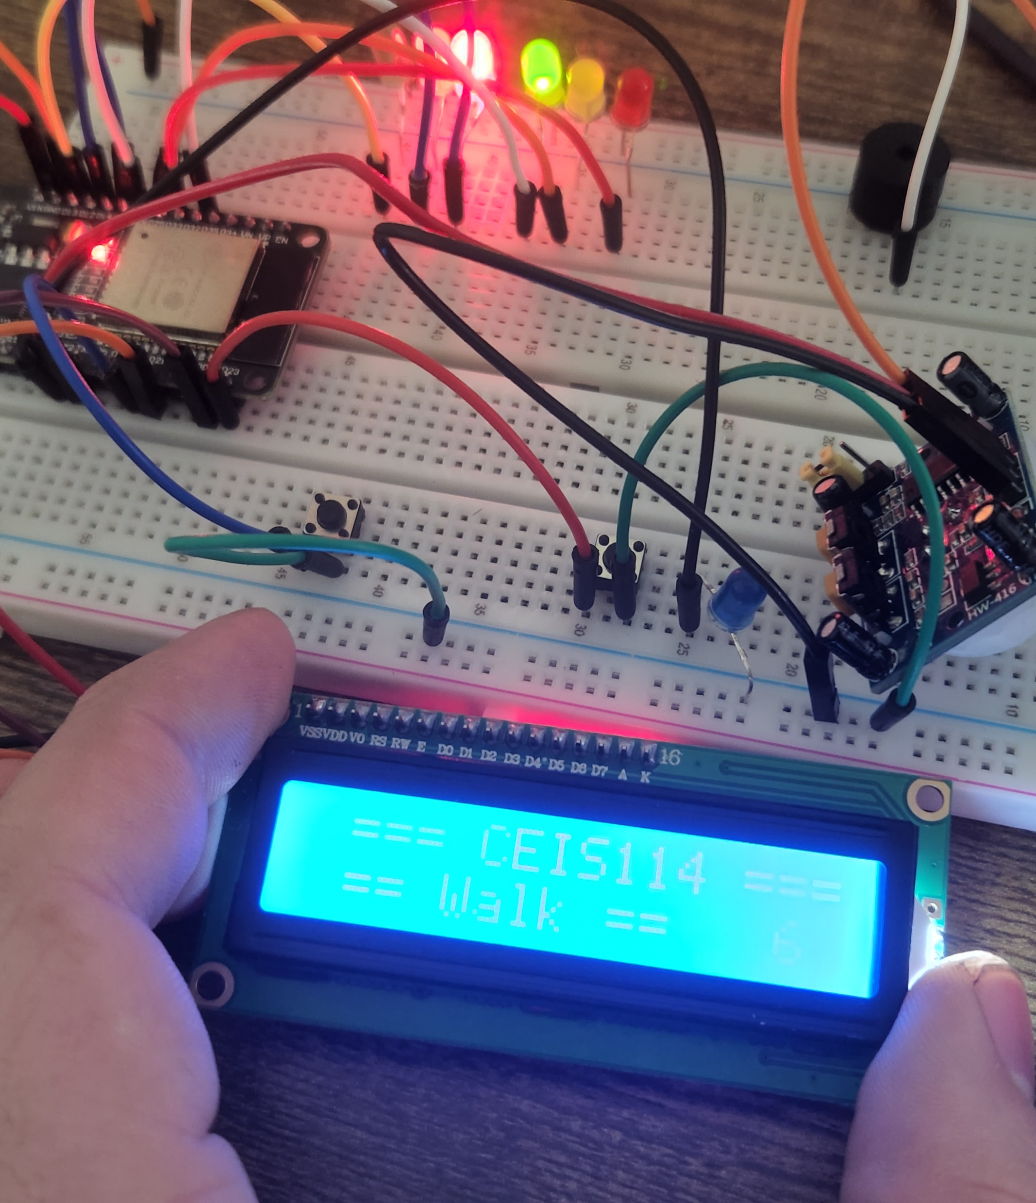
Picture of circuit with working LEDs and LCD display
ESP 32 Board
Colored LEDs: Red, Yellow, and Green (two sets)
One Blue LED – Emergency Light
220 Ohm Resistors (optional)
Push Buttons - 2
LCD Unit
Buzzer
PIR Motion Sensor
Router
Wires
Breadboard

Slide 25
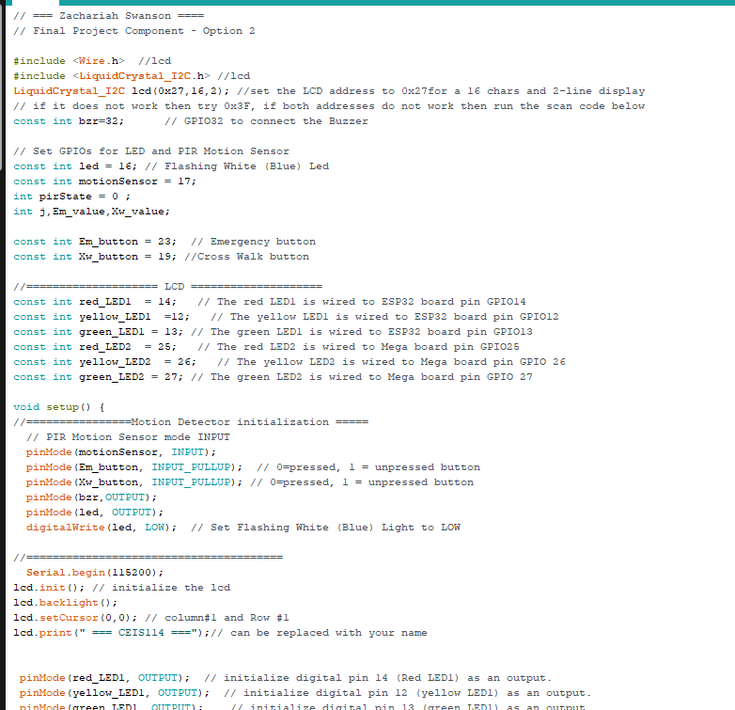
Screenshot of code in Arduino IDE
Screenshot of code in Arduino IDE. I define an emergency light and the motion sensor in this final step. When the motion sensor detects movement, the second set of lights will activate.

Slide 26
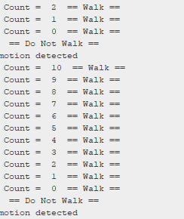
Screenshot of Serial Monitor in Arduino IDE
Screenshot of output in Serial Monitor
Ensuring that the Serial Monitor shows all the messages as intended.

Slide 27

Summary
With PowerPoint, I showed the process I took to wire, code, and test a traffic light with a provided scenario.

Slide 28


Thank You
Zachariah Swanson
https://michaelswanzach.wixsite.com/my-site

