Slide 1

This project is a presentation on working with VM in Microsoft Azure.
Presented by Zachariah Swanson

Slide 2
Goal: create run and remove a VM in Microsoft Azure
Tasks | Display
Deploying a VM in Azure | Screenshot
Connecting to the VM | Screenshot
Deleting the VM | Screenshot

Slide 3
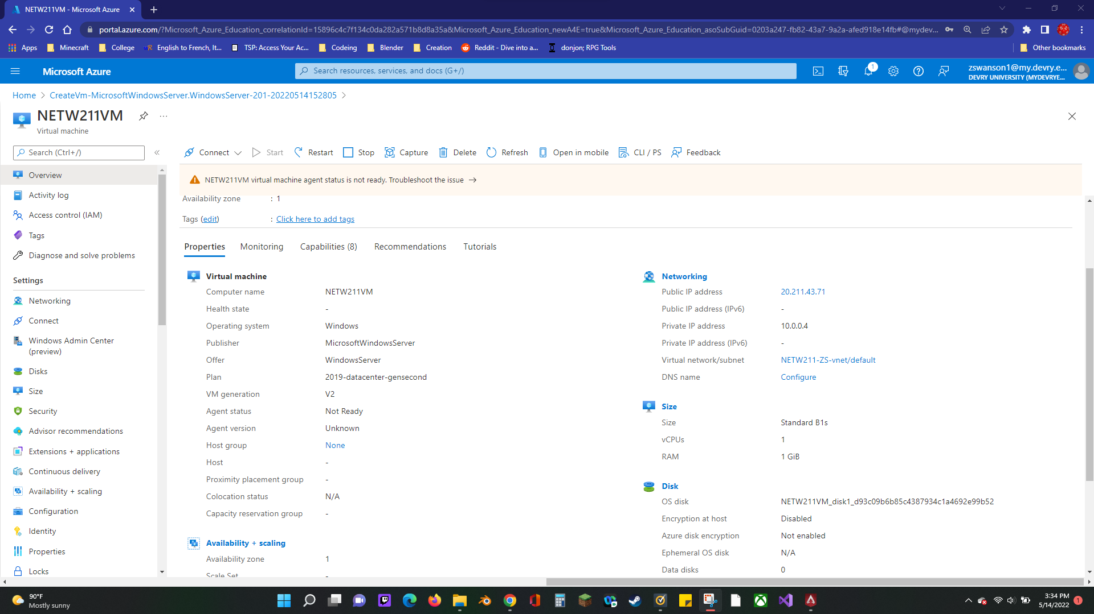
Deploying a VM in Azure
This screenshot shows the NETW211VM page with information such as the resource group name, subscription, public IP address, etc.

Slide 4
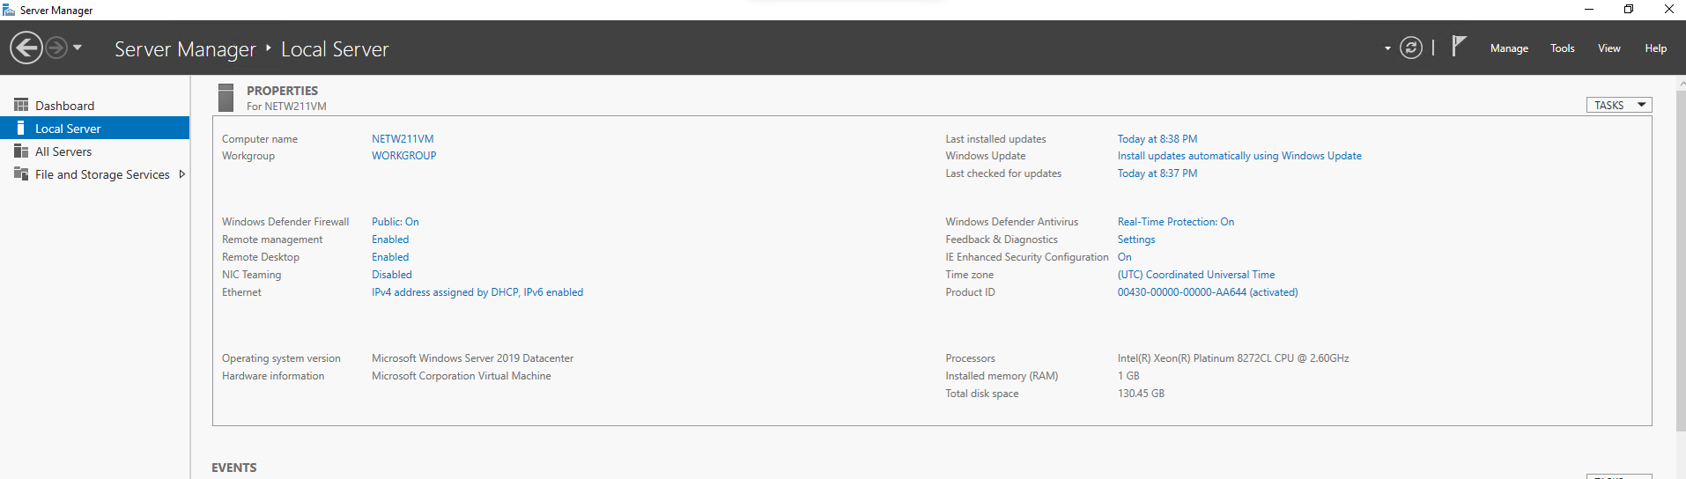
Connecting to the VM
This screenshot sows the PROPERTIES for NETW211VM page, with the computer name, operating system version, hardware information, etc.

Slide 5
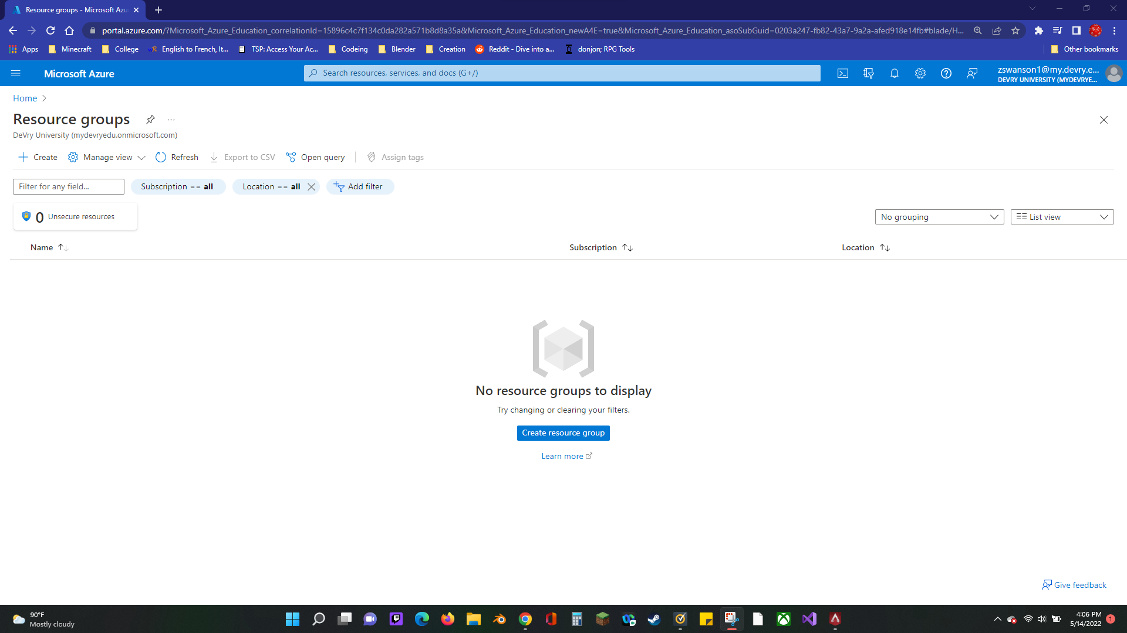
Deleting
the VM
This screenshot should show the Resource groups page, with the Azure for Students subscription selection and the “No resource groups to display” message.

Slide 6
Goal: Create a VM with two subnets and delete it safely.
Tasks | Display
Creating a VNet with Two Subnets | Questions
Deploying VMs into Subnets | Three Screenshots
Verifying Connectivity between VMs | Two Screenshots

Slide 7
Commonly asked questions.
With a /24 network prefix, how many usable IPv4 host addresses are there?
: There are 254 usable Ip addresses.
2. Why is the number of available IP addresses for Subnet0 (10.0.0.0/24) or Subnet1 (10.0.1.0/24) shown as 251?
: The service does not want to leave excess addresses for allocation.

Slide 8
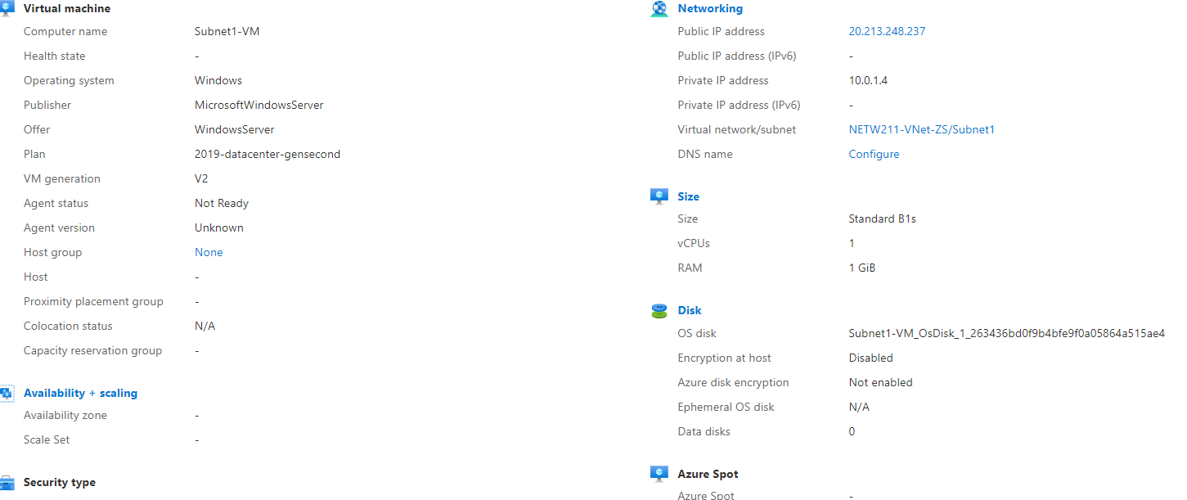
Deploying VMs into Subnets
This screenshot shows the Properties section of the Subnet0-VM page, showing the networking and size information of the VM.

Slide 9
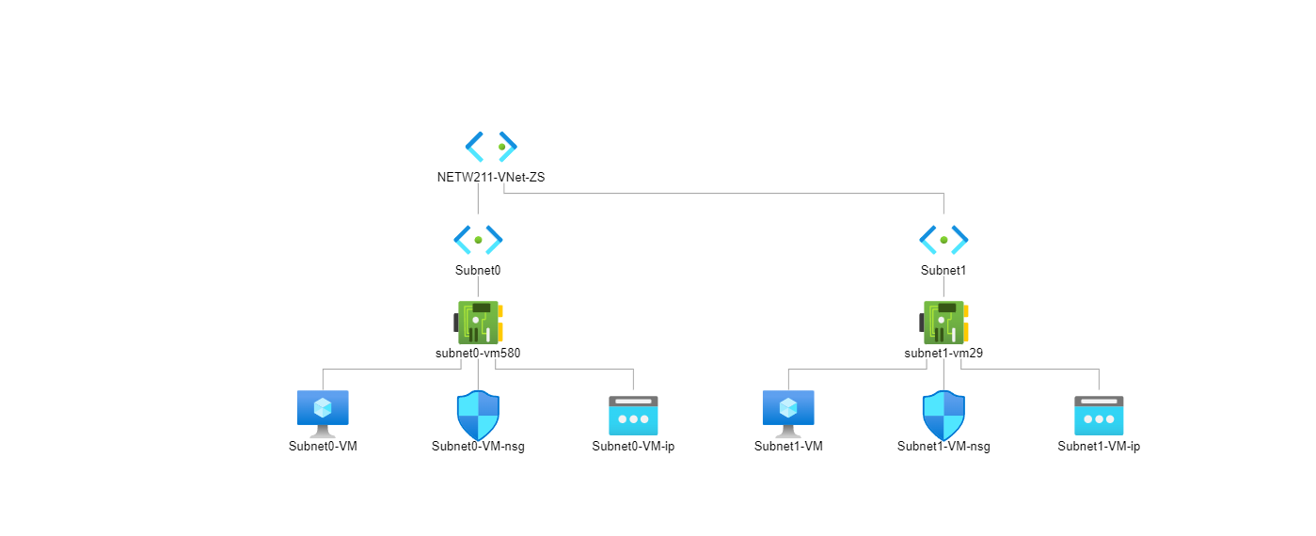
Deploying VM’s into subnets cont’d
This screenshot shows a topology diagram of the VNet NETW211-Vnet-ZS with two subnets and one VM in the subnet.

Slide 10
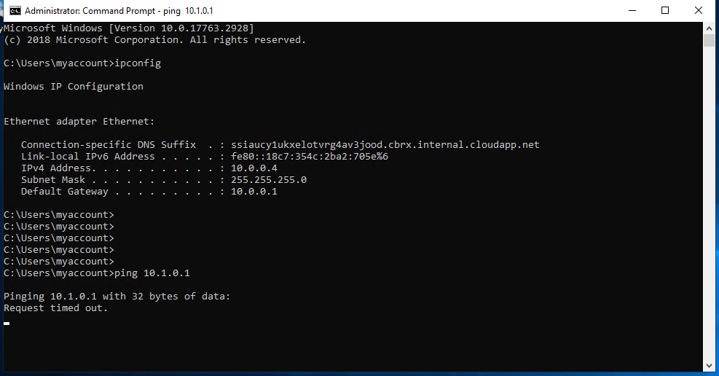
Verifying connectivity between VMs
This screenshot shows the ipconfig and ping results in the command prompt window, including the Subnet0-VM – 10.0.0.4 – Remote Desktop Connection window title.

Slide 11
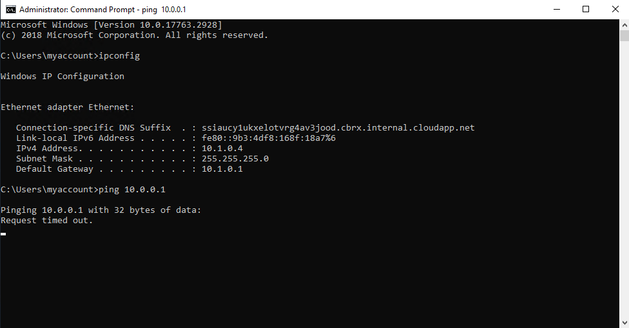
Verifying Connectivity between VMs
cont’d
This screenshot should show the ipconfig and ping results in the command prompt window, including the Subnet1-VM – 10.1.0.4 – Remote Desktop Connection window title.

Slide 12
Rubric
Goal: Configure an NSG from a VM
Tasks | Display
Launching a VM | Screenshot
Connecting to the VM via SSH | Screenshot
Configuring an NSG | Two screenshots

Slide 13
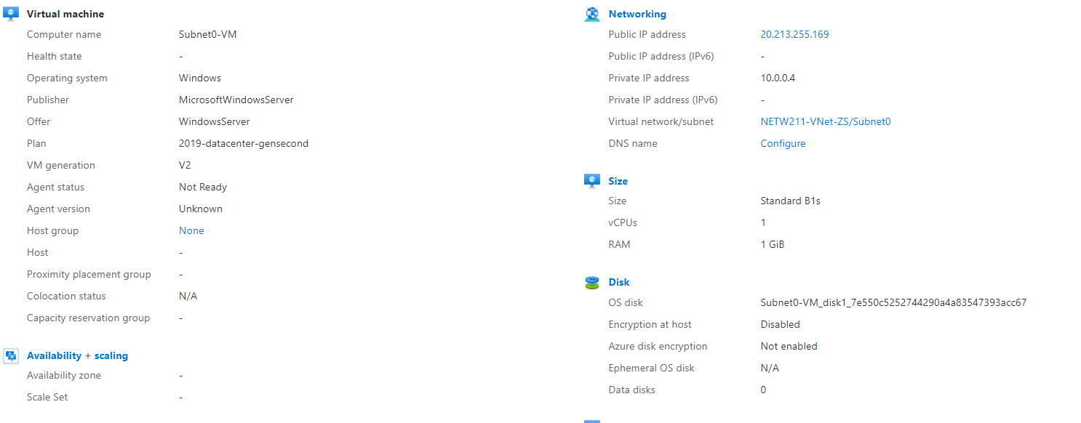
Launching a VM
This screenshot shows the NETW211-VM-ZS page, with information such as the resource group name, subscription, public IP address, etc.

Slide 14
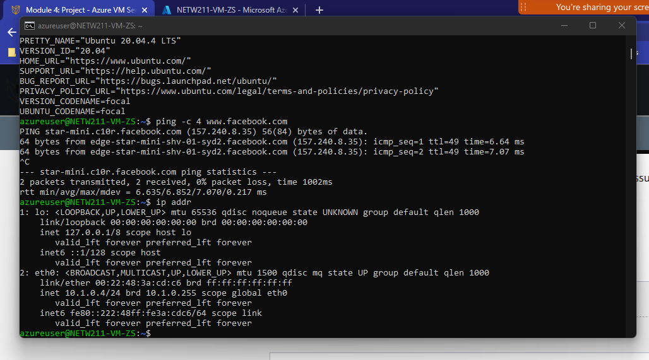
Connecting to the VM via SSH
This screenshot shows the azureuser@NETW211-VM-ZS window with the IPv4 address of the VM in the Azure cloud.

Slide 15
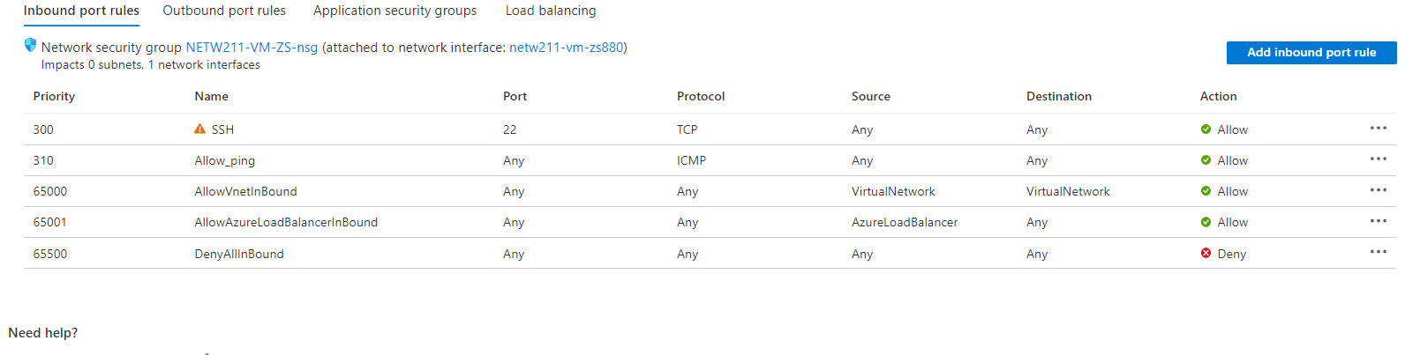
Configuring an NSG
This screenshot shows the Inbound port rules section with the newly added Allow_Ping rule.

Slide 16
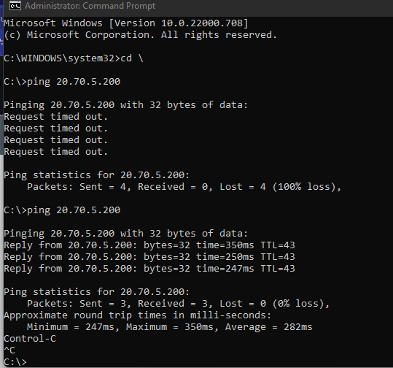
Configuring an NSG cont’d
This screenshot shows the successful ping result from my local computer to the VM in the Azure cloud.

Slide 17
Goal uploading and accessing a file using Blob snapshots and Versioning
Tasks | Display
Uploading and Accessing a File | Screenshot
Creating Blob Snapshots | Question, Screenshot
Enabling Blob Versioning | Screenshot

Slide 18
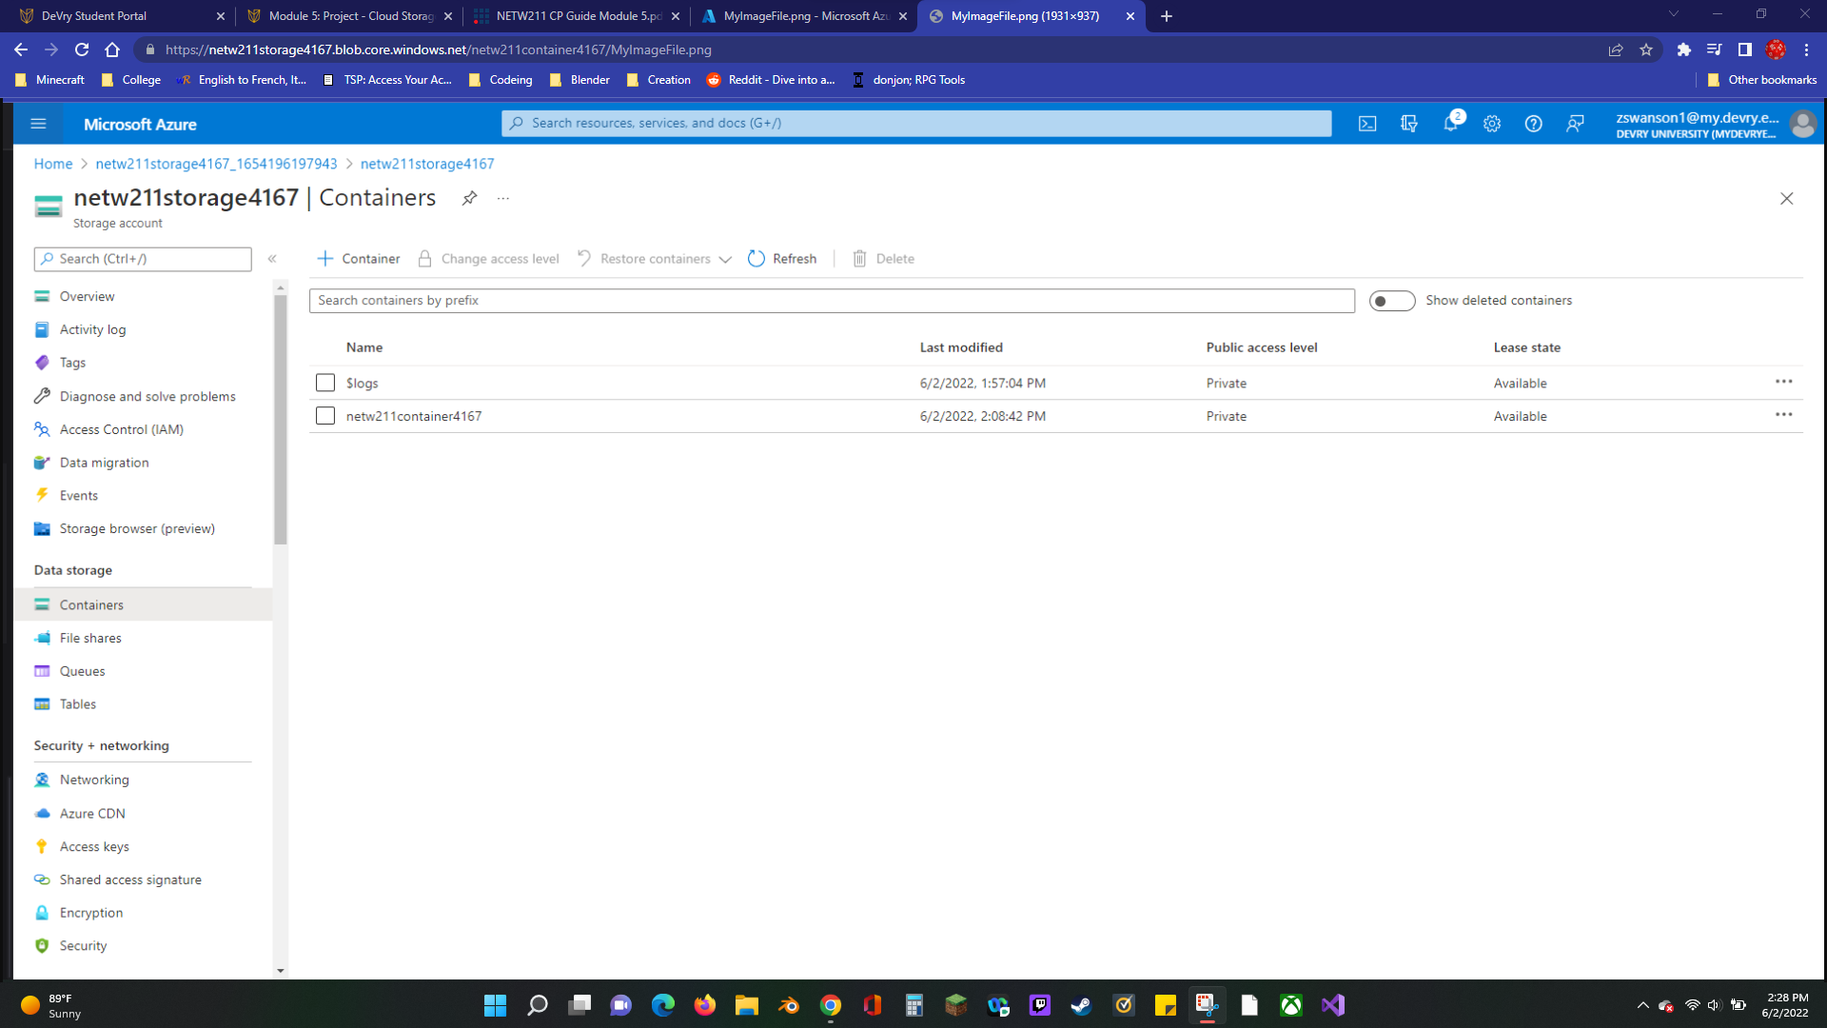
Uploading and Accessing a File
This screenshot shows the browser window with the image uploaded from your local computer and the URL on top of the window.

Slide 19

Popular question
What does the access tier setting do? What are the Azure blob storage access tiers?
: It optimizes storage costs by placing your data in the appropriate access tier. Hot, Hot (inferred), Cool, and Archive are the blob access tiers.

Slide 20
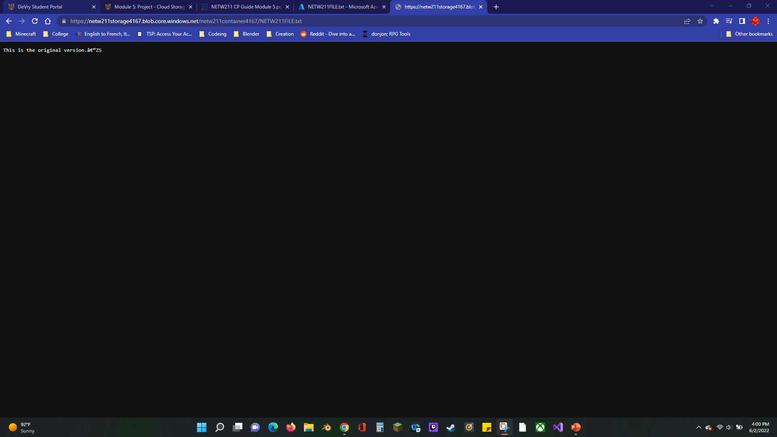
Creating Blob Snapshots
This screenshot shows the browser window with the “This is the original version. –ZS” message and the URL on top of the window

Slide 21
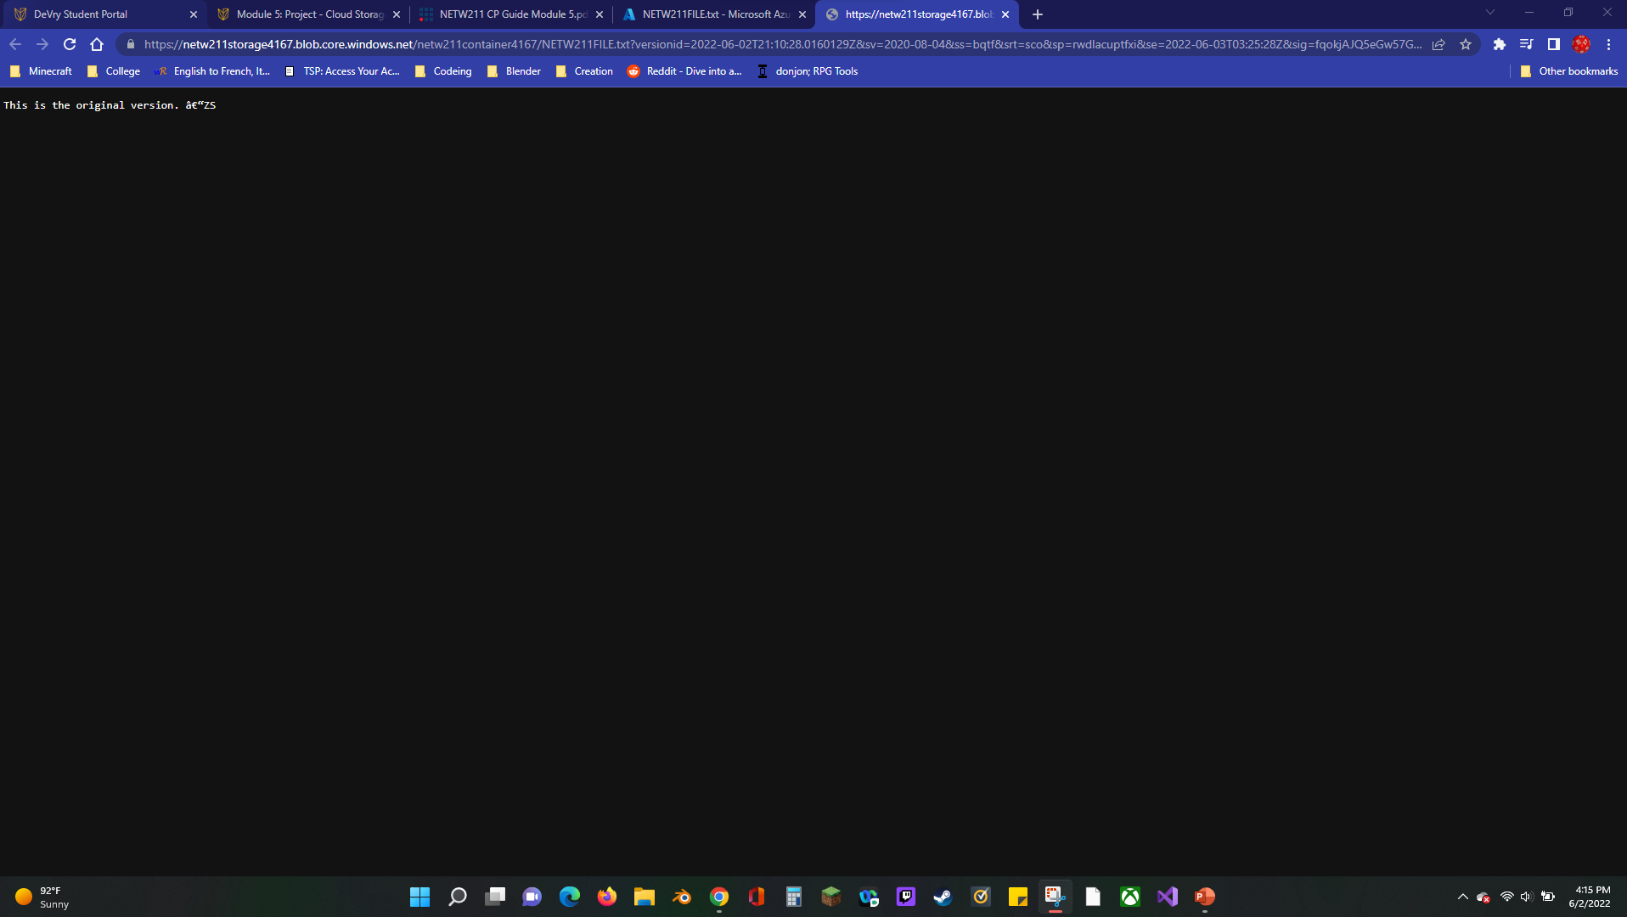
Enabling Blob Versioning
This screenshot shows the browser window with the “This is the first revised version. –ZS” message and the URL on top of the window.

Slide 22
Goal: Setting an alert for a VM.
Tasks | Display
Setting up an Action Group and Notifications | Screenshot
Setting up Alert Rules | Screenshot
Testing Alerts | Two screenshots

Slide 23
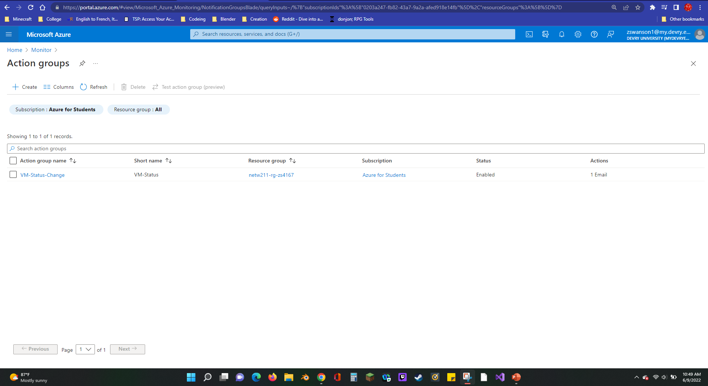
Setting up an Action Group and Notifications
This screenshot shows the “VM-Status-Change” action group on the Manage actions page.

Slide 24
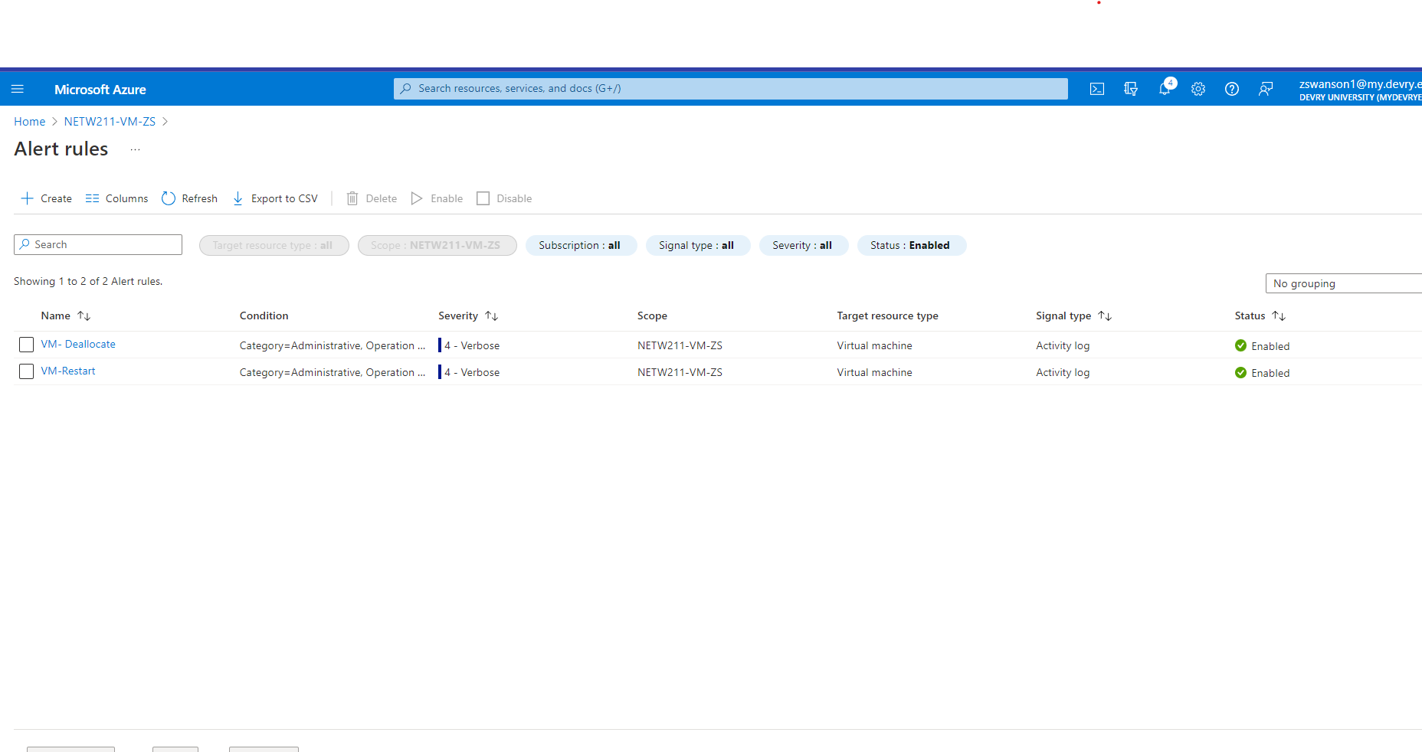
Setting up Alert Rules
This screenshot shows the Alert rules window showing the VM-Deallocate and VM-Restart rules.

Slide 25
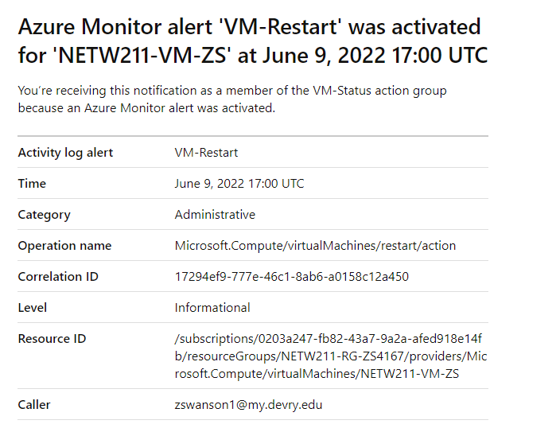
Testing Alerts
This screenshot shows the ‘VM-Restart’ was activated email message with the date and time of the alert.

Slide 26
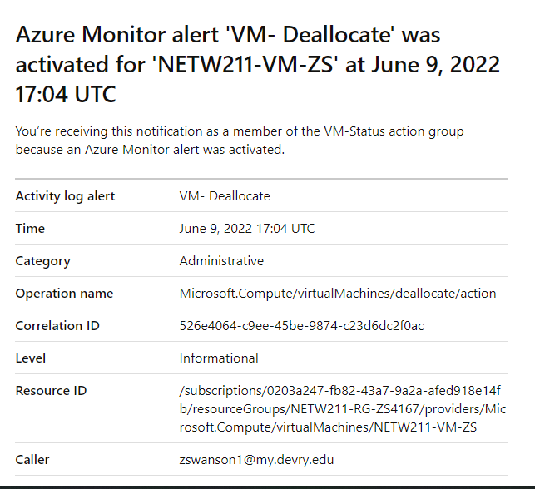
Testing Alerts cont’d
This screenshot shows the ‘VM-Deallocate’ was activated email message with the date and time of the alert.

Slide 27

Thank you for taking an interest in this project.
Zachariah Swanson
Email: michaelswanzach@gmail.com
Phone: (314)249-4167

