Slide 1

Exploring physics with IoT
In this slide-show I explore the world of physics using Internet of Things pack. I preformed five experiments learning basic physics along the way.

Slide 2
In the following five slides I set up the prerequisites for the experiments to follow. I must ensure I have all the requisite parts for any expiriments.

Slide 3
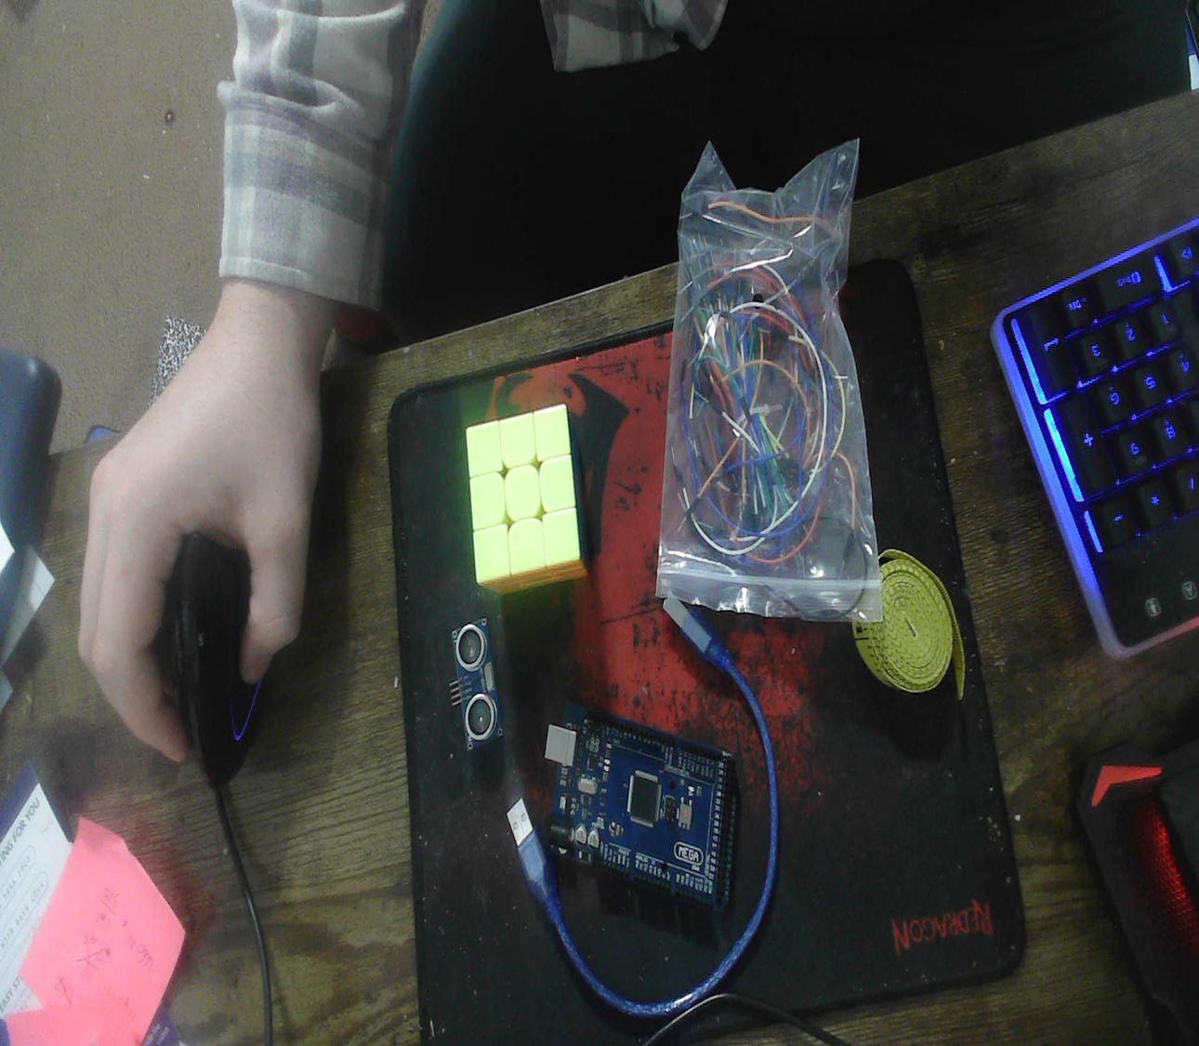
Materials List
Arduino Mega 2560
Ultrasonic sensor HC-SR04
Male to Male Wires
Breadboard
USB cable to connect Arduino
Ruler or tape measurer
Object to act as obstacle and/or undergo free-fall

Slide 4
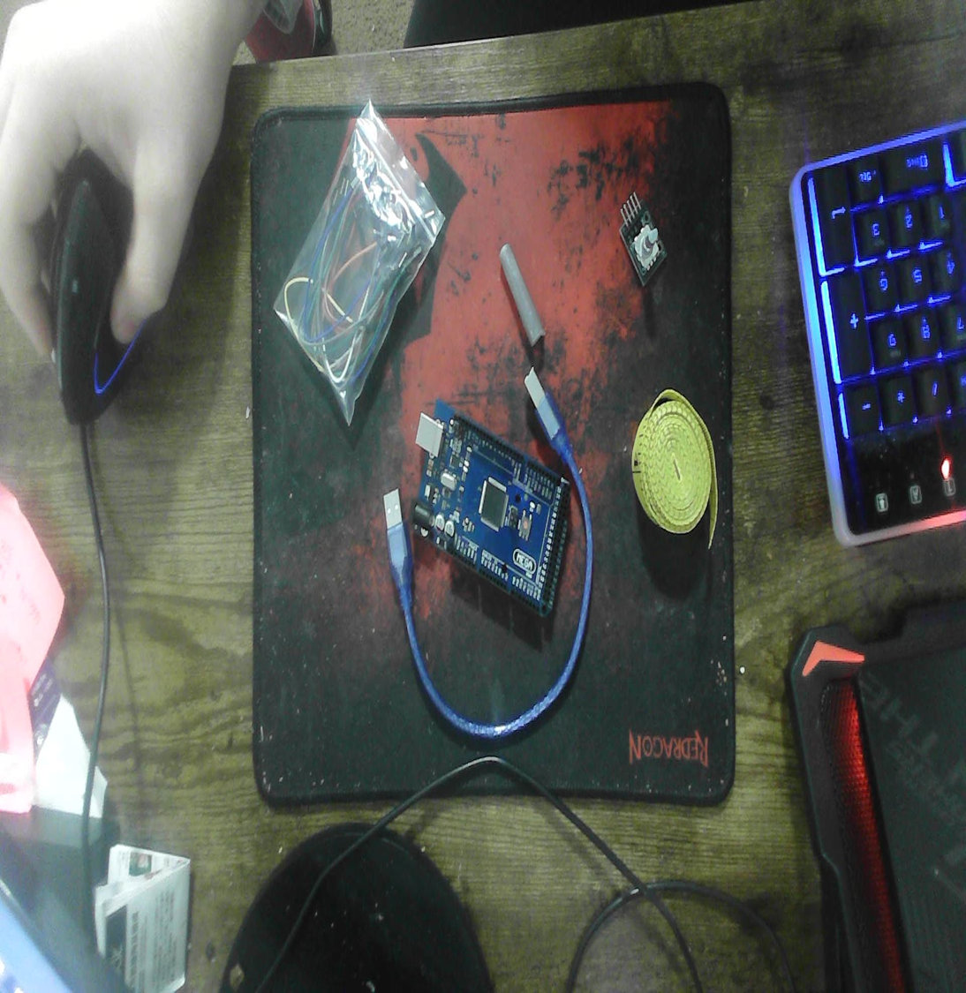
Materials List
Arduino Mega 2560
Rotary Encoder Part KY-040
Male to Female Wires
USB cable to connect Arduino
Object to attach onto rotary encoder
Ruler or tape measurer

Slide 5
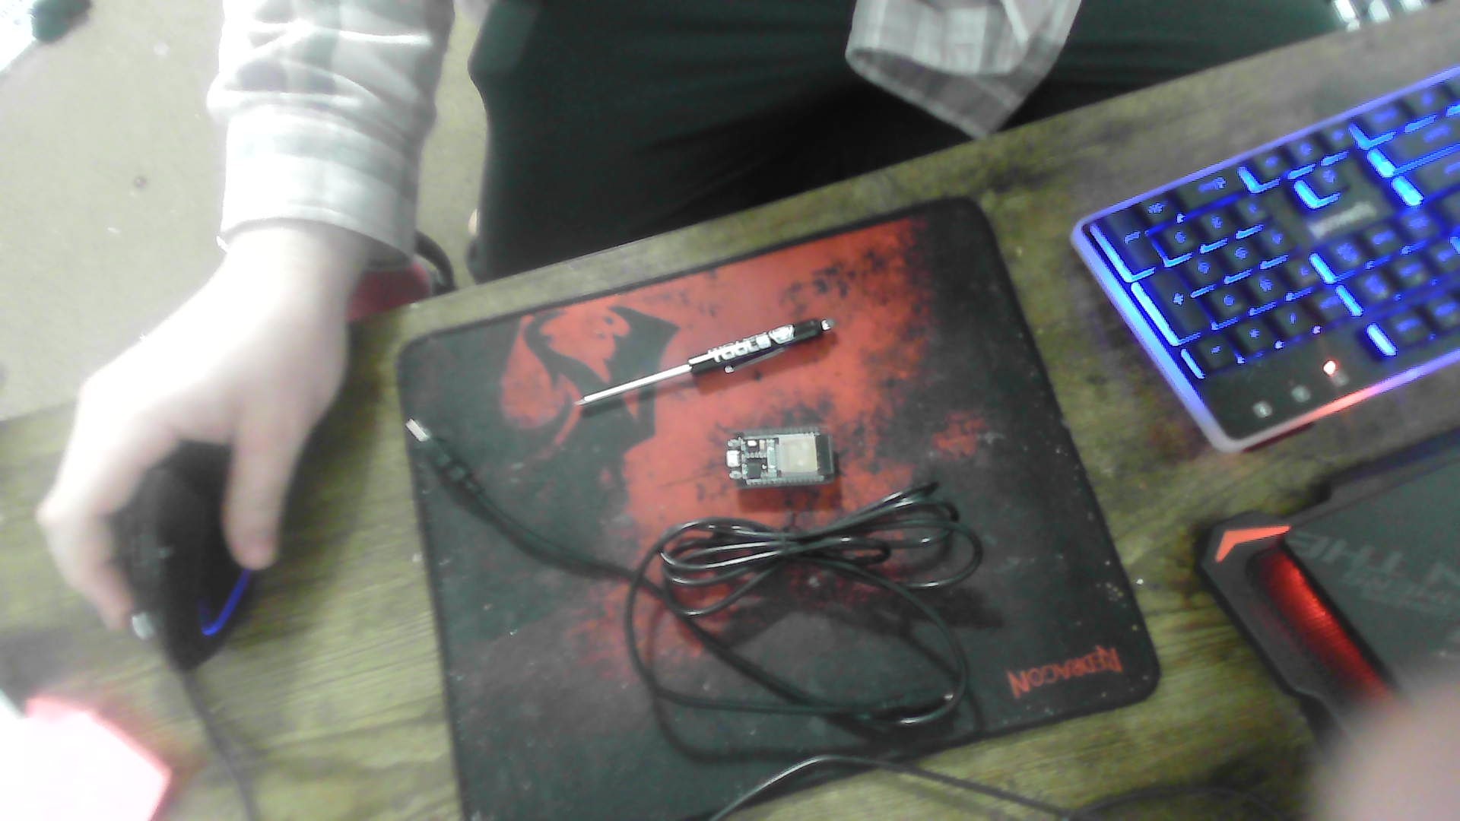
Materials List
ESP32 microprocessor
Micro-USB cable
Magnet

Slide 6
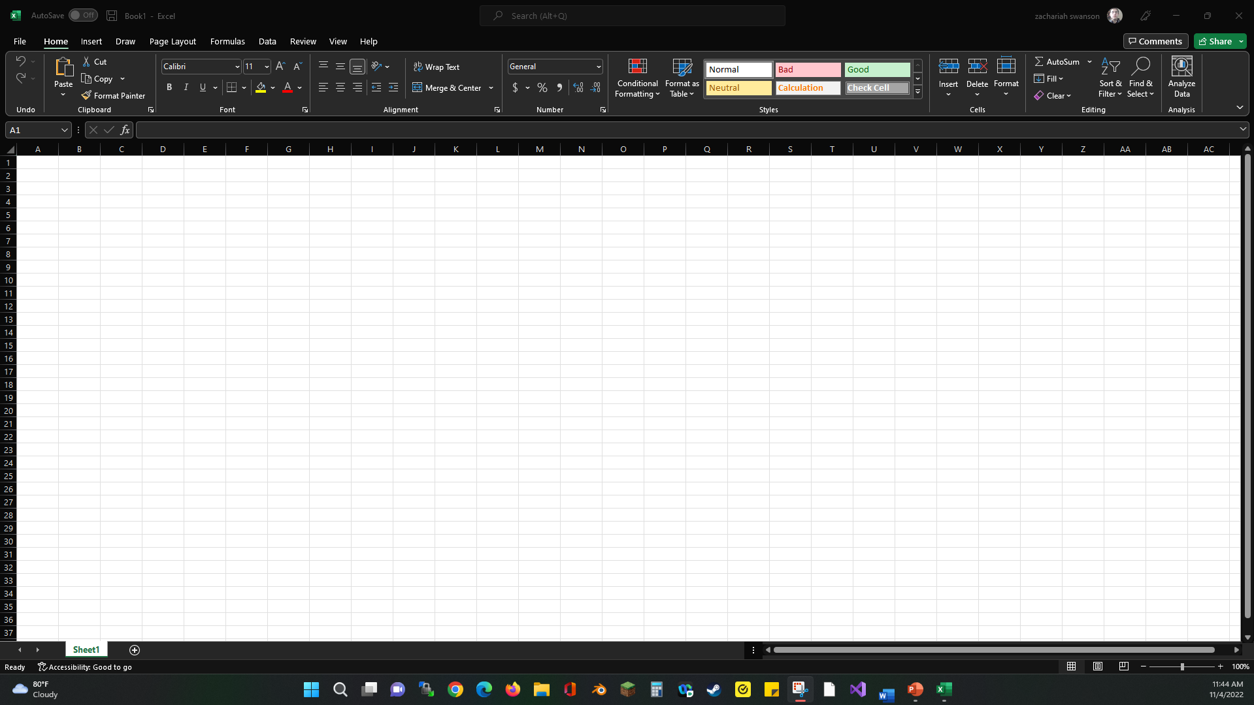
Required Software
Microsoft Excel installed and running on computer

Slide 7
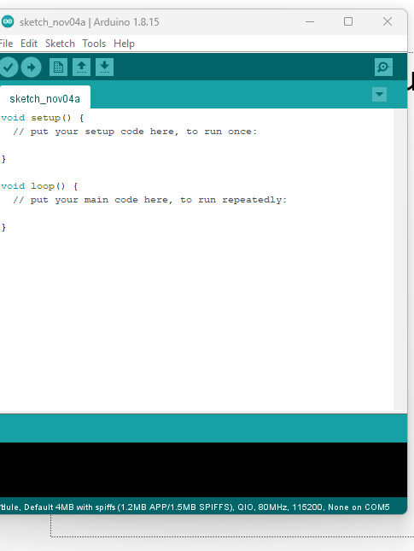
Required Software
Arduino IDE installed and running on your computer

Slide 8
In this experiment I’m testing the accuracy of the Ultrasonic sensor HC-SR04. I’m doing this in preparation for a gravity experiment.

Slide 9
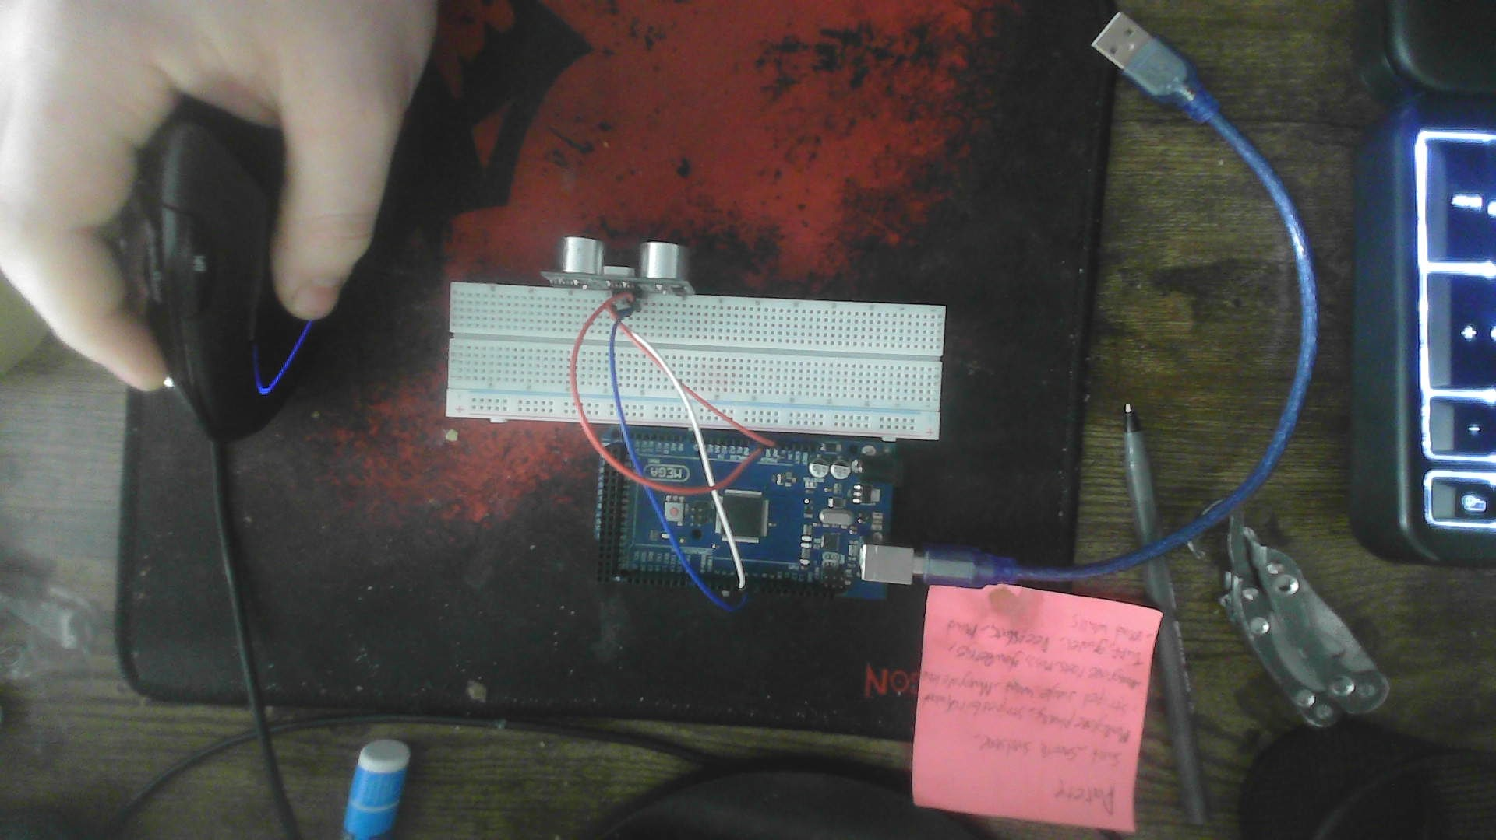
Experimental Set-up (Picture)
Materials List:
Mega 2560 Board
Ultrasonic sensor HC-SR04
Male to Male Wires
Breadboard
Ruler or tape measurer
Large and flat object to act as obstacle

Slide 10
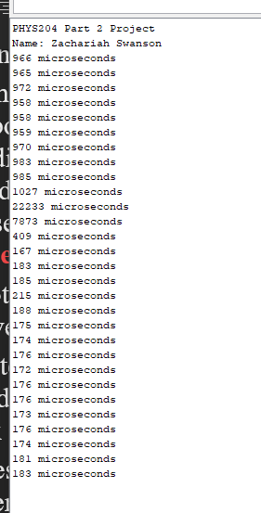
Raw Data
Screenshot of Serial Monitor from Arduino IDE showing raw data.
Must include your name displayed in the serial monitor.
Make sure “show timestamp” is NOT selected.

Slide 11
Data Collection
Trial | Ruler Distance (cm) | Total Roundtrip Distance (m) | Time from Serial Monitor (microseconds) | Roundtrip time (s) | Velocity = distance/time (m/s)
1 | 4cm | 0.04 | 176 | 0.000176 | 227
2 | 6cm | 0.06 | 185 | 0.000185 | 324
3 | 10cm | 0.010 | 198 | 0.000198 | 50.5
4 | 20cm | 0.020 | 503 | 0.000503 | 39.8
5 | 34cm | 0.034 | 958 | 0.000958 | 35.5

Slide 12
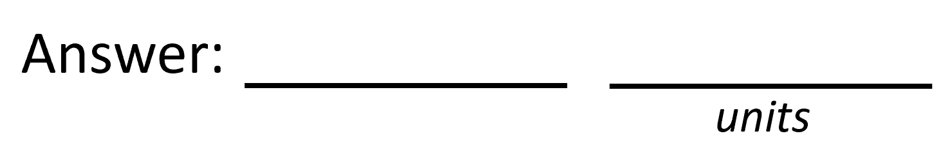
Data Analysis
Average velocity from table
Percent difference where $v_{sound}=343 m/s$
$$v_{avg}= \frac{v_{1}+v_{2}+v_{3}+v_{4}+v_{5}}{5}$$
135
m/s
$$Percent difference = \frac{\left|v_{avg}−v_{sound}\right|}{v_{sound}}×100$$
60.6
%

Slide 13
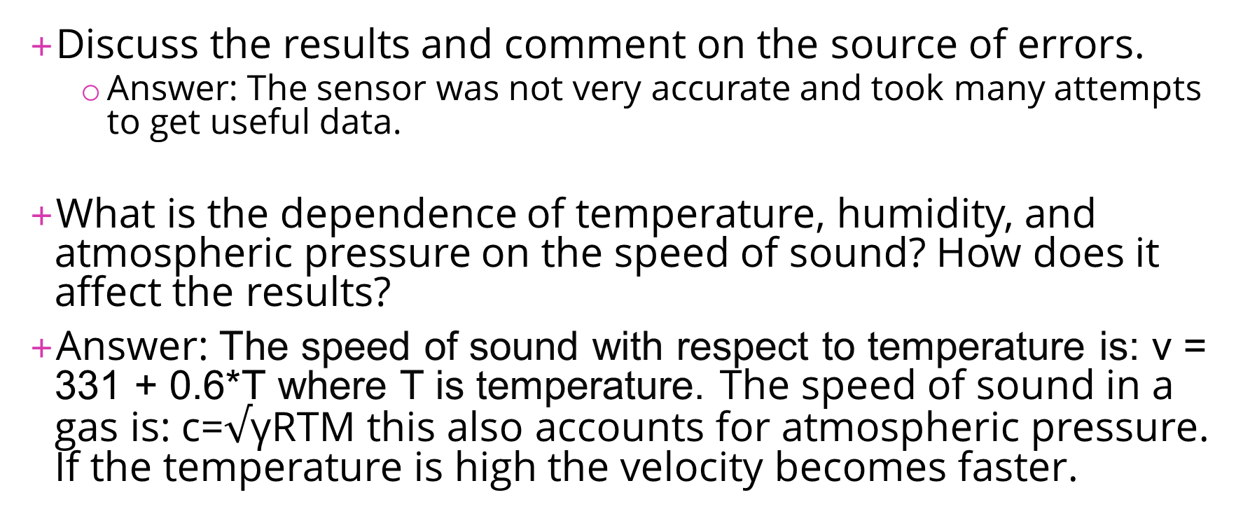
Conclusions
Discuss the results and comment on the source of errors.
  Answer: The sensor was not very accurate and took many attempts to get useful data.
What is the dependence of temperature, humidity, and atmospheric pressure on the speed of sound? How does it affect the results?
Answer: The speed of sound with respect to temperature is: v = 331 + 0.6*T where T is temperature. The speed of sound in a gas is: c=$√\text{γ}$RTM this also accounts for atmospheric pressure. If the temperature is high the velocity becomes faster.

Slide 14
This is my gravity experiment. I use a 7inch notebook weighing 1.38Lbs and dropping it from 3cm away form the sensor. The sensor detects the book and tracks its movement in microseconds until it hits the ground. I then take that data for statistical data.

Slide 15
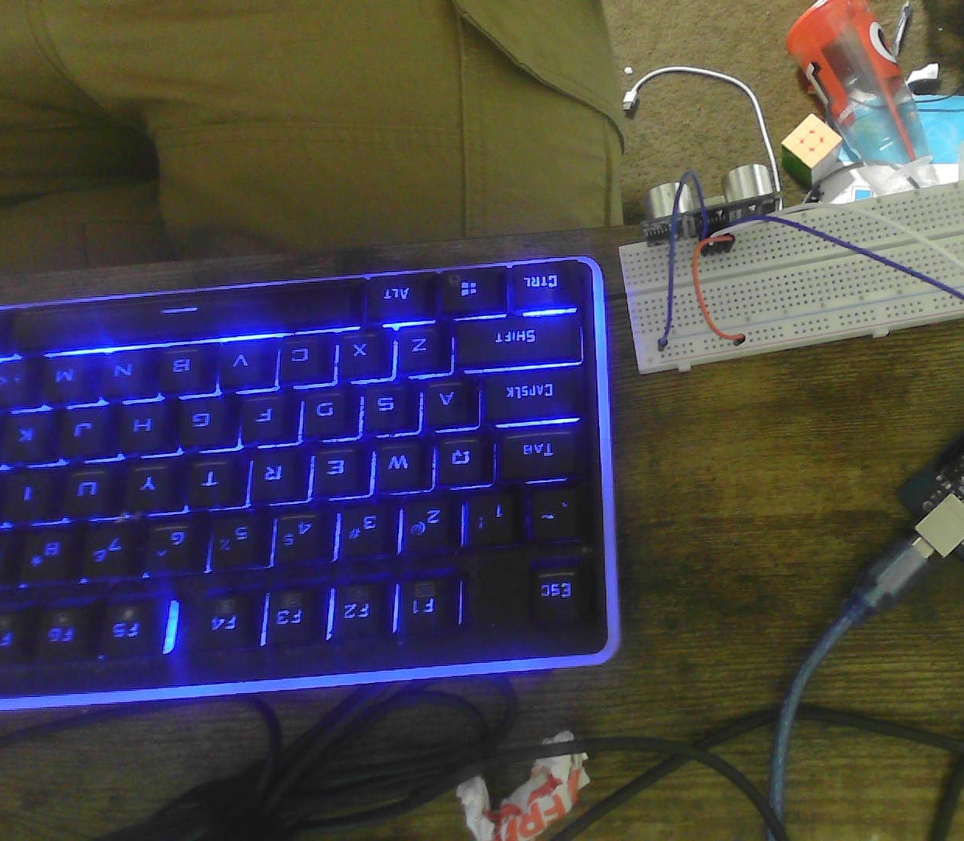
Experimental Set-up (Picture)
Materials List:
Mega 2560 Board
Ultrasonic sensor HC-SR04
Male to Male Wires
Breadboard
Large and flat object that is not susceptible to air resistance to undergo free fall motion

Slide 16

Serial Monitor (Screenshot)
Include screenshot of raw data showing the start of the fall and end of the fall of one trial.
Must include your name displayed in the serial monitor.
Make sure “show timestamp” is NOT selected.

Slide 17
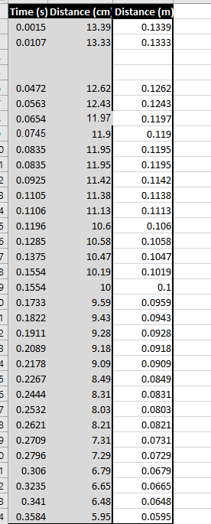
Excel Table
(Screenshot)
Include all values in the Excel table for a single trial showing the fall distance in centimeters and meters as a function of time
Be sure your drop your drop is long enough to experience free-fall.
A good drop is from a height of a table or countertop.

Slide 18
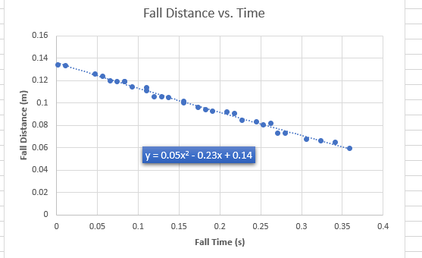
Excel Graph
(Screenshot)
Include Excel graph for a single trial showing the fall distance as a function of time.
Confirm that most data points fall along the curve fitting.
The x² coefficient should be between 2.5 and 7.5 such that its yields an acceleration value between 5 m/s² and 15 m/s²

Slide 19
Data Collection
Trial | x² coefficient value from curve fitting | Acceleration (m/s²) = 2* (x² coefficient)
1
2
3
4
5

Slide 20
Data Analysis
Average acceleration from table
Percent difference with $g=9.8 m/s^{2}$
$$a_{avg}= \frac{a_{1}+a_{2}+a_{3}+a_{4}+a_{5}}{5}$$
1.09585
m/s²
$$Percent difference =\frac{\left|a_{avg}−g\right|}{g}×100$$
88.8
m/s²

Slide 21
Data Analysis
Average acceleration from table
Percent difference with $g=9.8 m/s^{2}$
$$a_{avg}= \frac{a_{1}+a_{2}+a_{3}+a_{4}+a_{5}}{5}$$
1.09585
m/s²
$$Percent difference =\frac{\left|a_{avg}−g\right|}{g}×100$$
88.8
m/s²

Slide 22
Conclusions
Discuss the results and comment on the source of errors.
  Answer:
  The Sensor indicated points closer to it after indicating ones further away. This caused many errors.
How much variation is there from trial to trial? What does this indicate about the uncertainty of the result?
  Answer: The variation from trial to trail was small. I think this indicate despite an absolute accuracy that the results are verifiable.

Slide 23
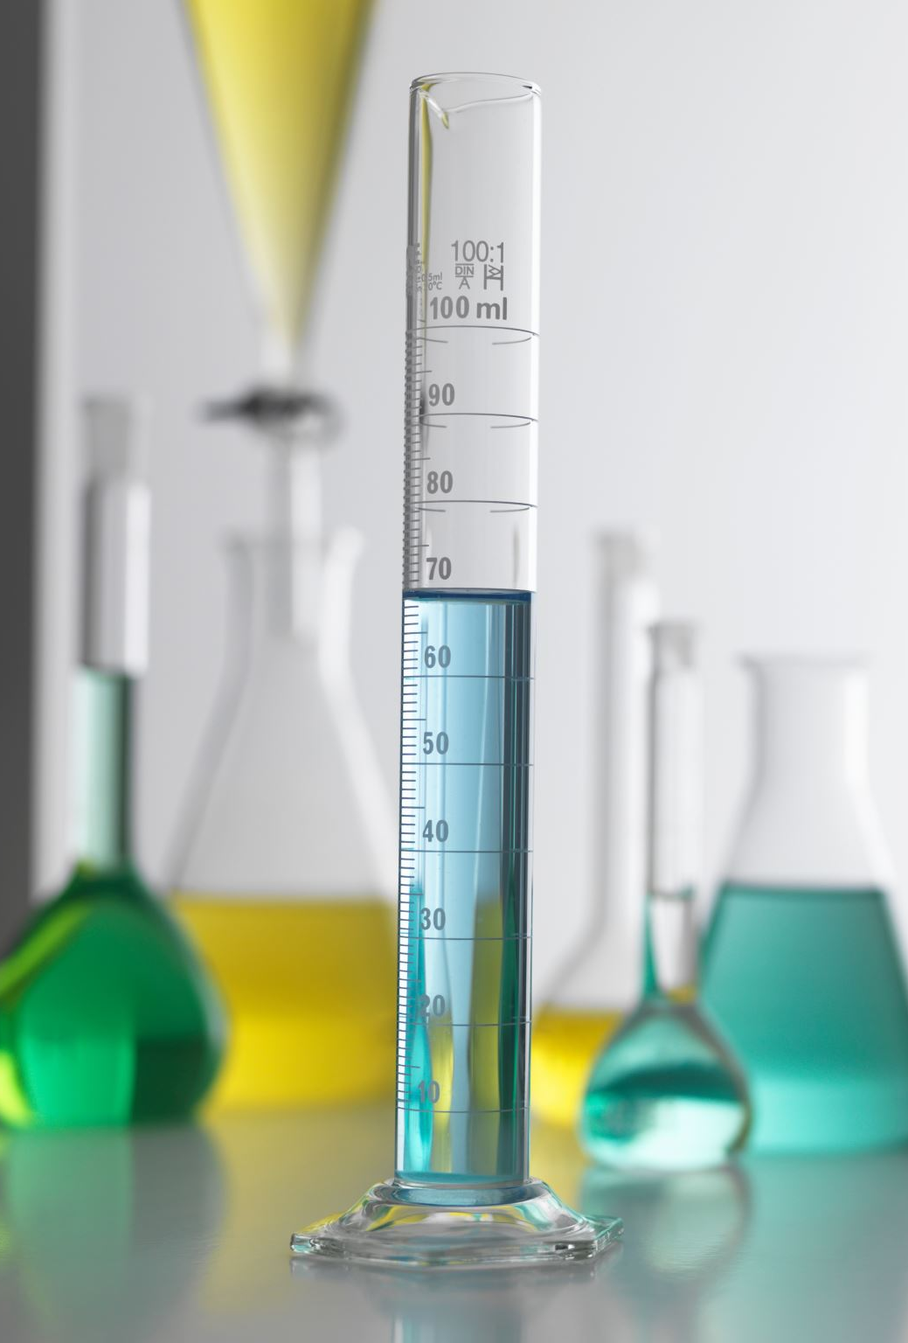
In this experiment I take the data from the last experiment in order to graph the types of energy involved and how much energy is used overall.

Slide 24
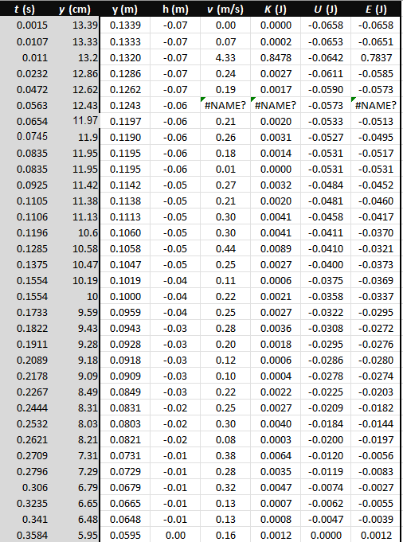
Excel Table
(Screenshot)
Include all values in the Excel table for a single trial showing the fall distance in centimeters and meters as a function of time with the values generated for kinetic energy K, potential energy U, and total mechanical energy E.

Slide 25
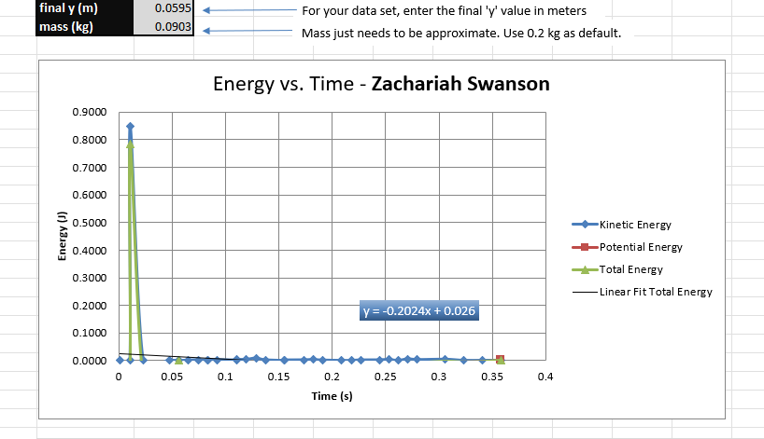
Excel Graph
(Screenshot)
Include Excel graph for a single trial showing the plots of the kinetic energy K, potential energy U, and total mechanical energy E as a function of time.
Must include your name in the title of the graph.

Slide 26
Data Analysis
Theoretical value of final velocity
Final velocity from experimental data (or largest velocity)
Percent difference
$h=y_{final}−y_{initial}=$
-0.04611
m
$v_{f}=\sqrt{2gh}=$
0.951
m/s
$v_{experimental}$ =
0.16
m/s
$$Percent difference =\frac{\left|v_{f}−v_{experimental}\right|}{v_{f}}×100$$
83.18
%

Slide 27
Conclusions
Discuss the key characteristics of the plot. Consider the points when potential energy U is maximum, U is minimum, kinetic energy K is maximum, K is minimum and when U and K are the same value. What is the significance of these points?
  Answer: Kinetic energy moves strait up the chart with a short fall the data does not spread. Potential energy does not move in my chart I could not fix this.

Slide 28
Conclusions
What is the trend of the best fit line for the total energy E in your data? If the data is accurate, the total mechanical energy should decrease slightly. Why is that?
  Answer: The mechanical energy does not account for potential energy, but total energy does.

Slide 29
In this experiment I use the Rotary Encoder part KY-040 against a flat surface to calculate accuracy.

Slide 30
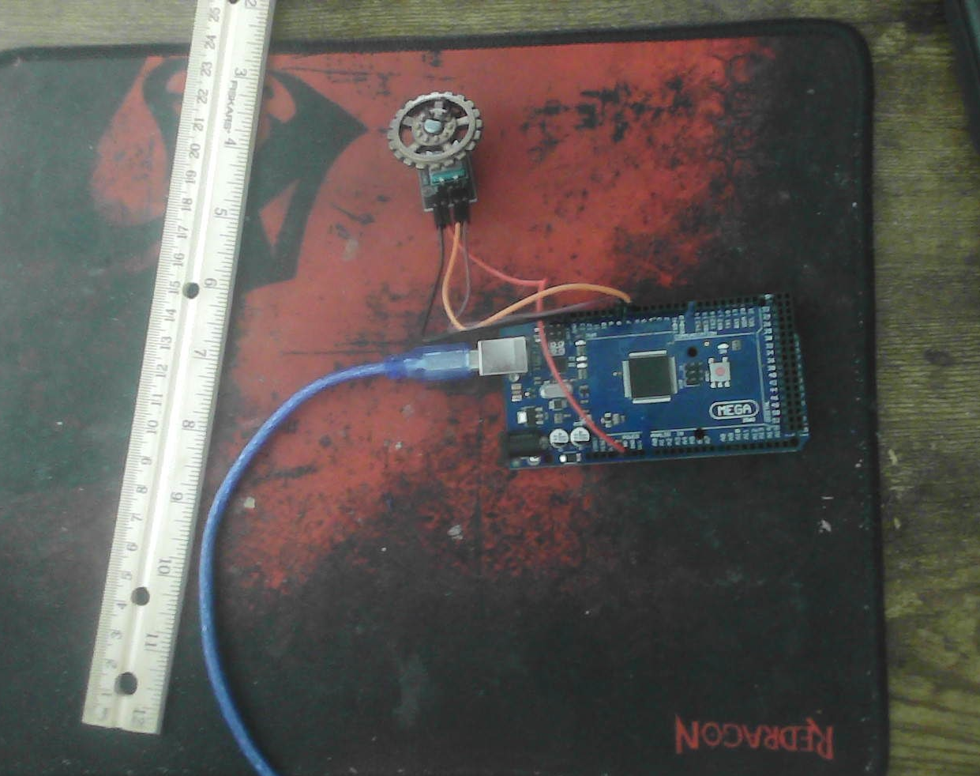
Experimental Set-up (Picture)
Materials List:
Mega 2560 Board
Rotary Encoder Part KY-040
Male to Female Wires
Object to attach onto rotary encoder
(e.g. cork, bottle cap, ball)
Ruler or tape measurer

Slide 31
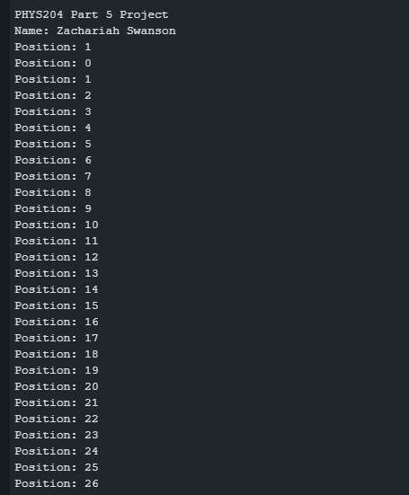
Raw Data (Screenshot)
Screenshot of Serial Monitor from Arduino IDE showing raw data.
Must include your name displayed in the serial monitor.

Slide 32
Data Collection
Object diameter: d =
Object radius: r =
Number of pulses for one revolution: x =
Resolution = $\left(\frac{1 }{x } \frac{Revolution}{pulses}\right)∙\left(\frac{2∙π radians}{1 Revolution}\right)=$
3
cm
1.5
cm
30
Radianspulse
0.209

Slide 33
Data Analysis
Trial | Number of pulses N | Encoder distance r$∙Resolution∙$ N | Measured distance with ruler | Percent difference
1 | 9 | 2.82 cm | 5cm | 43.6%
2 | 26 | 8.15cm | 10cm | 18.5%
3 | 36 | 11.29cm | 13cm | 13.15%
4 | 60 | 18.81cm | 21cm | 5.95%
5 | 8 | 2.51cm | 3cm | 16.33%

Slide 34
Conclusions
Discuss the results and comment on the sources of error.
  Answer: reviewing my results it seems the more distance covered the more accurate the measurement. Although at 3cm the % difference was lower then at 5cm.
What are some applications of this measuring technique? Could this measuring system be used to measure surfaces that are not flat?
  Answer: This measurement system would be good at determining the an approximant diameter of the earth.

Slide 35
In this experiment I use a magnet and the ESP32 to observe the Hall effect.

Slide 36
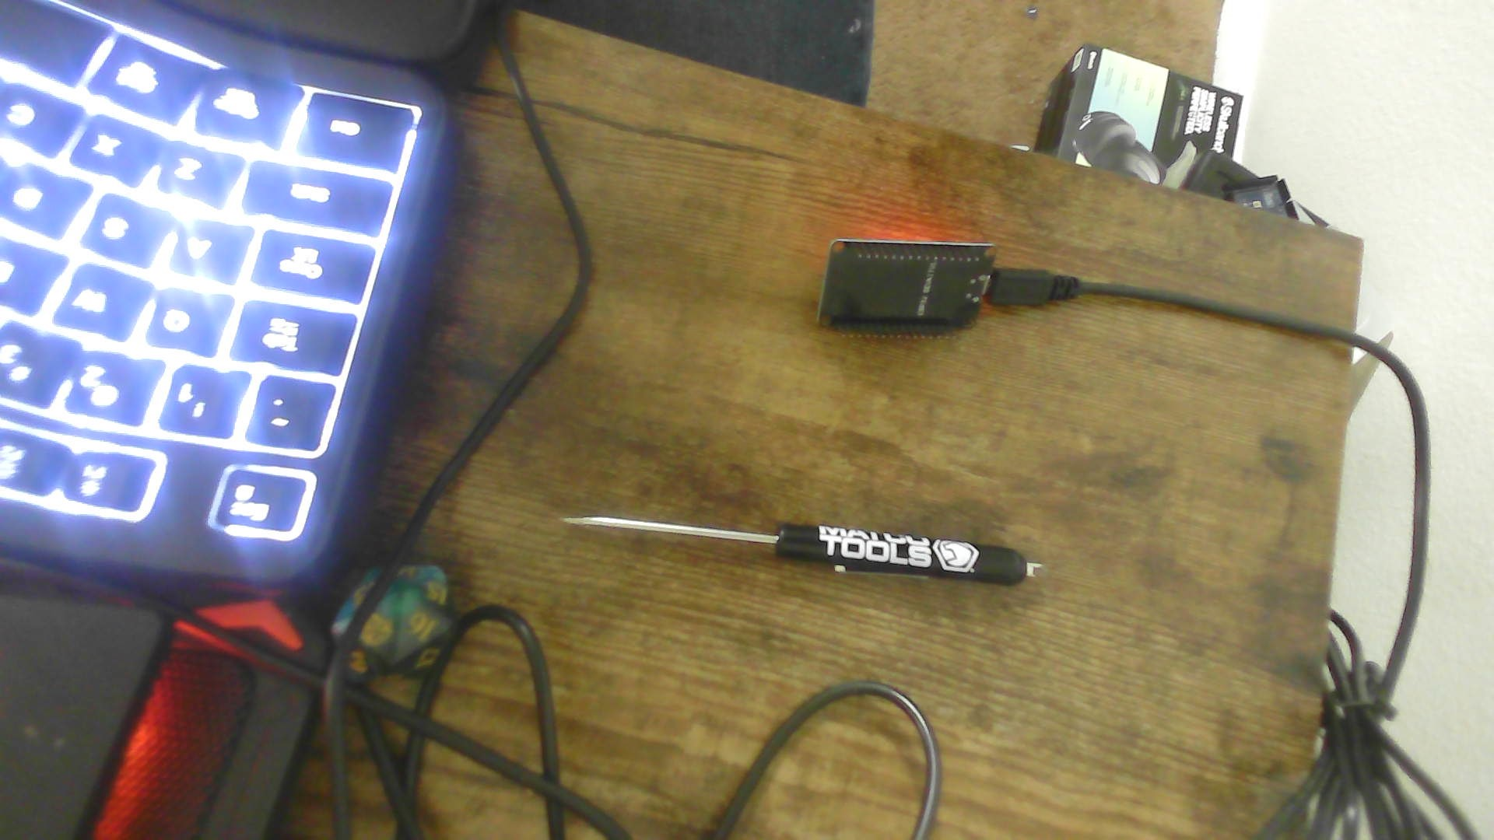
Experimental Set-up (Picture)
Materials List:
ESP32 microprocessor
Micro-USB cable
Magnet

Slide 37
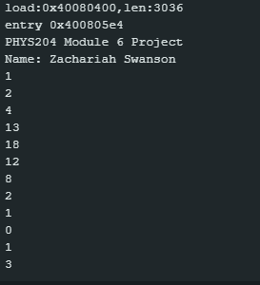
Raw Data (Screenshot)
Screenshot of Serial Monitor from Arduino IDE showing raw data.
Must include your name displayed in the Serial Monitor.
Press EN button to display name.
Unselect “Autoscroll” and scroll all the way up.

Slide 38
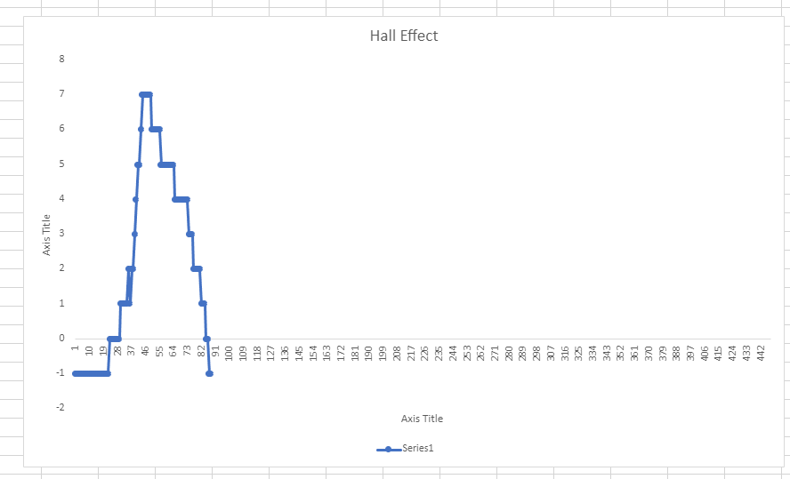
Excel Graph
(Screenshot)
Include Excel graph for a single trial of data plotted as a function of time.
Must include your name in the title of the graph.

Slide 39
Conclusions
Discuss the results and comment on the sources of error.
  Answer: Having a constant set of ones and zeros made it difficult to gather data.
Describe how the Hall sensor works. What are some applications for the Hall effect sensor?
  Answer: It measures the magnetic field in relation to the pull on the device.

Slide 40

Thank you for viewing

